Slide 1
Assessing the security of an SMM supervisor
Ilja van Sprundel
ivansprundel@ioactive.com

Slide 2
whoami
Ilja van Sprundel
Sr. Director of Operating Systems Security @IOActive
Code review
Low level security reviews
C/C++, assembly
OS
Kernel, driver
Hypervisor
Boot / UEFI / SMM
Embedded firmware stuff

Slide 3
audience?
Folks with interest in:
Embedded / firmware development
Bootloaders, BIOS, UEFI
Low level security (C/C++/rust)
Generally security / tech curious

Slide 4
Standing on the shoulders of giants
Nikolaj Schlej
Corey Kallenberg
Xeno Kovah
John Butterworth
Sam Cornwell
Joanna Rutkowska
Yuriy Bulygin
Jeremiah Cox
Alexander Matrosov
Vincent Zimmer
Oleksandr Bazhaniuk
Eugene Rodionov
Rafal Wojtczuk
John Heasman
Alexander Tereshkin
Jonathan Brossard
Mickey Shkatov
Jiewen Yao
Aditya Kapoor
Loïc Duflot
John Loucaides
Lee Fisher
Christopher Domas
Trammell Hudson
Rodrigo Branco
Jesse Michael
And more ...

Slide 5
agenda
What?
Why?
Current SMM supervisor implementations
Reviewing SMM supervisor security
Review / discuss discovered issues
Observations
Call to action
Q&A

Slide 6
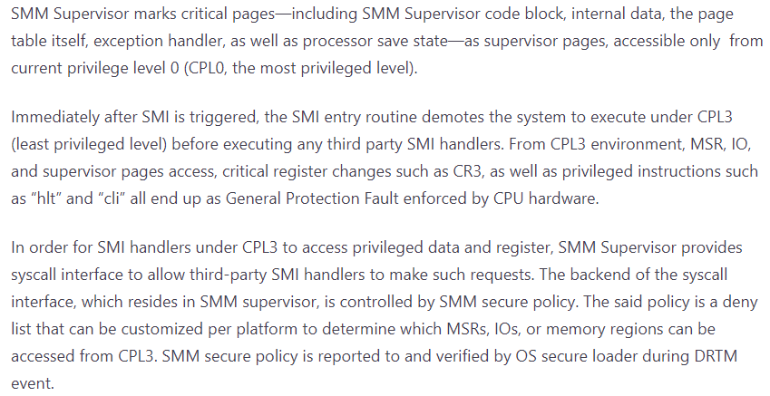
What?
SMM: System Management Mode.
What is an SMM supervisor?
A way to deprivilege and isolate SMM handlers
Notes:
https://www.microsoft.com/en-us/security/blog/2020/11/12/system-management-mode-deep-dive-how-smm-isolation-hardens-the-platform/

Slide 7
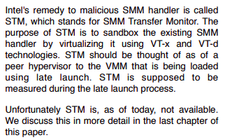
Why?
There is some history here
Goes back over a decade
TXT research by Joanna Rutkowska and Rafal Wojtczuk:
Notes:
https://invisiblethingslab.com/resources/bh09dc/Attacking%20Intel%20TXT%20-%20paper.pdf

Slide 8
Why?
There has been a lot of security research performed on SMM handlers since Joanna & Rafal’s research
And even a little bit of SMM security research before that
Near endless stream of SMM vulnerabilities in the past 5-10 years
Because:
SMM is just insanely powerful.
Called “ring -2” for a reason.
Interest in SMM compromises goes way beyond TXT concerns
E.g., some vulnerable SMM handlers have been shown to allow OS->hypervisor compromises.

Slide 9
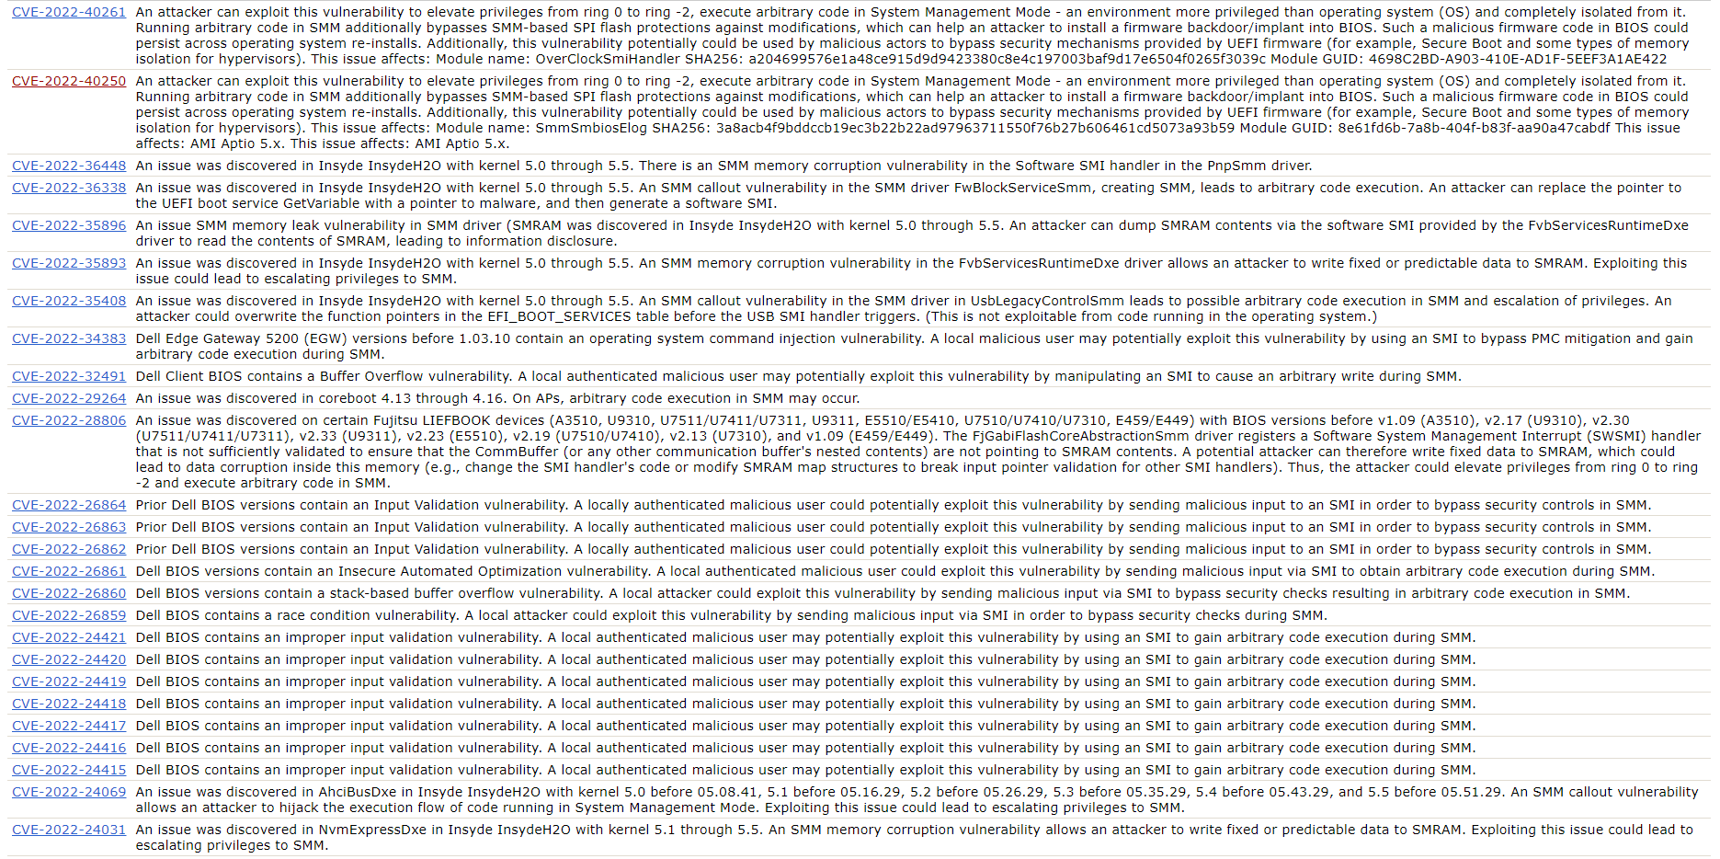
Notes:
https://cve.mitre.org/cgi-bin/cvekey.cgi?keyword=SMM

Slide 10
Why?
Steps have since been taken to add mitigations, harder SMM handlers and document what SMM handlers should and shouldn’t do.
Ultimately, they’re just so powerful
They remain very juicy targets.
Hence, the SMM supervisor
Minimize SMM TCB
Deprivilege, isolate, measure, apply policy

Slide 11
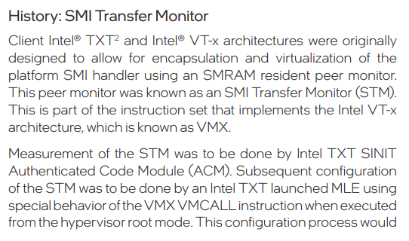
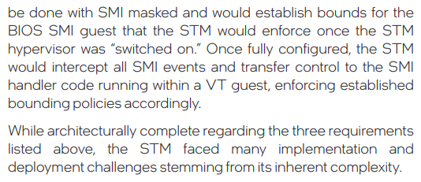
Current implementations: Intel
Intel proposed an STM
An implementation was made and open sourced [eventually]
https://github.com/jyao1/STM
Ultimately not used by Intel
Notes:
https://www.intel.com/content/dam/www/central-libraries/us/en/documents/drtm-based-computing-whitepaper.pdf

Slide 12
Current implementations: Intel
Described in "Intel® Hardware Shield: Trustworthy SMM on the Intel vPro® Platform”:
Mix of technologies. Those below have some parallels with an SMM supervisor.
Intel® Runtime BIOS Resilience
Make use of security properties memory paging provides
Makes use of intel specific hw enhancements (CR0 lock, CR3 lock, ….)
Intel® System Security Report
Facilitate attestation of SMI handlers (even if they’re compromised)
Intel® System Resources Defense
Privilege separation between SMM entry and SMM handlers
Entry runs at ring 0
Handlers run at ring 3
Notes:
https://www.intel.com/content/dam/www/central-libraries/us/en/documents/drtm-based-computing-whitepaper.pdf

Slide 13
Current implementations: AMD
AMD seems to implement a fairly tradition supervisor
Somewhat modelled after STM but using CPL3 and CPL0 split instead of virtualization
Run SMM handlers in ring 3
Privileged code is stubbed out and invokes system calls
Small kernel running in ring 0
Enforces policy
MSR access
IO port access
Access to memory regions
Access to privileged instructions
…
Notes:
https://community.amd.com/t5/business/amd-and-microsoft-secured-core-pc/ba-p/418204
https://www.amd.com/system/files/documents/amd-security-white-paper.pdf
https://www.microsoft.com/en-us/security/blog/2020/11/12/system-management-mode-deep-dive-how-smm-isolation-hardens-the-platform/

Slide 14
Current implementations
There are various levels of documentation
However, both Intel and AMDs implementation is closed source.
Makes it hard to get a real sense of how these things work under the hood
Without performing intensive reverse engineering, runtime testing and fuzzing

Slide 15
Current implementations: mm_supv
Project Mu MM Supervisor
Part of Microsoft’s Project Mu
Modular adaptation of edk2
https://github.com/microsoft/mu_feature_mm_supv

Slide 16
SMM Supervisor overview
Some references to AMD in code and documentation
Not clear to what extend AMD code is used.
Or not used
But simply ‘inspired by’
Notes:
https://github.com/microsoft/mu_feature_mm_supv/blob/bf16bd369759a388160edd1001cb9aa683a446bf/MmSupervisorPkg/Library/SysCallLib/NeedSysCallLib.c
https://github.com/microsoft/mu_feature_mm_supv/blob/ae9845d06af54fee653e3698354ba15d918ff66b/MmSupervisorPkg/Docs/MmSupervisorDesign/mm_supervisor_design.md

Slide 17
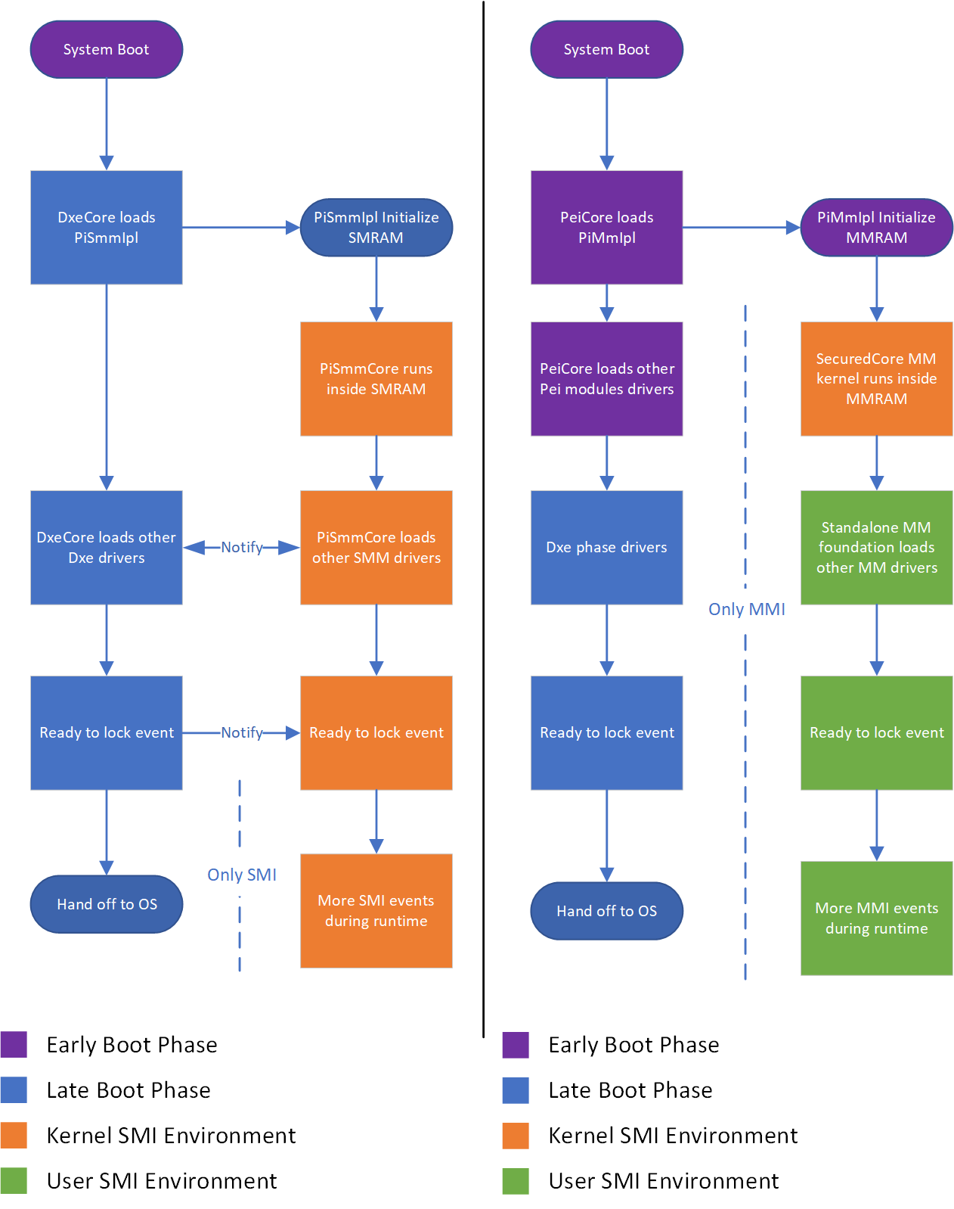
Notes:
https://github.com/microsoft/mu_feature_mm_supv/blob/ae9845d06af54fee653e3698354ba15d918ff66b/MmSupervisorPkg/Docs/MmSupervisorDesign/mm_supervisor_design.md

Slide 18
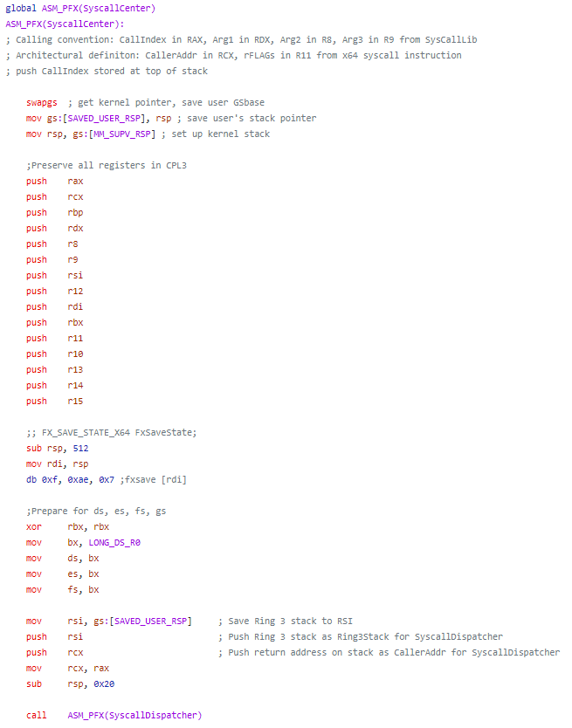
SMM Supervisor overview
Assume
Compromised SMM handler
Try to break supervisor
Some entrypoints
SysCallEntry.nasm
SyscallDispatcher.c

Slide 19
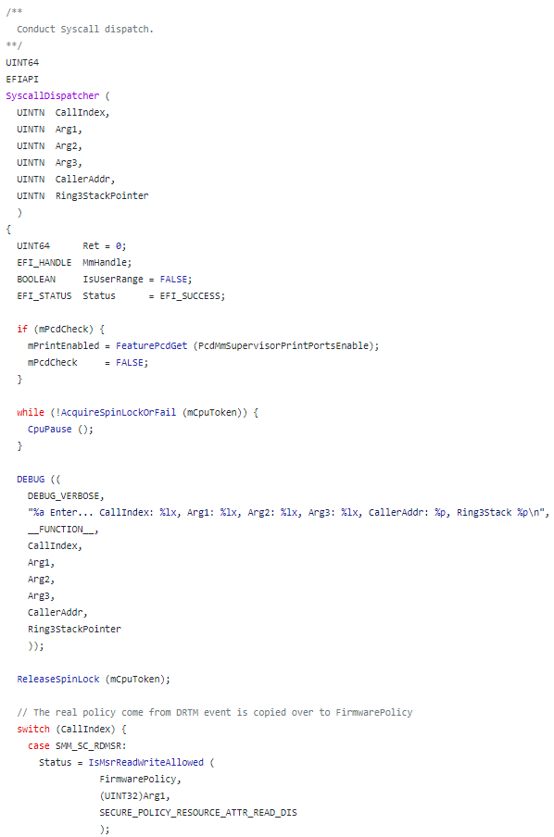

Slide 20
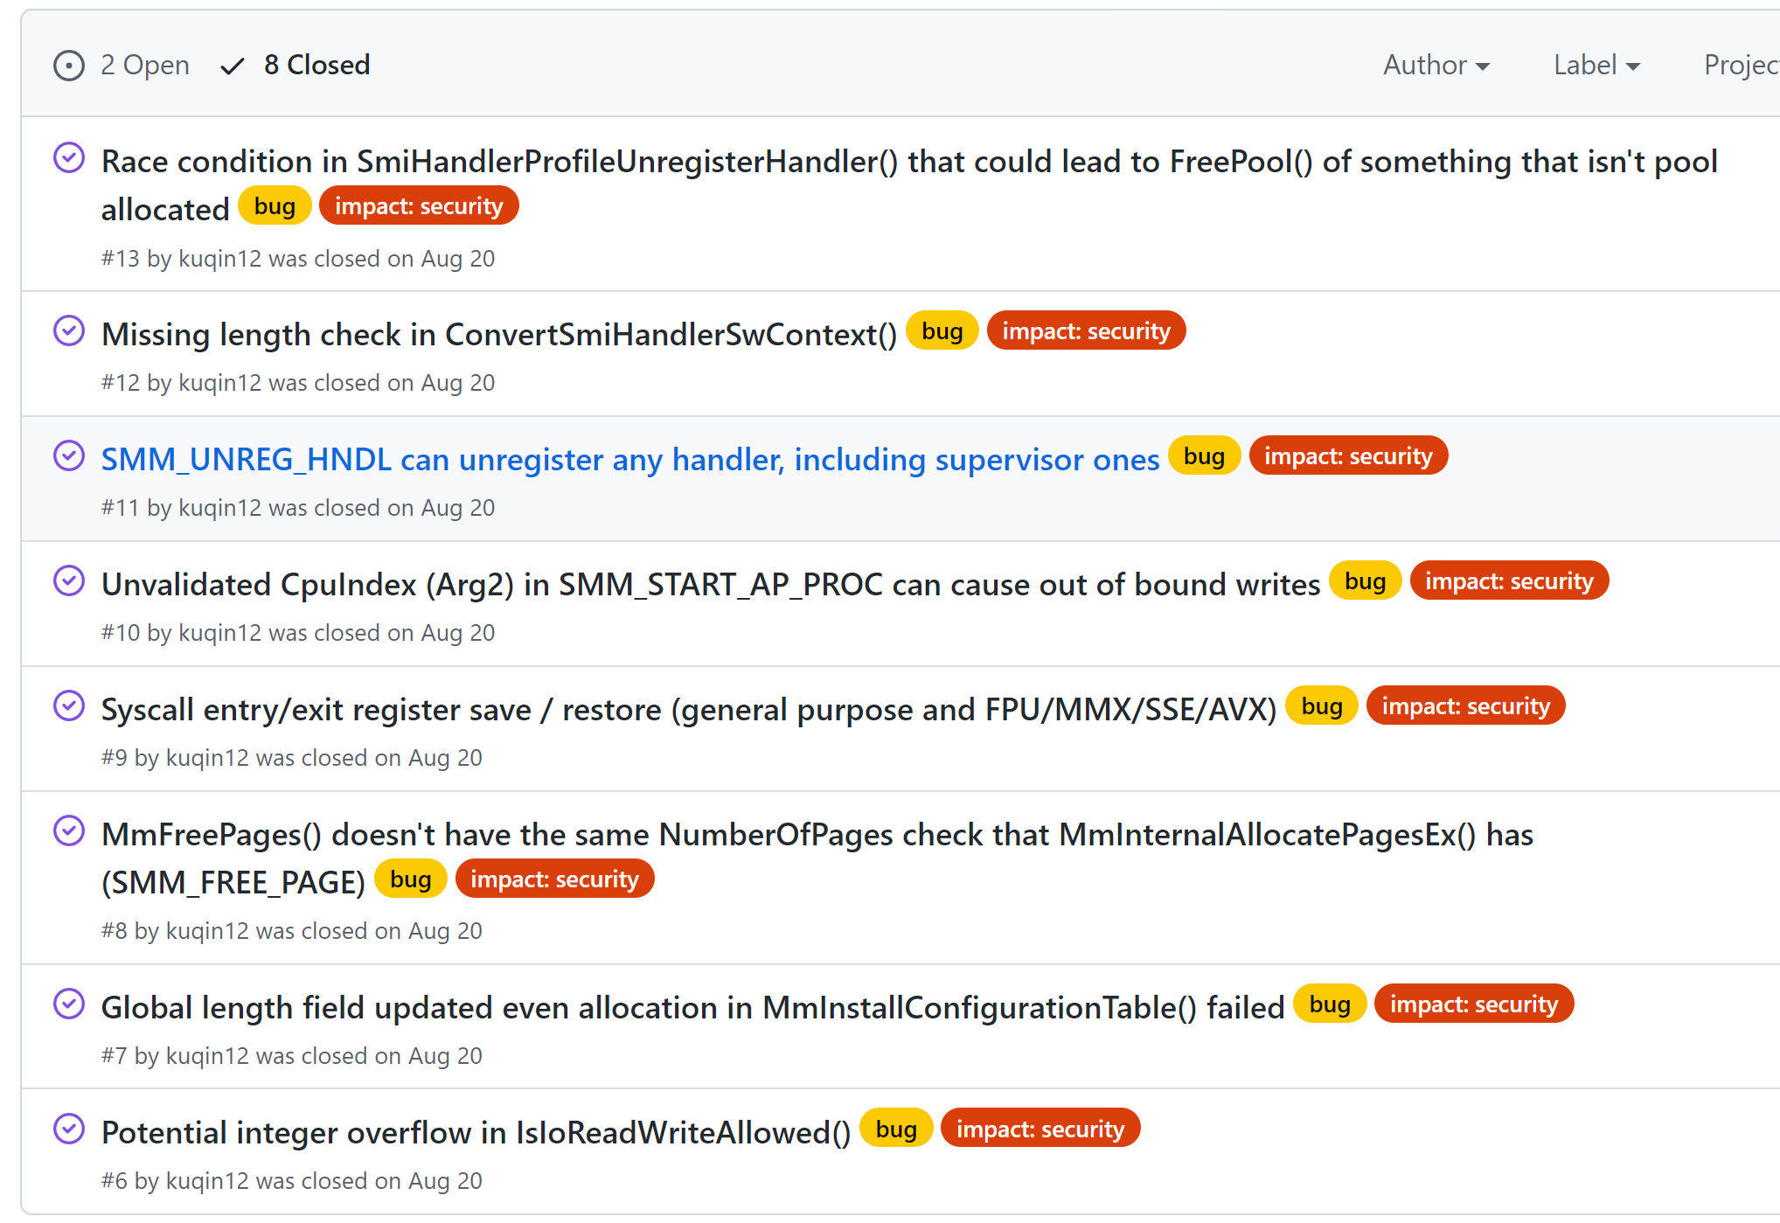
Reviewing security
Spend roughly 1-2 weeks reading code
Found 9 issues
Integer overflow (CWE-190)
Race condition (CWE-367)
Missing length validation (CWE-130)
Missing index validation (CWE-129)
Missing device validation (CWE-20)
Missing handler unregistry check (CWE-284)
Syscall entry/exit missing save/restore (CWE-665)
Inconsistent length checks (CWE-130)
Improper cleanup on OOM error (CWE-459)
All but 1 are fixed.
Unfixed bug is in profile code only used for debugging.

Slide 21
Reviewing security
Timeline
Initial report – June 3rd 2022
MS acknowledges report. Lays out next steps – June 3rd 2022
MS provides update – June 10th 2022
Actively reviewing report
Credit?
CVE?
I respond on same day – June 10th 2022
I ask for an update – July 19th 2022
MS gives update – July 29th 2022
Reason for delay: vacation and covid
Issues are fixed internally!
How do we publish and document this? Suggests some options
I respond on same day “all suggestions work for me” – July 29th 2022
MS pushes all fixes to github – August 20th 2022

Slide 22
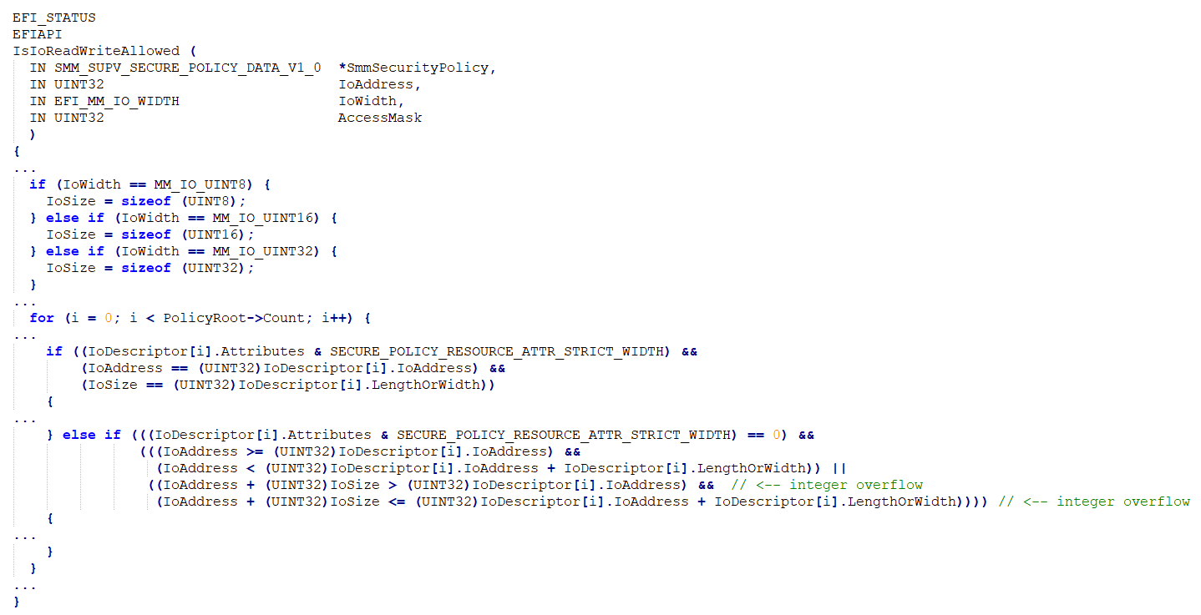
Integer overflow

Slide 23
Integer overflow
IsIoReadWriteAllowed() is called to validate ioport read and writes
Validation logic contains integer overflow
If port is really big the addition of the size could overflow
If there’s policy to write to low ports
You can write to a really high port
Very narrow set of circumstances
Exploitability depends on specific policies

Slide 24
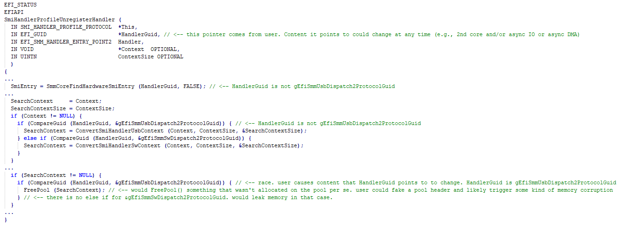
Race condition

Slide 25
Race condition
TOCTOU race condition
HandlerGuid pointer to user memory
Time Of Check
HandlerGuid is not gEfiSmmUsbDispatch2ProtocolGuid
Time Of Use
HandlerGuid is gEfiSmmUsbDispatch2ProtocolGuid
Result
Free’s a resource that is only there when the check for HandlerGuid == gEfiSmmUsbDispatch2ProtocolGuid (during Time of Check)

Slide 26
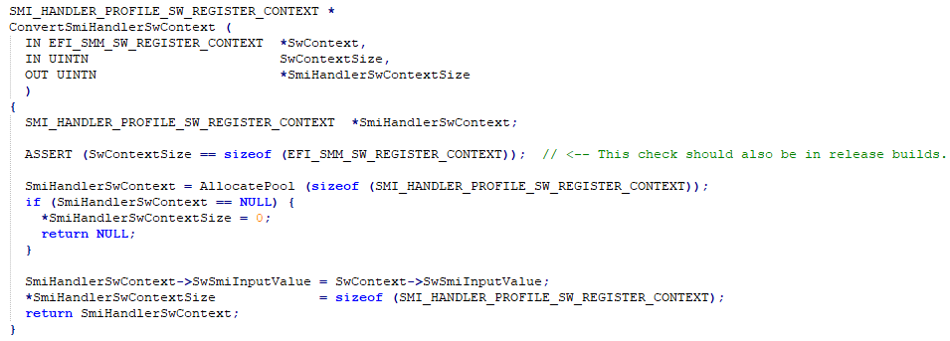
Missing length validation

Slide 27
Missing length validation
ConvertSmiHandlerSwContext() is handed a context/size provided by userland
Can be variable length
There is an ASSERT() for this
But that goes away in release builds
Thus, no real length check
Could access data beyond user
Might touch kernel memory
Might give away something about this kernel memory
Could info leak

Slide 28
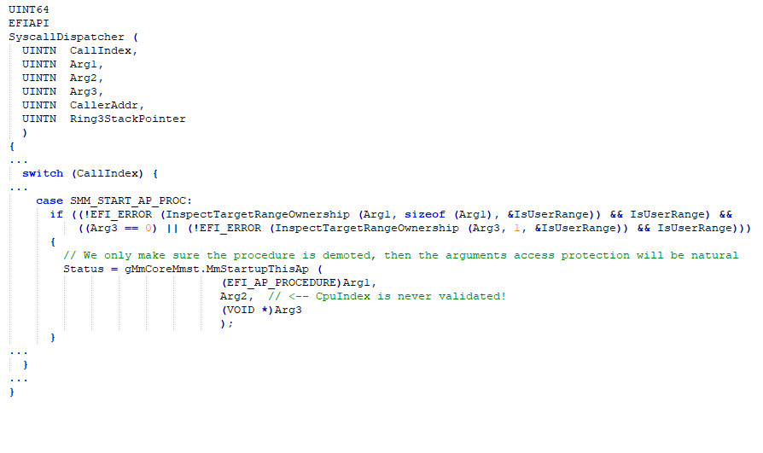
Missing index validation

Slide 29
Missing index validation
Syscall to start application processor
Takes CPU index as argument
Is never validated
Used as index in array.
Writes to array
Result
Memory corruption

Slide 30
Missing device validation

Slide 31
Missing device validation
UsbContext->Device points to userland
Complicated structure that gets parsed
Contains forward references
Not captured. Content not validated
Result
Info leak. Crash. Maybe memory corruption
This is in profile code and isn’t (or shouldn’t be) part of release
Is currently unfixed
Has wontfix label
Open issue in github

Slide 32
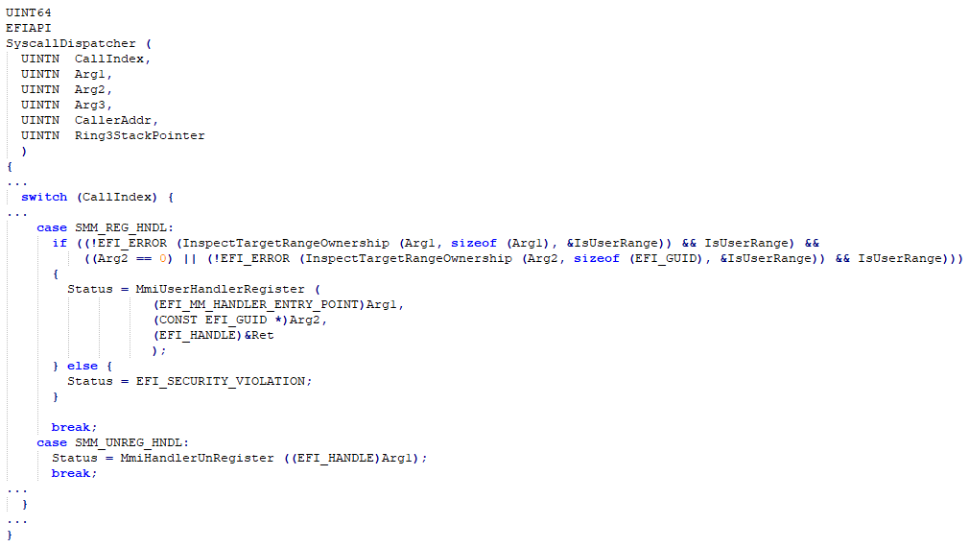
Missing handler unregistry check
Syscall dispatch has a syscall to register and unregister a handler

Slide 33
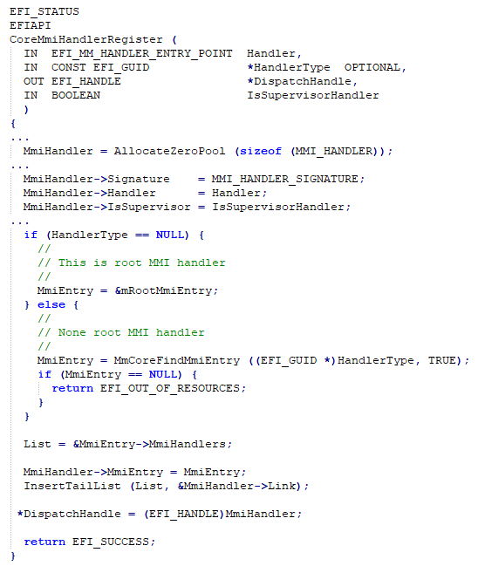
Missing handler unregistry check
Handler registration

Slide 34
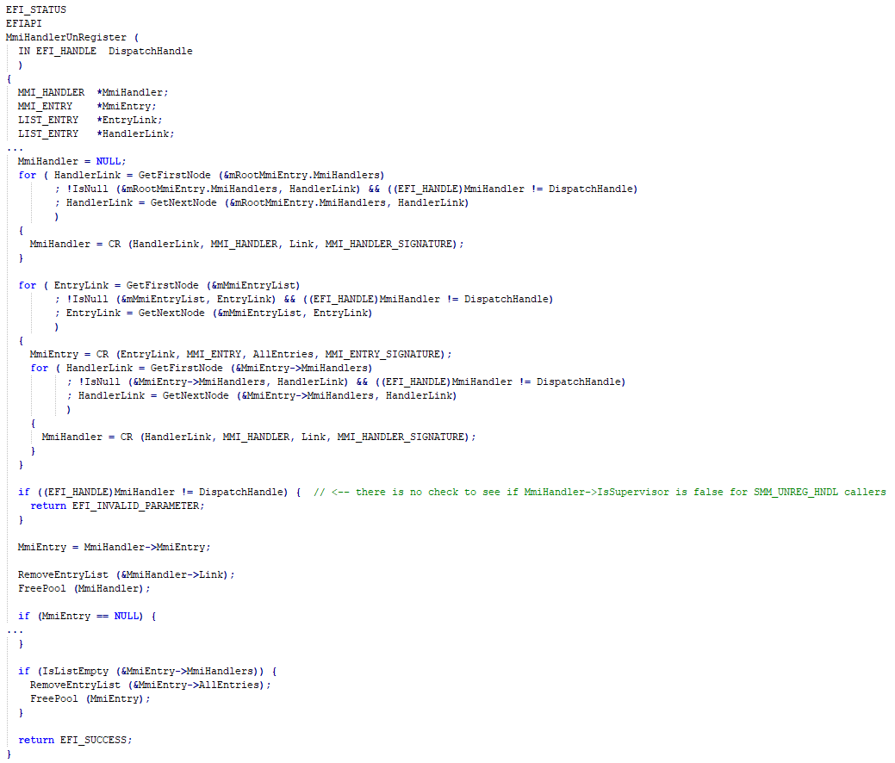
Missing handler unregistry check
No check for
IsSupervisorHandler

Slide 35
Missing handler unregistry check
SMM_REG_HNDL
Allows user to register user handlers
SMM_UNREG_HNDL
Allows user to unregister any handler
Including supervisor handlers

Slide 36
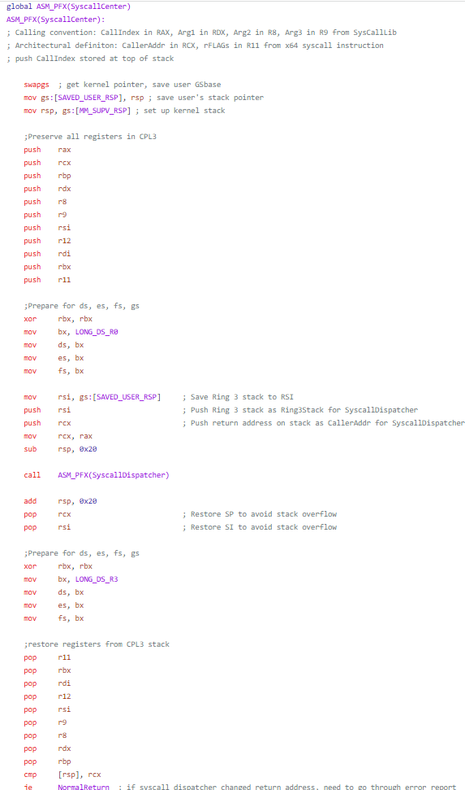
Syscall entry/exit missing save/restore

Slide 37
Syscall entry/exit missing save/restore
Raw syscall handler
Assembly calls into C code
Saves user registers
Calls C function
Restores user registers
Not all registers are saved/restored
MMX/SSE/FPU
Optimizing compilers tend to use the SIMD registers and instructions for things like memcpy()
Result
Possible information leak

Slide 38
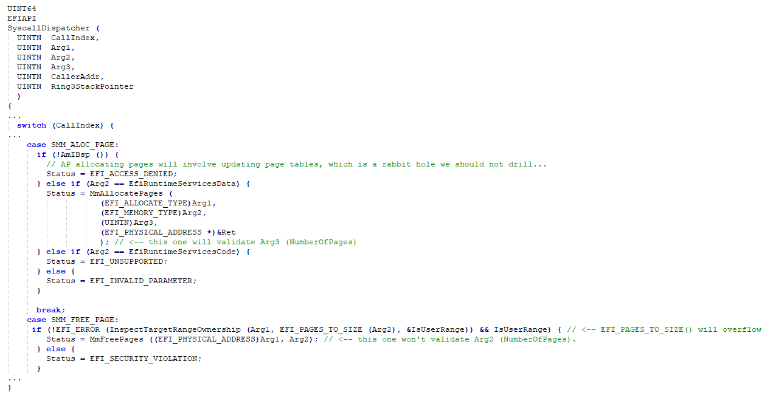
Inconsistent length checks
Syscall dispatch has a syscall to allocate pages and free pages.

Slide 39
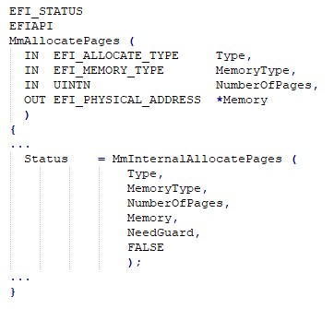
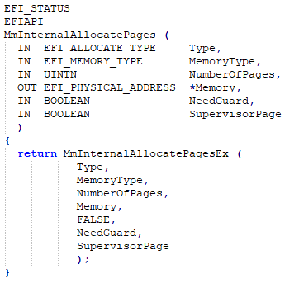
Inconsistent length checks

Slide 40
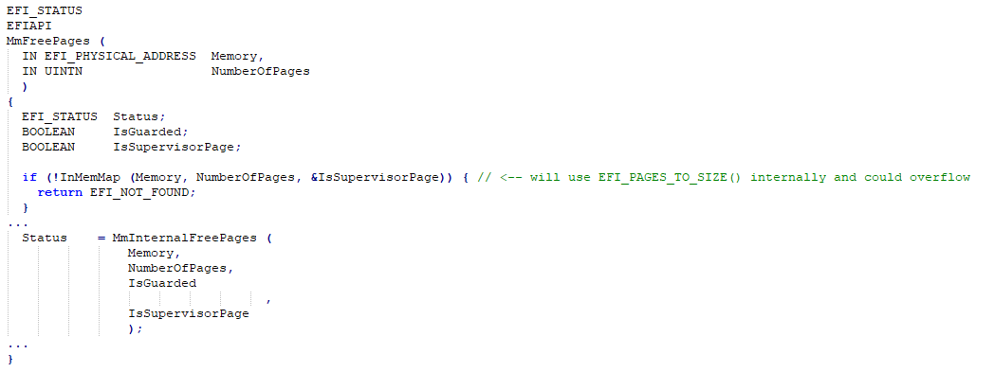
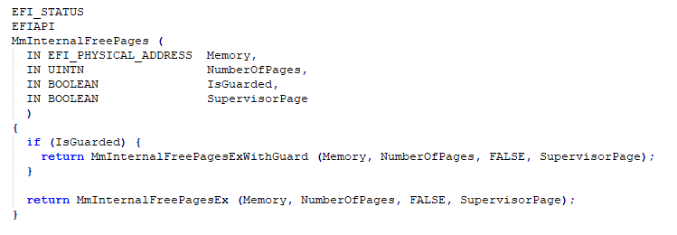
Inconsistent length checks

Slide 41
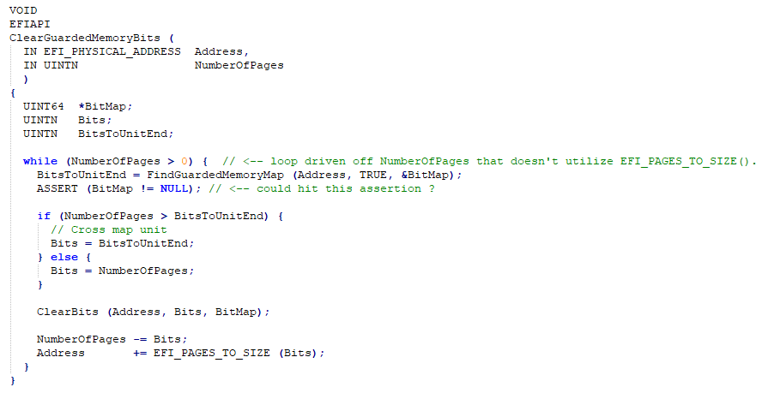
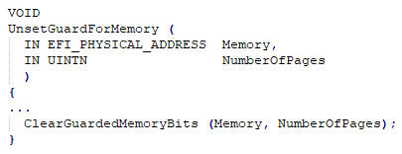
Inconsistent length checks

Slide 42
Inconsistent length checks
User can call SMM_ALOC_PAGE syscall to allocate pages.
Calls MmAllocatePages() and friends to do the work
Has upperbounds check of size value
has some page calculation overflows, but they are consistent throughout
User can call SMM_FREE_PAGE syscall to free pages
Calls MmFreePages() and friends to do the work
No upper bounds check
No consistent page calculation overflow
Drives a loop based on NumberOfPages
Will iterate a lot more than the page calculation overflow
Might hit assert
Might read out of bound, might possibly write out of bounds

Slide 43
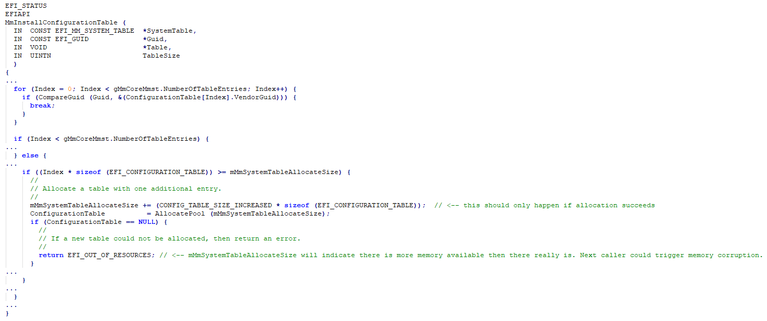
Improper cleanup on OOM error

Slide 44
Improper cleanup on OOM error
SMM_INST_CONF_T syscall will call into MmInstallConfigurationTable
MmInstallConfigurationTable will add an entry to the configuration table.
If table is too small, reallocate
mMmSystemTableAllocateSize (global variable) is updated with new size
If allocation fails (e.g., out of memory) mMmSystemTableAllocateSize isn’t restored to the previous value
Next caller will then cause memory corruption

Slide 45
Observation(s)
code written by experienced senior developers
very aware of the attack surface and the risks.
Know what they’re doing
All previously mentioned issues are one-off’s
They were not systemic
And yet, they happened…
Why?
code written in C

Slide 46
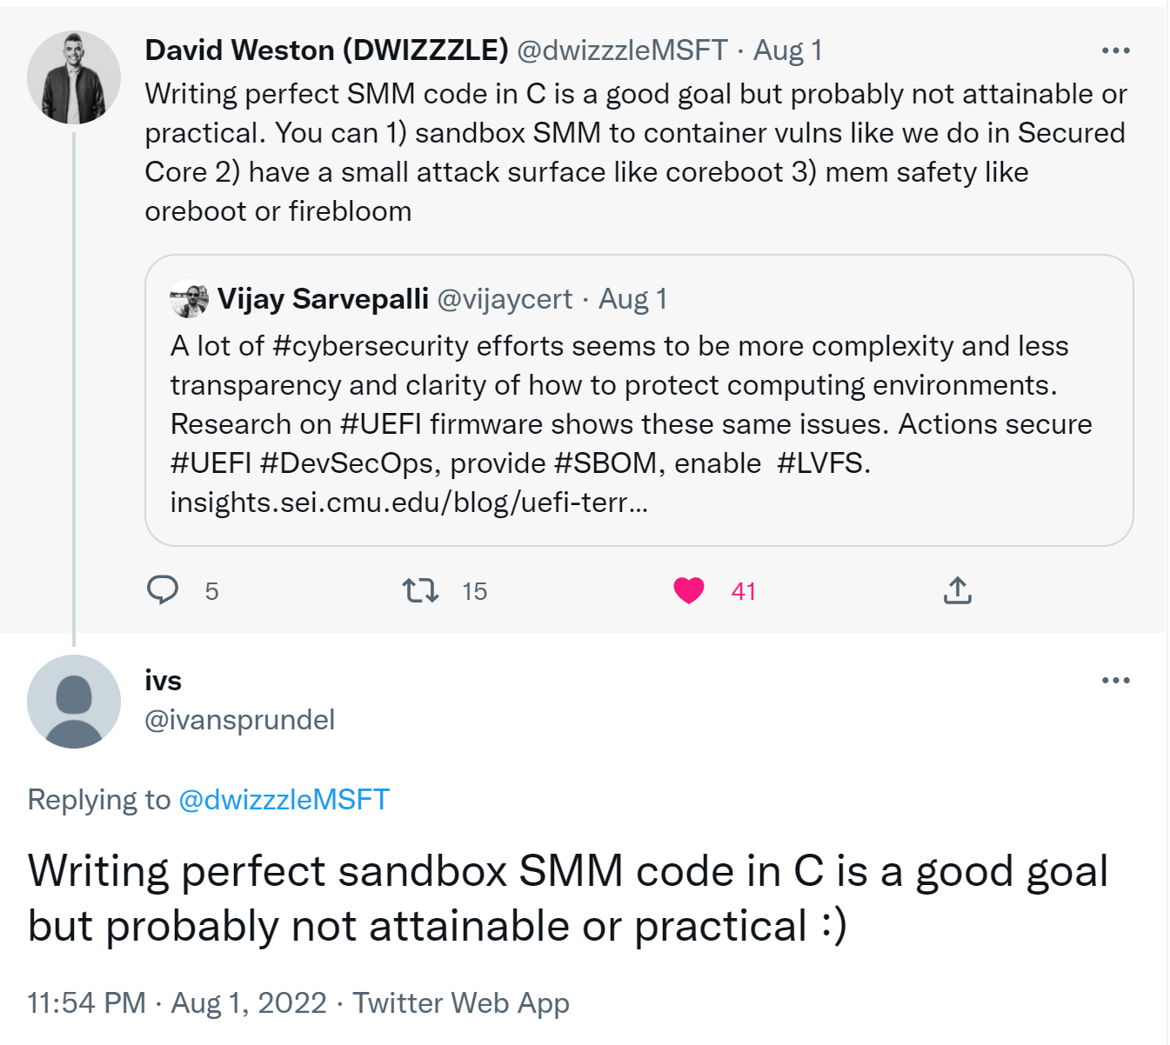

Slide 47
Call to action: unsafe languages
C/C++ code should become legacy
Should consider writing new code of this kind in a more modern language. e.g., rust
There is some supporting code to enable writing UEFI code in rust
https://github.com/rust-osdev/uefi-rs
https://github.com/r-efi/r-efi
https://github.com/jyao1/edk2/tree/edkii-rust/RustPkg
EDKII should strongly consider integrating rust support
Chances are there will be more security bugs that directly correlate to an unsafe language (e.g., C/C++) in SMM supervisors
Rust (and others) are not a silver bullet either
Will drastically reduce the number of security issues of this kind

Slide 48
Call to action: policy
Policy
policies created by IBVs
over privileged policies?
Allow list vs deny list
Long allow lists
policy audits

Slide 49
Questions?

Slide 50
references
https://invisiblethingslab.com/resources/bh09dc/Attacking%20Intel%20TXT%20-%20paper.pdf
https://www.intel.com/content/dam/www/central-libraries/us/en/documents/drtm-based-computing-whitepaper.pdf
https://community.amd.com/t5/business/amd-and-microsoft-secured-core-pc/ba-p/418204
https://www.amd.com/system/files/documents/amd-security-white-paper.pdf
https://www.microsoft.com/en-us/security/blog/2020/11/12/system-management-mode-deep-dive-how-smm-isolation-hardens-the-platform/
https://github.com/microsoft/mu_feature_mm_supv

