Slide 1
Starbleed
A Full Break of the Bitstream Encryption of Xilinx 7-Series FPGAs
Maik Ender, Amir Moradi, Christof Paar
Hardwear.io

Slide 2

https://www.reddit.com/r/ElectricalEngineering/comments/g6vaey/
u/iguetesilva

Slide 3
Starbleed
A Full Break of the Bitstream Encryption of Xilinx 7-Series FPGAs
Maik Ender, Amir Moradi, Christof Paar
Hardwear.io

Slide 4

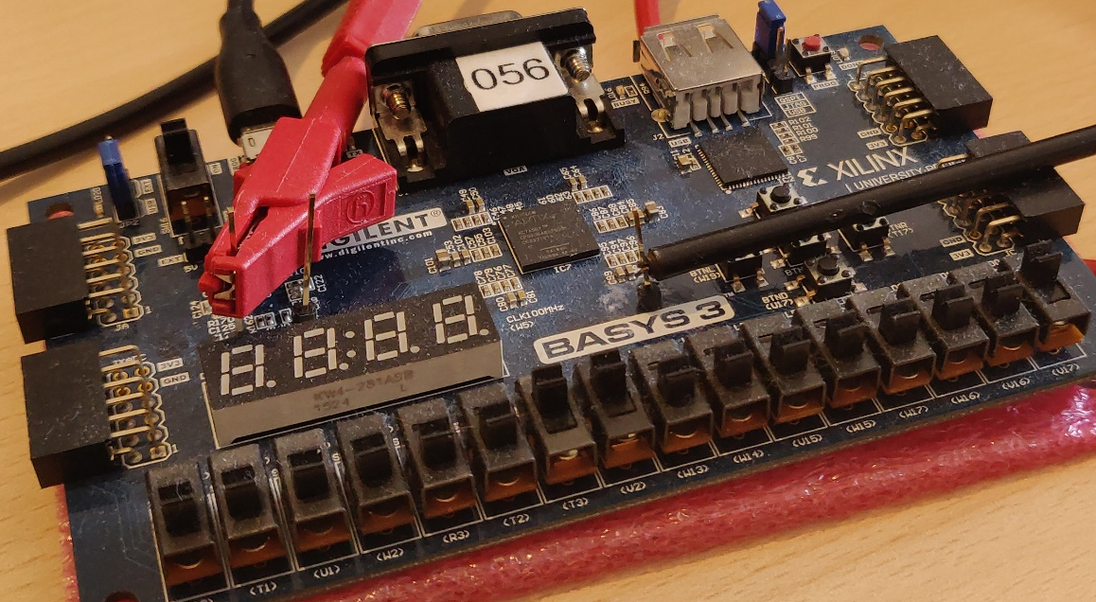
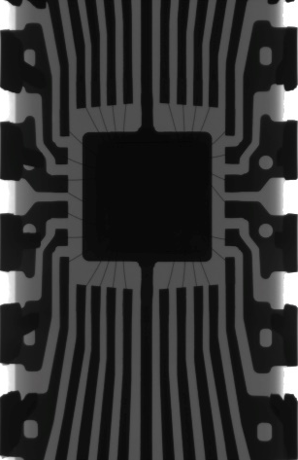



Field Programmable Gate Arrays
program
Bitstream
Photo by Mario Caruso on Unsplash
FFFFFFFF
AA995566
"StartDec"
"WrCntr0"
02003FE5
Photo by American Public Power Association on Unsplash
Bitstream contains FPGA‘s design
Stored on external memory
Field Programmable Gate Array (FPGA)
Special IC
Reprogrammable logic
Photo by Patrick Tomasso on Unsplash
Photo by Chuanchai Pundej on Unsplash
Notes:
Determine their functionality after manufacturing
Telecommunications
Industrial control systems
Aerospace
Military
Artificial Intelligence
Datacenters
Bitstream = firmware (simplification)

Slide 5


Bitstream Security
program
Bitstream
Photo by Mario Caruso on Unsplash
FFFFFFFF
AA995566
"StartDec"
"WrCntr0"
02003FE5
Photo by American Public Power Association on Unsplash
Bitstream security is vital
  Design cloning
  Reverse engineering
  Design manipulation
  Hardware Trojans
Photo by Patrick Tomasso on Unsplash
Photo by Chuanchai Pundej on Unsplash
Notes:
Assured
interdict
Algorithms
Intellectual property
implant

Slide 6


Bitstream Encryption
encrypted program
Bitstream
FPGA
FFFFFFFF
AA995566
"StartEnc"
"WrCntr0"
02003FE5
CRYPTO
Key
Fuses/BBRAM
Bitstream encryption
Confidentiality: bitstream is encrypted
Authenticity: FPGA loads only designs from integrator
Integrity: Bitstream is not changed
AES-256
HMAC
Notes:
Hides the bitstream conted from the adversary

Slide 7

Attack
encrypted program
please decrypt the bitstream
okay
Bitstream
FPGA
FFFFFFFF
AA995566
"StartEnc"
"WrCntr0"
02003FE5
CRYPTO
Key
Fuses/BBRAM
Bitstream encryption
Confidentiality: bitstream is encrypted
Authenticity: FPGA loads only designs from integrator
Integrity: Bitstream is not changed
Starbleed Attack I:
Break Confidentiality
Manipulate the encrypted bitstream
Starbleed Attack II:
Break Authenticity
Notes:
Hides the bitstream conted from the adversary

Slide 8
HOW TO PROGRAM AN FPGA?

Slide 9
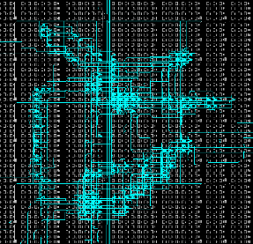
Configuration Engine
FPGA
Configuration Registers
Bitstream
"Header"
"StartDec"
HMACHead
"WrCntr0"
02003FE5
"WrFDRI"
COFFEEEE
BADB0070
FDRI
Fabric
FDRO
Dec?
Encrypted
DEC
Status
Configuration Engine
JTAG
Control 0
HMAC tag
WBSTAR
…
Notes:
Abstract model
Frame data register in
Writes to this register configure frame data at the frame address specified in the FAR register.
Frame data register out
20 documented registers

Slide 10
Bitstream Program
FPGA
Configuration Registers
Bitstream
"Header"
"StartDec"
HMACHead
"WrCntr0"
02003FE5
"WrFDRI"
COFFEEEE
BADB0070
FDRI
Fabric
FDRO
HMACHead
"StartDec"
"WrCntr0"
"Header"
"WrFDRI"
BADB0070
HMAC tag
02003FE5
COFFEE
Dec?
DEC
Status
Configuration Engine
JTAG
Control 0
HMAC tag
WBSTAR
…
Notes:
authenticity

Slide 11
Read Register
FPGA
Configuration Registers
Bitstream
FFFFFFFF
AA995566
"Rd STAT"
FDRI
Fabric
FDRO
"Rd STAT"
C00FFEE
"WrCntr0"
FFFFFFFF
AA995566
"WrFDRI"
02003FE5
COFFEE
Dec?
DEC
Status
I am fine
BADB0070
Configuration Engine
JTAG
Control 0
WBSTAR
…

Slide 12
ATTACK I
BREAKING CONFIDENTIALITY

Slide 13
Attack
The FPGA notices the manipulation (HMAC invalid) and resets
FPGA
Configuration Registers
Bitstream
"Header"
"StartEnc"
HMACHead
"WrCntr0"
02003FE5
"WrFDRI"
COFFEEEE
BADB0070
"Header"
"StartDec"
HMACHead
"WrCntr0"
02003FE5
"WrWBSTAR"
COFFEEEE
BADB0070
FDRI
Fabric
FDRO
HMACHead
COFFEEEE
"StartDec"
"WrCntr0"
"Header"
WrWBSTAR
HMAC tag
BADB0070
02003FE5
COFFEEEE
Dec?
DEC
Status
divert
Configuration Engine
JTAG
Control 0
HMAC tag
WBSTAR
Exploit CBC malleability
…
Cut bitstream

Slide 14
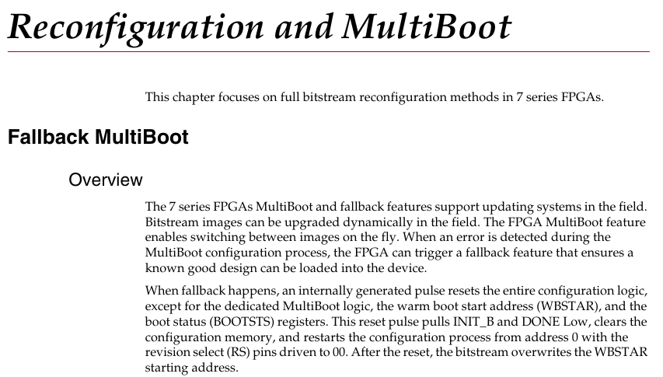
MultiBoot – Documentation
Notes:
Readout
The FPGA MuliBoot feature enables switching between images on the fly
Warm boot start address (WBSTAR) register

Slide 15
Attack – Readout
The FPGA notices the manipulation (HMAC invalid) and resets
FPGA
Configuration Registers
Bitstream
"Header"
RdWBSTAR
FDRI
Fabric
FDRO
RdWBSTAR
COFFEEEE
"Header"
Dec?
HMAC tag
DEC
Status
divert
Configuration Engine
JTAG
Control 0
02003FE5
WBSTAR
COFFEEEE
…

Slide 16
Attack – Overview
The FPGA notices the manipulation (HMAC invalid) and resets
1) Manipulated
Bitstream
FPGA
1) Manipulate the bitstream
Configuration Registers
"Header"
"StartDec"
HMACHead
"WrCntr0"
02003FE5
"WrWBSTAR"
COFFEEEE
BADB0070
FDRI
Fabric
2) Configure the FPGA with the malicious bitstream
FDRO
Dec?
WrWBSTAR
DEC
Status
3) Resets the FPGA (automatically)
HMAC tag
Configuration Engine
JTAG
Control 0
2) Readout
Bitstream
4) Read out the WBSTAR register
WBSTAR
COFFEEEE
"Header"
RdWBSTAR
…
5) Reset the FPGA (manually)
→Leak one bitstream word (32 bits)
Notes:
7.9 miliseconds
7K160T -> 3:42
7VX1140T -> roughly a day

Slide 17
Bitstream Security
Attack I:
Break Confidentiality
Photo by Mario Caruso on Unsplash
= Attacker can decrypt bitstream
?
Bitstream security is vital
Design cloning
Reverse engineering
Design manipulation
Hardware Trojans
Photo by American Public Power Association on Unsplash
Photo by Patrick Tomasso on Unsplash
?
Photo by Chuanchai Pundej on Unsplash
?
Notes:
Assured
interdict

Slide 18
ATTACK II
BREAKING AUTHENTICITY

Slide 19
Attack II: Breaking Authenticity
Attack I: Decrypt the bitstream
HMAC (still) assures authenticity
→Any manipulation is detected
HMAC key can be decrypted by attack I
→Forge new valid HMAC tags
Encrypt new/manipulated bitstreams:
  Decryption oracle + CBC malleability
  = encryption oracle
  Know attack: ‘‘Practical padding oracle
  attacks‘‘ Rizzo et al. WOOT 2010
Bitstream
"Header"
"StartEnc"
HMACHead
"WrCntr0"
02003FE5
"WrFDRI"
COFFEEEE
BADB0070
HMAC key
Attacker can forge valid HMAC tags
HMAC tag
please decrypt the bitstream
okay
FPGA
CRYPTO
Notes:
Juliano Rizzo and Thai Duong. Practical padding oracle attacks. 4th USENIX Workshop WOOT 2010.

Slide 20
Bitstream Security
Attack I:
Break Confidentiality
FULL BREAK
OF THE
BITSTREAM ENCRYPTIO
Photo by Mario Caruso on Unsplash
Attack II:
Break Authenticity
?
Bitstream security is vital
Design cloning
Reverse engineering
Design manipulation
Hardware Trojans
Photo by American Public Power Association on Unsplash
Photo by Patrick Tomasso on Unsplash
?
Photo by Chuanchai Pundej on Unsplash
?
Notes:
Assured
interdict

Slide 21
WHAT WENT WRONG?

Slide 22
What Went Wrong?
‘‘Use before validate‘‘ (Attack I)
HMAC key stored inside the encrypted bitstream (Attack II)
Commands interpreted before HMAC validation
Bitstream
"Header"
"StartDec"
HMACHead
"WrCntr0"
02003FE5
"WrFDRI"
COFFEEEE
BADB0070
HMAC key
Attacker can forge valid HMAC tags
HMAC tag
Notes:
As far as we break the confidentiality we break the authenticity

Slide 23
COUNTERMEASURES
&
DEFENSE TECHNIQUES

Slide 24
Countermeasures & Defense Techniques
 | New Devices | New Series | Current 7-Series
Validate before use | • | •
Patchable Encryption | • | •
IFA, Model Checker | •
OpenSource Hardware | •
Obfuscation
Revision Select PIN

Slide 25

Countermeasures & Defense Techniques
 | New Devices | New Series | Current 7-Series
Validate before use | • | •
Patchable Encryption | • | •
IFA, Model Checker | •
OpenSource Hardware | •
Obfuscation
Revision Select PIN
Countermeasures
  Validate the bitstream before interprete by the configuration engine

Slide 26
Countermeasures & Defense Techniques
 | New Devices | New Series | Current 7-Series
Validate before use | • | •
Patchable Encryption | • | •
IFA, Model Checker | •
OpenSource Hardware | •
Obfuscation
Revision Select PIN
Countermeasures
  Validate the bitstream before interprete by the configuration engine
  Patchable bitstream encryption in the reconfigurable fabric
Notes:
It is a bit ironic that the bitstream encryption is not reprogrammable in a reprogrammable device

Slide 27
Countermeasures & Defense Techniques
 | New Devices | New Series | Current 7-Series
Validate before use | • | •
Patchable Encryption | • | •
IFA, Model Checker | •
OpenSource Hardware | •
Obfuscation
Revision Select PIN
Countermeasures
  Validate the bitstream before interprete by the configuration engine
  Patchable bitstream encryption in the reconfigurable fabric
General defense techniques
  Attack already visible in documentation
  → specification is flawed
Notes:
Not fomaly verify the HDL code since the specification is already flawed
Does not leak any confidential data

Slide 28
Countermeasures & Defense Techniques
 | New Devices | New Series | Current 7-Series
Validate before use | • | •
Patchable Encryption | • | •
IFA, Model Checker | •
OpenSource Hardware | •
Obfuscation
Revision Select PIN
Countermeasures
  Validate the bitstream before interprete by the configuration engine
  Patchable bitstream encryption in the reconfigurable fabric
General defense techniques
  Attack already visible in documentation
  → specification is flawed
  OpenSource transparency
    Follow Kerckhoffs Principle
    "Everything except the key is known"
    OpenTitan

Slide 29
Countermeasures & Defense Techniques
 | New Devices | New Series | Current 7-Series
Validate before use | • | •
Patchable Encryption | • | •
IFA, Model Checker | •
OpenSource Hardware | •
Obfuscation
Revision Select PIN
Countermeasures
  Validate the bitstream before interprete by the configuration engine
  Patchable bitstream encryption in the reconfigurable fabric
General defense techniques
  Attack already visible in documentation
  → specification is flawed
  OpenSource transparency
    Follow Kerckhoffs Principle
    "Everything except the key is known"
    OpenTitan

Slide 30

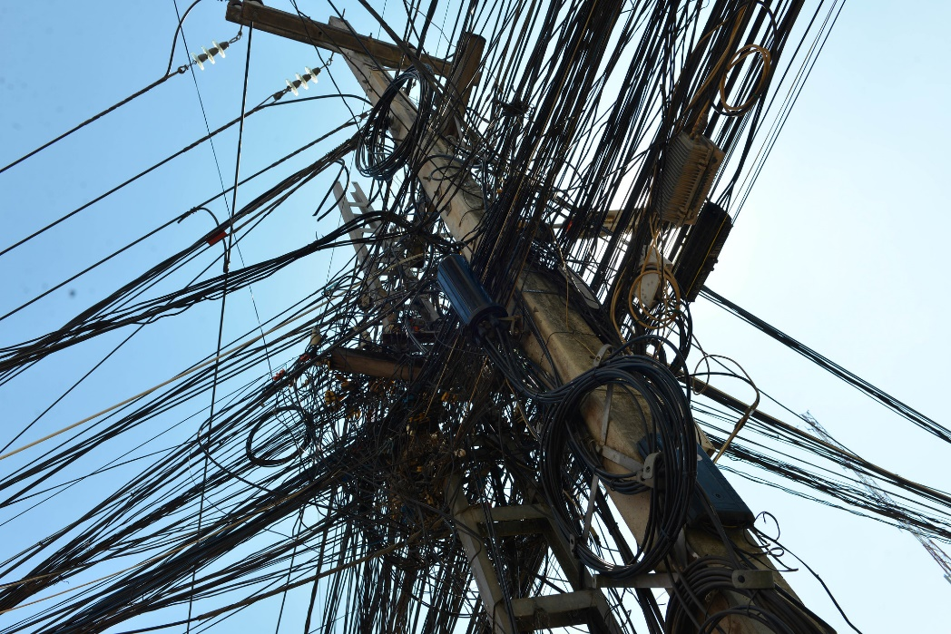
Obfuscation
Still same functionality
‘‘Harder‘‘ to reverse engineer
Raise-the-bar countermeasure only
https://www.flickr.com/photos/curious_e/
Photo by American Public Power Association on Unsplash
Notes:
The design is tangled
Expense
costs

Slide 31
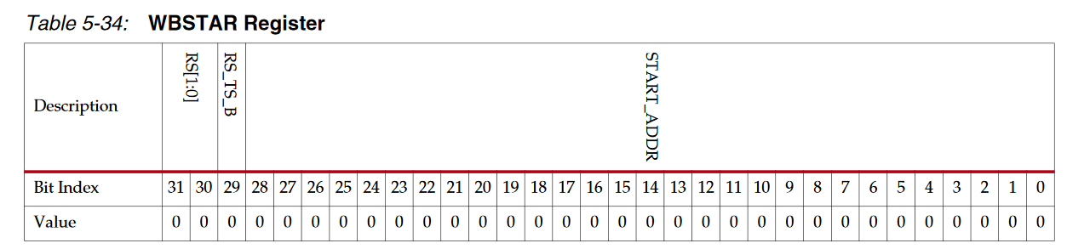

Revision Select PIN
Value default 0
During attack leaks bitstream content ≠ 0
1
1
Revision select pins
Drive output pin on next warm boot
PCB
RS Pins
Reset Logic
FPGA
Modify PCB
Wire RS pin to a reset logic
If RevisionSelect ≠ 0
  Reset FPGA
  Remove BBRAM key power to clear encryption key
Attacker can still modify the PCB
WBSTAR
Key
BBRAM
CLEAR
CRYPTO
Power (Vcc)
Vcc
Notes:
Placed on a PCB
We use this to our advantage
brick

Slide 32


Conclusion
Attack I:
Break Confidentiality
decrypting the bitstream
Attack II:
Break Authenticity
manipulating the bitstream
@MaikEnderEU
Full break of confidentiality and authenticity
Only access to configuration interface needed
Xilinx 7-Series and (partially) Virtex-6 affected
For current devices only raise-the-bar countermeasures
General defense techniques:
Verify the specification, OpenSource
https://www.usenix.org/conference/usenixsecurity20/presentation/ender
Notes:
Assured
interdict
This was how we break the bitstream encryption using the bitstream encryption
Formal verification methods

