Slide 1
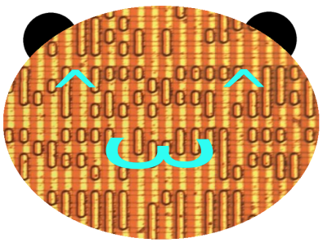
Capturing Mask ROMs
John McMaster
Hardwear.io 2020
Notes:
XXX: pokeball?

Slide 2
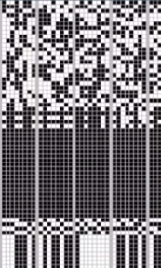
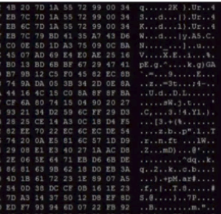
What is a mask ROM?
Hard coded bits on a chip
Used for main firmware, boot ROM, or configuration
Low cost per bit, but inflexible

Slide 3
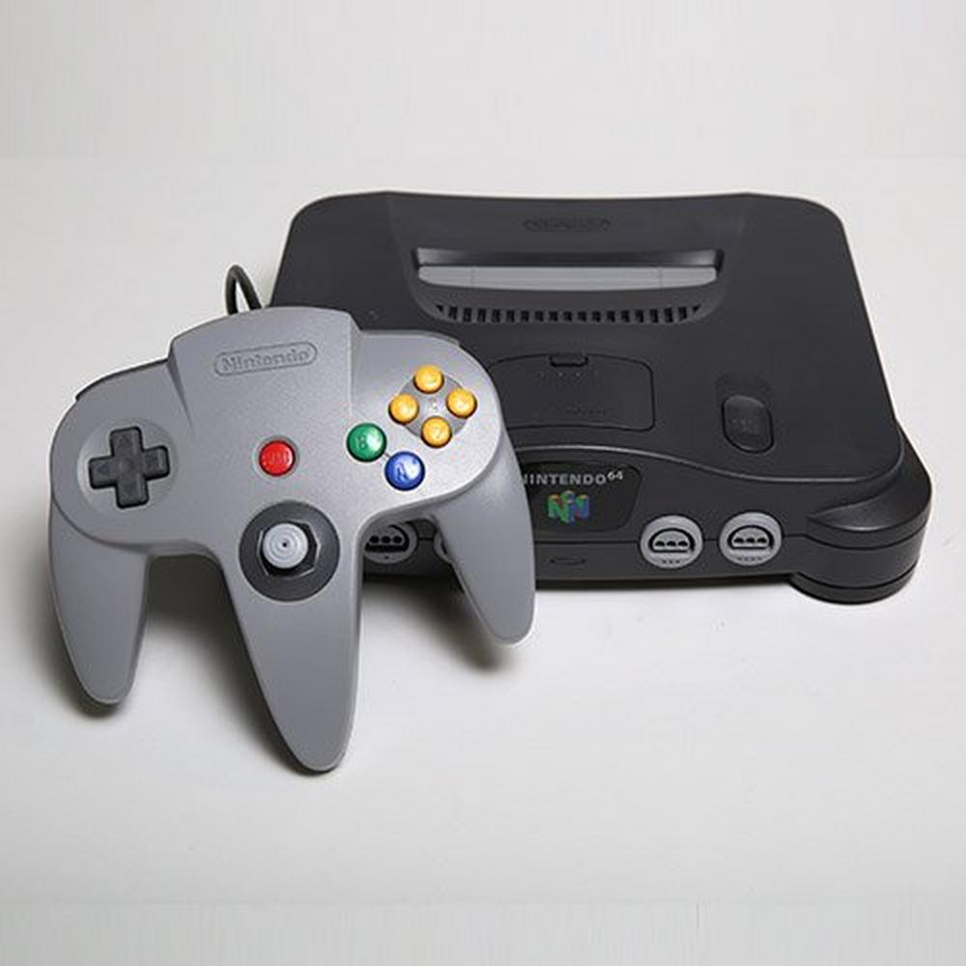
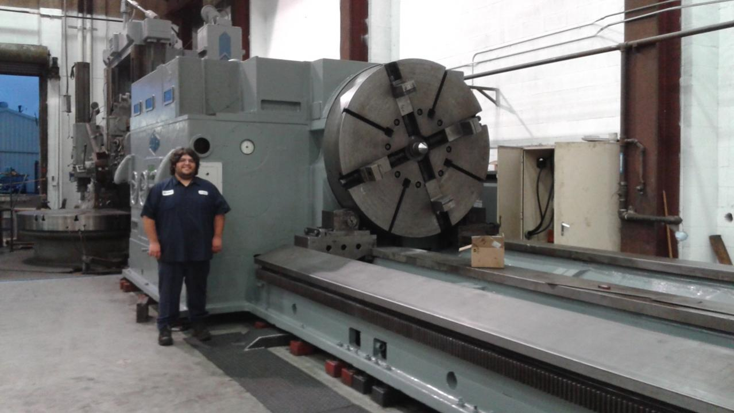
Why extract it?
Analyze boot security
Fix broken hardware
Emulate classic arcade games

Slide 4
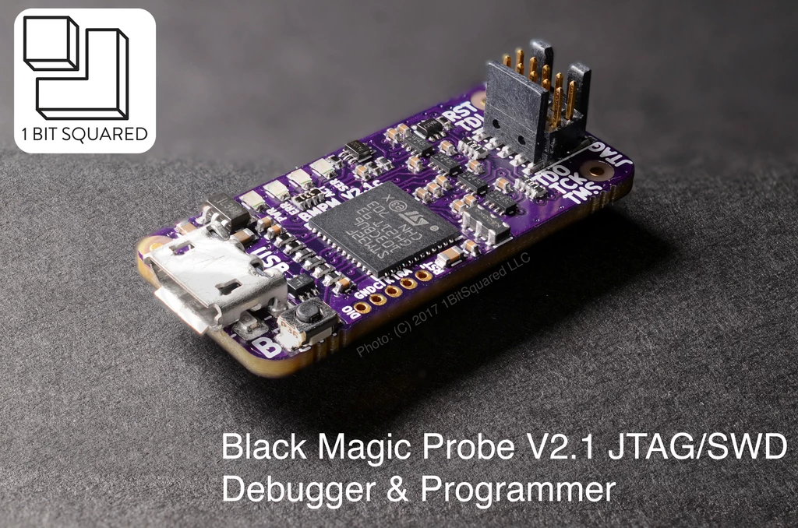
The best way is easy street
Try to use JTAG or other test interfaces to directly dump
Try getting code execution and "trojan" it
Ex: issue NMI until stack overflow into external memory
Try glitching
Ex: Sharp SM4 change instruction mid instruction phase
This talk is about when all of that failed

Slide 5
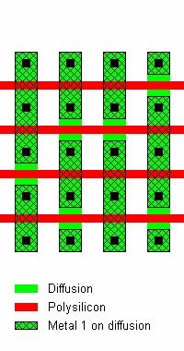
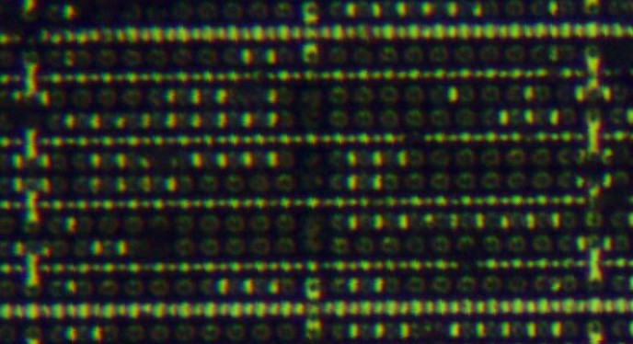
A real ROM: metal NAND ROM
Activate all red control lines except one ("NAND") to read out
Metal bypass jumpers (via contacts) may or may not be present
If jumper: 0, else 1; read out along columns
But: details don't actually matter!
Sound Blaster CT1741
nats
Sergei P. Skorobogatov

Slide 6
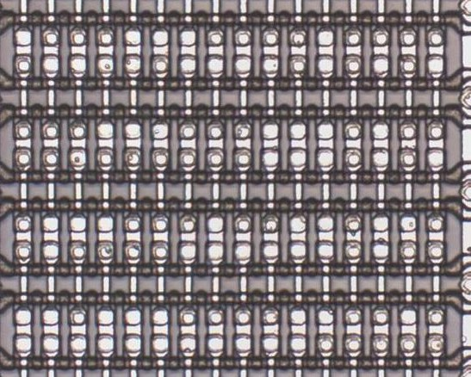
Lets get some bits!
Image entire ROM under microscope
Crossed polarization can help enhance contrast
Small: type up by hand
...but this quickly gets tiresome
Mitsubishi MSL8042 CPU
Contact NOR, brightfield
Notes:
TODO: replace ROM w/ Game Boy boot ROM

Slide 7
Microscope
Image
Image to
Bits
Bitmap to Binary
Bitmap
Profit!
rompar
.txt
zorrom
django-
monkeys
.jpg
.bin
bitract
.png
bitviewer

Slide 8
Microscope
Image
Image to
Bits
Bitmap to Binary
Bitmap
Profit!
rompar
.txt
zorrom
django-
monkeys
.jpg
.bin
bitract
.png
bitviewer

Slide 9
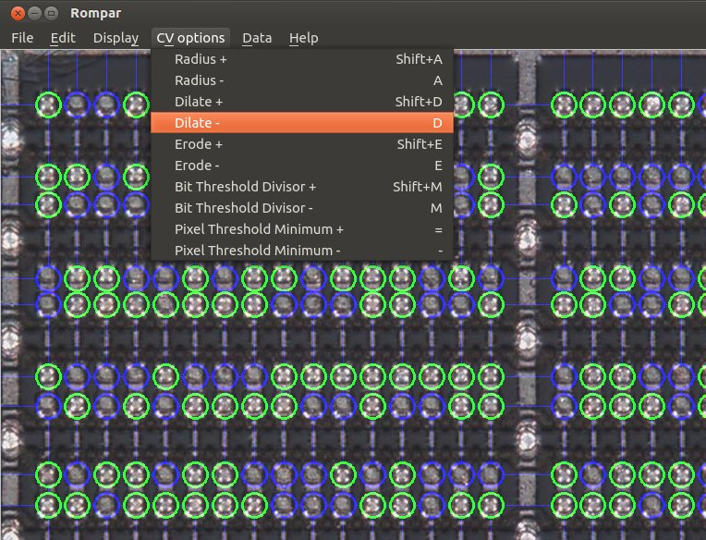
Image to bits: rompar
By Adam Laurie w/ contributions
I'm current lead / maintainer
Basic CV to classify bits + manual tweaks
Open source Python
Platforms did you ask?
https://github.com/AdamLaurie/rompar
Mitsubishi MSL8042 CPU
Contact NOR, crossed polarized

Slide 10
Rompar: Windowz support!
By popular demand, Clawgrip created a Windows installer!
Notes:
FIXME: Installer screenshot
FIXME: confirm Clawgrip wants credit

Slide 11
Advanced rompar
--txt: discard db and load new .txt
Load from another program
--dx/--dy: re-align grid
Load new image onto existing layout
--annotate: highlight bits
Quickly triage CV results
Notes:
FIXME: annotation screemshot

Slide 12
Image to bits: Bitract
By Chris Gerlinsky
Convert microscope image to bitmap
Open source C++
https://media.hardwear.io/bits-from-the-matrix-optical-rom-extraction-chris-gerlinsky/
Notes:
FIXME: screenshot

Slide 13
Bits to binary: Zorrom
Built in chip specific algorithms
Open source Python
Notes:
FIXME: screenshot

Slide 14
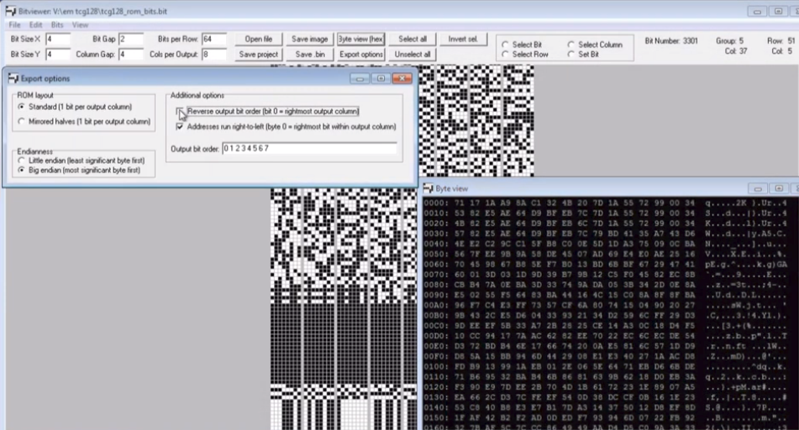
Bits to binary: Bitviewer
Built in permutation post processing
Open source C++
https://media.hardwear.io/bits-from-the-matrix-optical-rom-extraction-chris-gerlinsky/

Slide 15
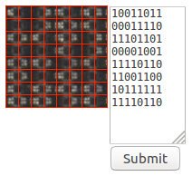
Django-monkeys
MAME crowdsourced ROM capture
Post processing combines 5 results
Flags bad/inconsistent bits for review
99.99% => 99.999% accuracy vs CV
64Kb ROMs practical
Fujitsu MB86233 DSP
Contact NAND
https://github.com/andrew-gardner/django-monkeys

Slide 16
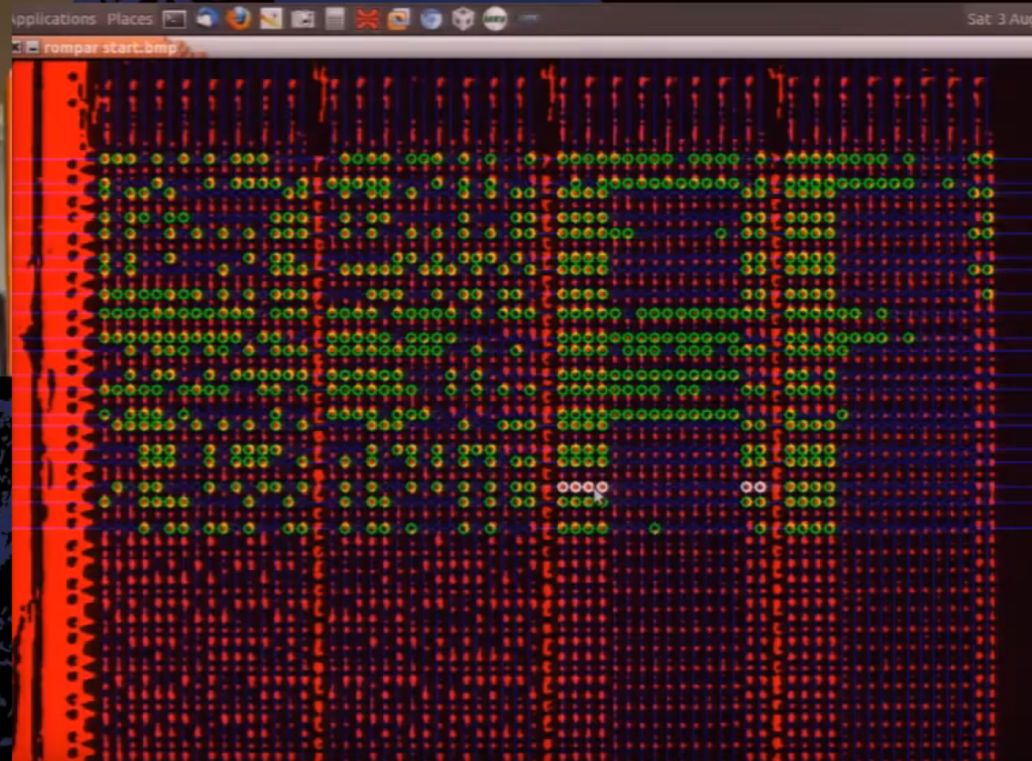
Post processing
What is the bit order?
High addresses often unused
Permute until disassembles cleanly
Look for strings
Atmel MARC4
Adam Laurie

Slide 17
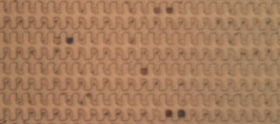
Implant mask ROM
Primary ROM technology since mid 90s
Doping differences usually not visible
What to do?

Slide 18
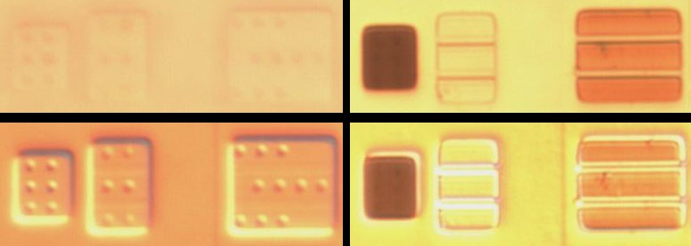
Implant staining
Stain: chemical solution to reveal doping
Ex: Dash etch (HNO3, HAc, HF)
Does this also work on implants?
Left: unstained, right: stained
Top: brightfield, bottom: DIC

Slide 19
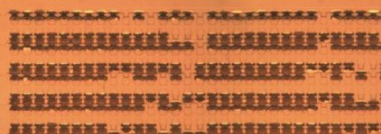
Implant ROM stained
Sort of
Worked only on first generation implant ROMs
Why?
Sharp SM4
(Nintendo 6102 CIC)

Slide 20
Old vs new results
FIXME: add SB before and after tuning

Slide 21
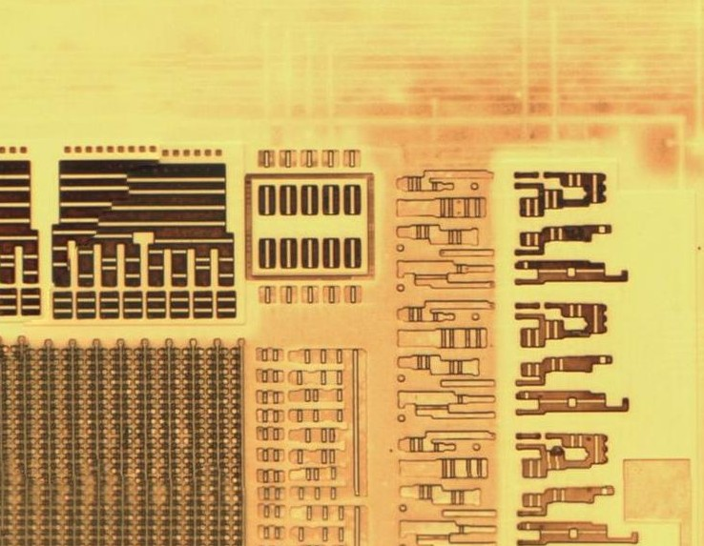
Dash: metal contamination
Metal seems to oxidize Si, pre-maturely etching it when removing SiO2
Symptom: metal tracks visible on raw Si substrate
Fixes
Remove metal w/ lapping
High concentration HF
Remove metal w/ phosphoric acid
Sharp SM4
(Nintendo 6102 CIC)
Notes:
Crazy ideas: fluorinert, redox shield reactions

Slide 22
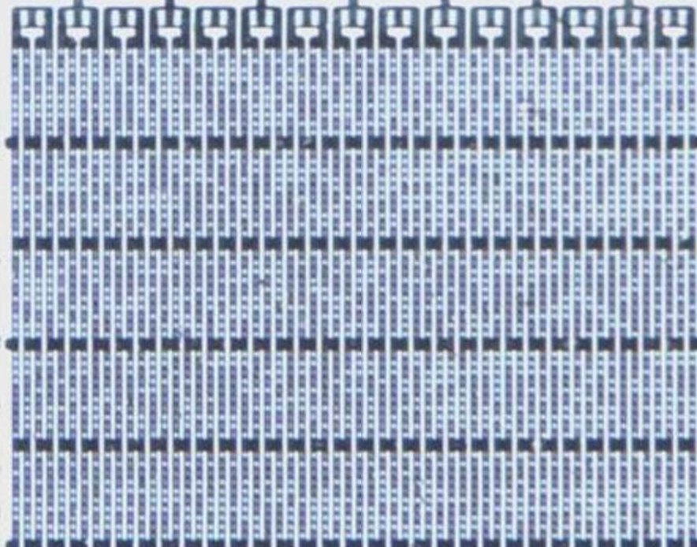
Dash: light dependence
Strong light enhances selectively dramatically
Not required for older chips
Right: w/o light sometimes revealed bits, but never well. Consistent with light
Sanyo LC5...?
(RSA SecurID 2C)
Notes:
Probably requires halogen

Slide 23
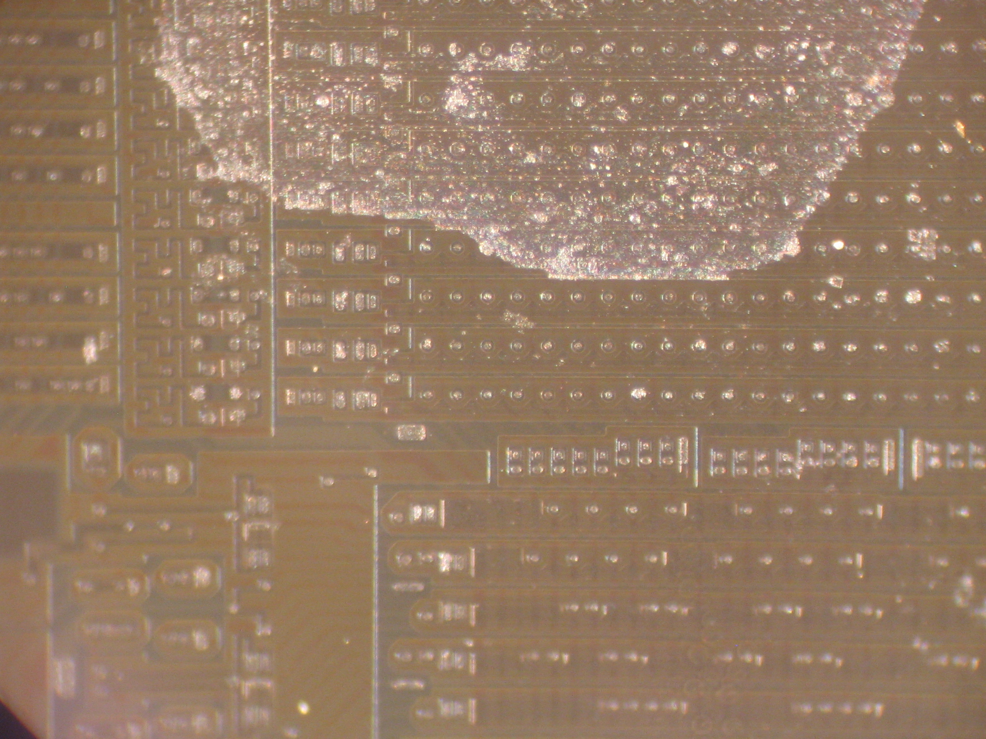
Dash woes: temperature
Etch rates strongly temperature dependent
Acetic acid (HAc) freezing point: 62°F
Too cold lab => ruined chip

Slide 24
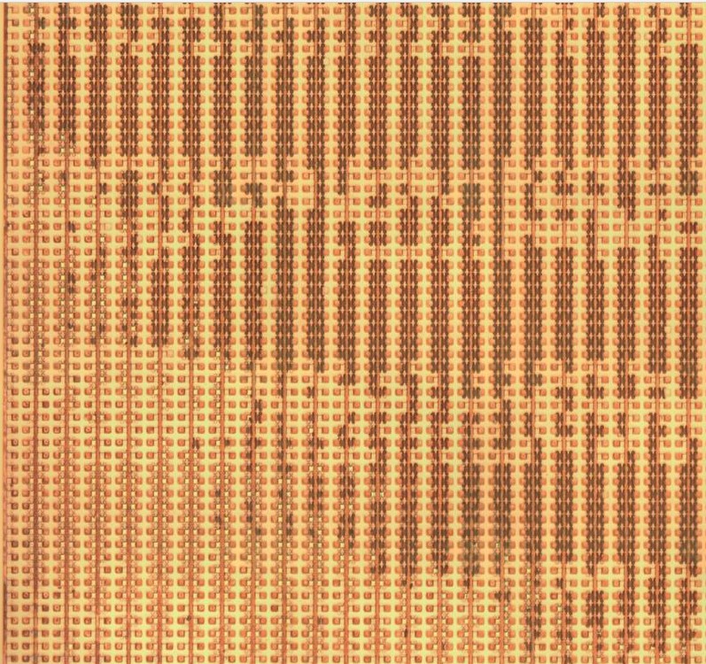
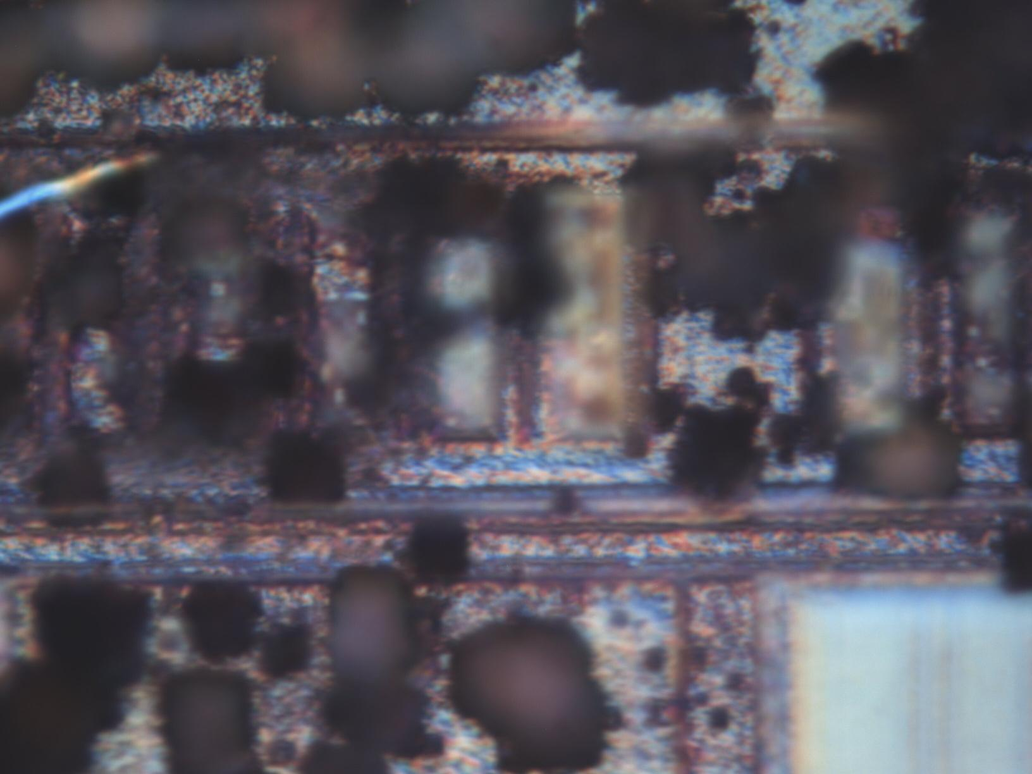
Dash woes: don't over-etch!
Implant very thin => easy to destroy the bits
Symptom: all bits one polarity

Slide 25
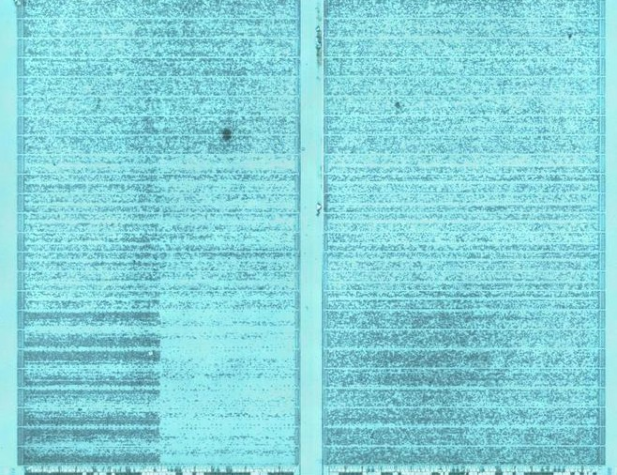
Dash: onto newer chips
So-so results extracting bits from newer GeneralPlus MCUs
Suspect due to uneven metal removal
Looking into lapping to fix
Optical resolution limits => SEM imaging
GeneralPlus GPL168001A-068A-C

Slide 26
Advanced techniques
(less common or
often impractical)

Slide 27
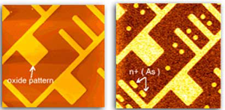
Scanning Capacitance Microscopy
Probe records doping dependent capacitance
Relatively slow
Requires AFM => somewhat uncommon
Open source STM => SCM conversion?
https://www.bruker.com/products/surface-and-dimensional-analysis/atomic-force-microscopes/modes/modes/nanoelectrical-modes/scm.html

Slide 28
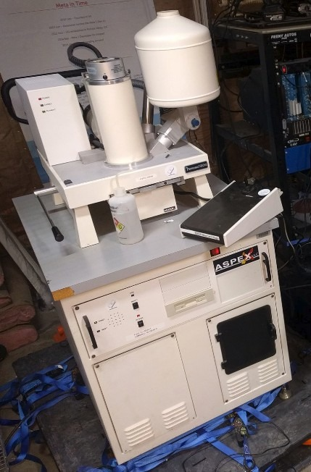
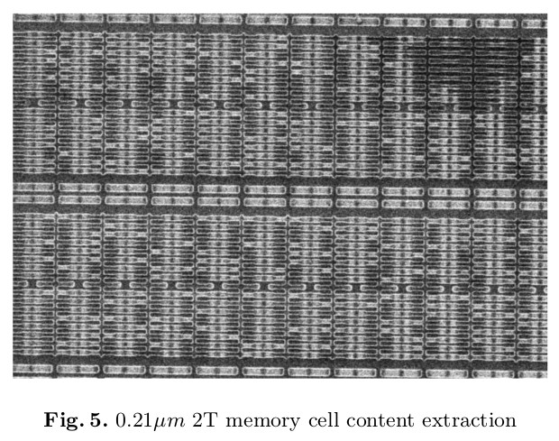
PVC for dead EPROM
Passive Voltage Contrast (PVC)
EPROM charge repels electron beam
Similar concept for implant ROM

Slide 29
Thanks for listening!
John McMaster <JohnDMcMaster@gmail.com>
@JohnDMcMaster
https://github.com/AdamLaurie/rompar
https://github.com/andrew-gardner/django-monkeys
https://github.com/SiliconAnalysis/zorrom
https://github.com/SiliconAnalysis/bitviewer/
https://github.com/SiliconAnalysis/bitract/

Slide 30
Backup

Slide 31
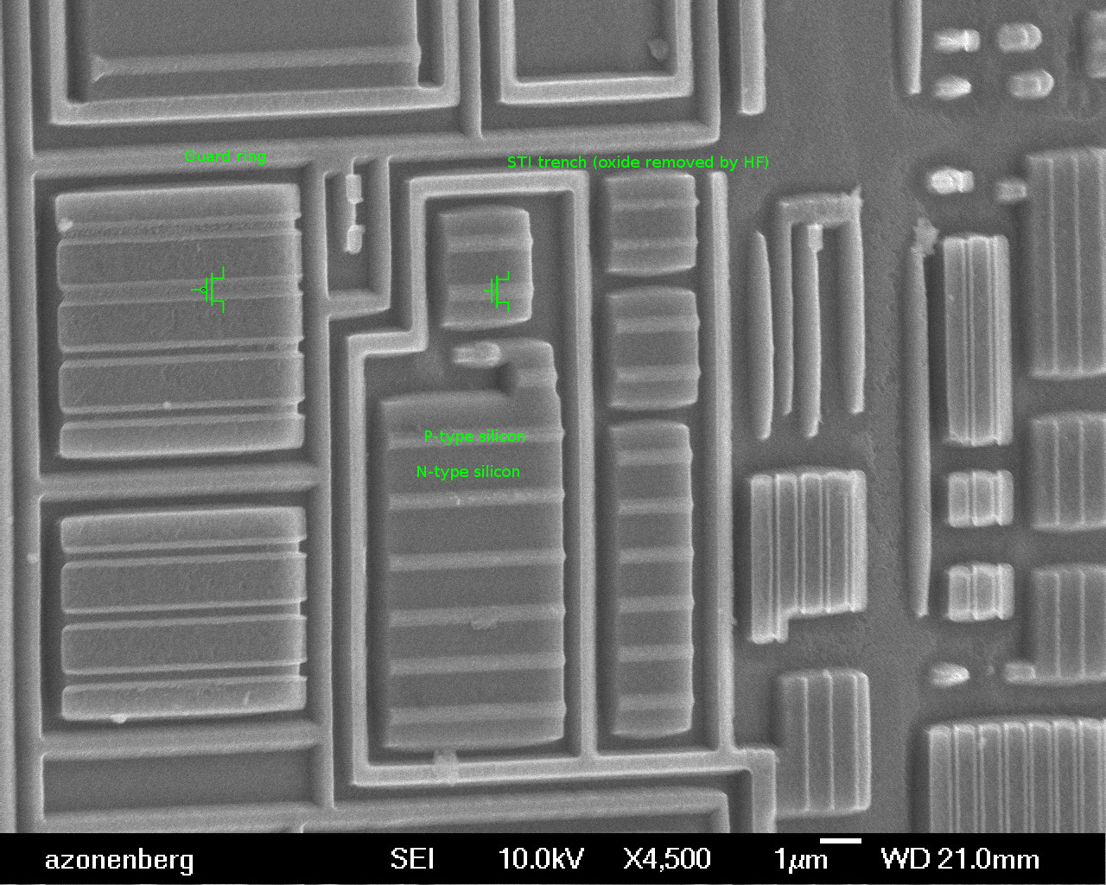
How does Dash etch work?
HNO3, HAc, HF
HNO3 oxidizing Si => SiO2
HF eating SiO2
Competing reactions influenced by doping
Xilinx XC2C32A
Andrew Zonenberg

Slide 32
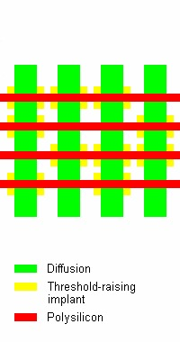
But many more ways!
Technology: contact, transistor, implant, etc
NOR vs NAND, endianess, parity
Mostly ignore specifics: just resolve bits!

Slide 33
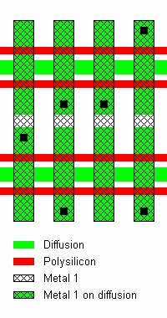
Example: contact NOR

Slide 34
CMOS Transistor 101
Green: diffusion
Red: polysilicon gate
Voltage on red line controls current flowing between adjacent green areas
Black dots: contact/via between layers (ie green to cross hatch)
Cross hatched: metal traces
Misc images from Sergei P. Skorobogatov

Slide 35
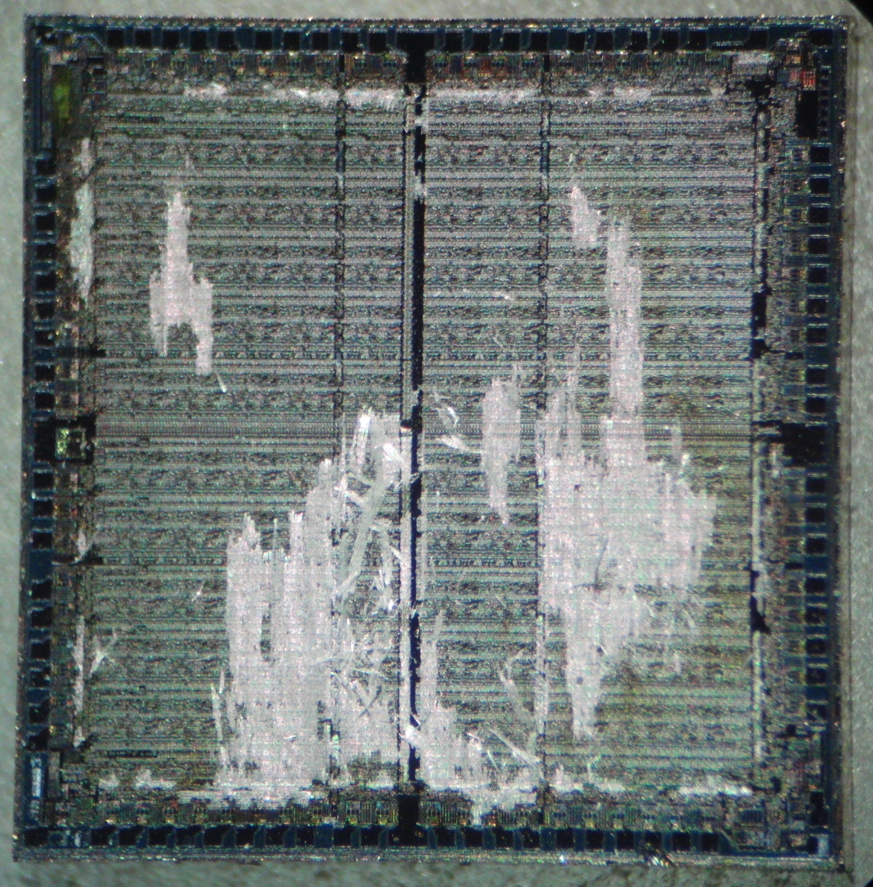
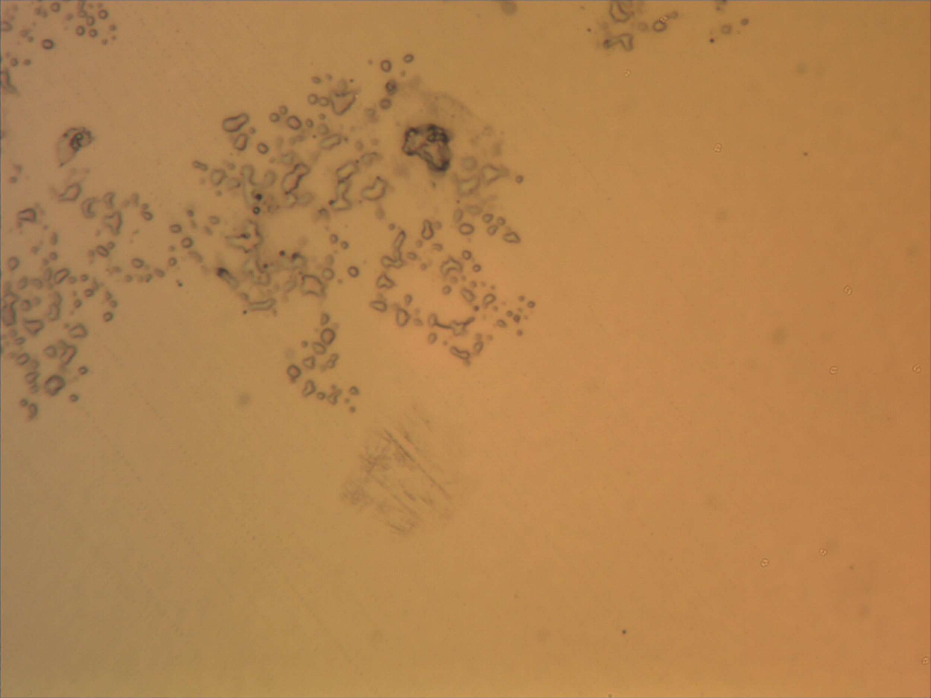
Dash: clean clean clean!
Small contamination => large effect
Rinse acetone or water w/ IPA
Blow dry if possible
Xilinx XC2018

Slide 36
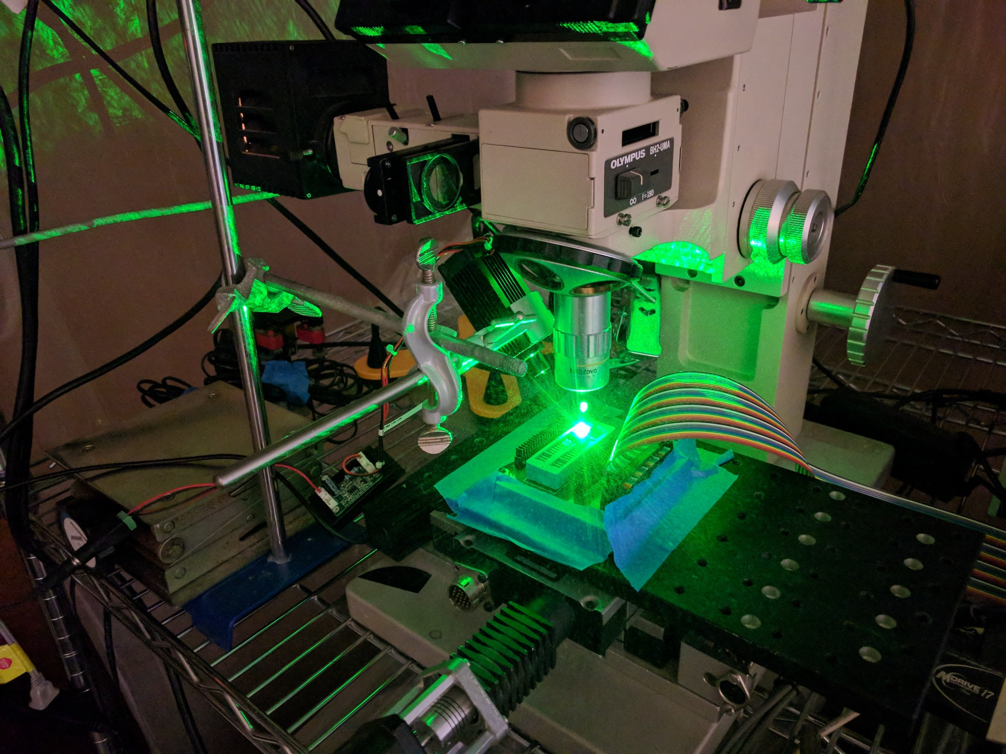
VCT for mask ROM?
Implant ROM capacitance varies by bit
Capacitively couple through by biasing sample
Similar idea using laser

Slide 37
Dash: summary
Thin bits need to be very evenly developed
Removing above layers can make it difficult to present an even surface
Older chips easier to process
Strong light helps

