Slide 1
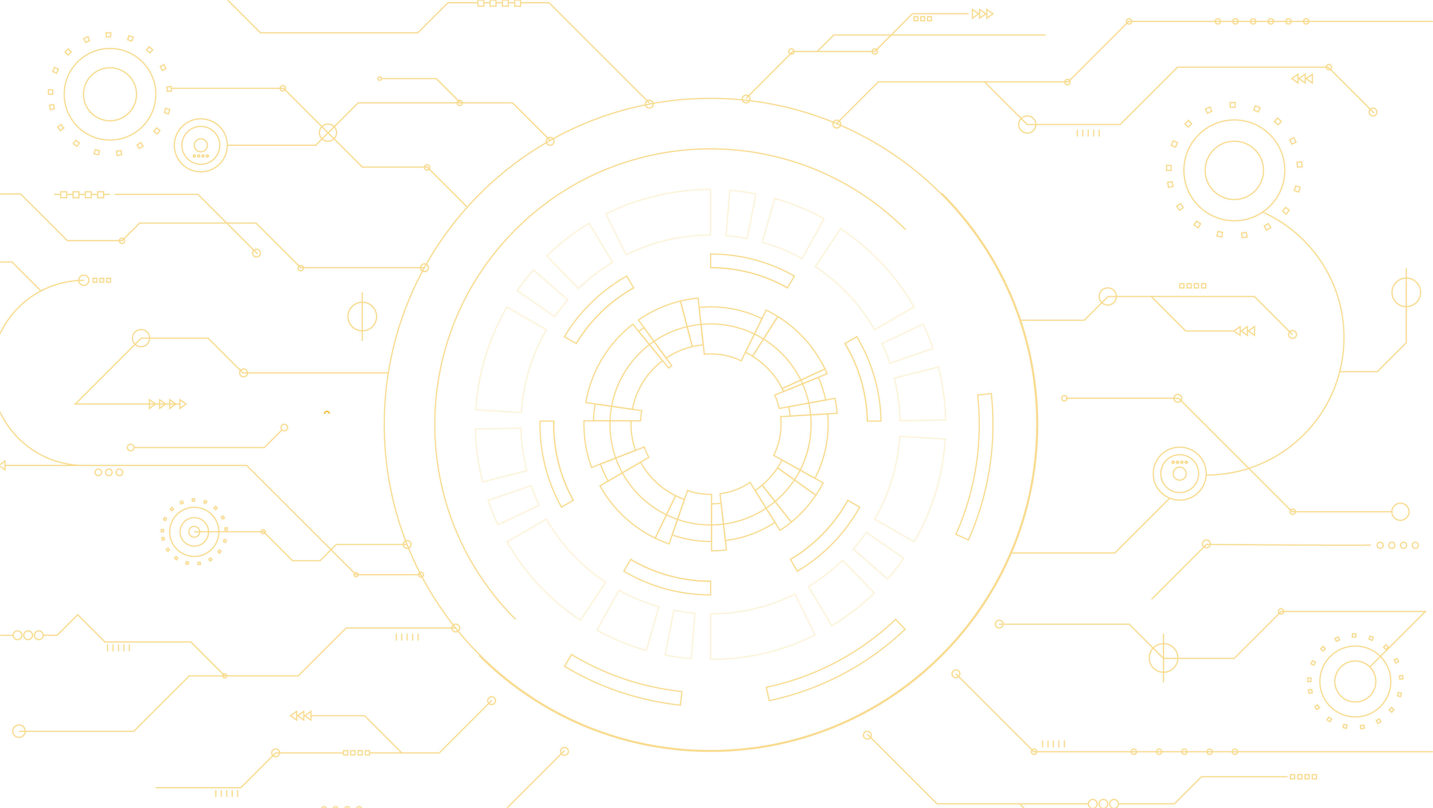
8 cryptographic, hacking and hardware puzzles to solve...
Knowledge of cryptography, physics, chemistry, electronics, computers, mathematics, history and flags may be useful…
00
Wall Challenge
for
Hardwear.io Virtual Con 2020
THE ANSWERS!
73

Slide 3
Challenge
1

Slide 4
What UN country is 20kOhms?
11
G
O
L
D
GOLD
CA
4 Bands, 5%

Slide 5
What UN country is 20kOhms?
11
G
O
L
D
GOLD
CA
4 Bands, 5%

Slide 6
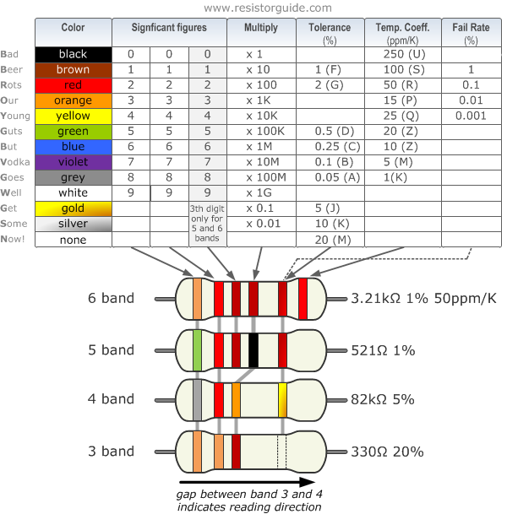
Resistor Colour Code Chart
11
CA

Slide 7
20k Resistors
11
Orange, Yellow, or Gold?
CA

Slide 8
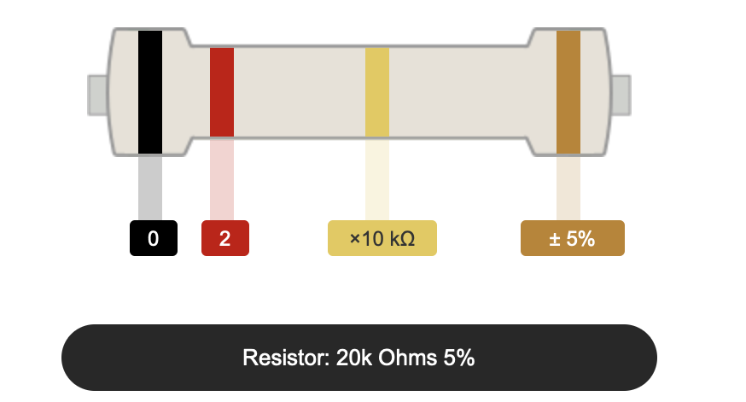
Germany
11
There is more than one way to encode 20k!
Breaking rules?
From Digikey.com
CA
4 Bands, 5%

Slide 9
Germany
11
From Wikipedia
From Digikey.com
CA
4 Bands, 5%

Slide 10
Germany
11
Red, Red, Yellow is 220k!
From Wikipedia
From Digikey.com
CA
4 Bands, 5%

Slide 11
Takeaway……
11
Colour-coding is like a code book cipher:
If you don’t know how to decode the colours, then they don’t mean anything!
Flags are not coloured according to the resistor colour code!
Surface mount (and other modern) resistors
do not use coloured bands!
CA

Slide 13
Challenge
2

Slide 14
What is next in this sequence? (C09)
02
Clue!
?
2D

Slide 15
These are inverted 7-segment displays…
02
?
2D

Slide 16
The next number is 0…
02
9 8 7 6 5 4 3 2 1 0
2D

Slide 17
Takeaway……
02
Try opposites or inverses or reversals or mirrors or rotations.
Familiar patterns may appear!
Leonardo da Vinci wrote his notebooks in mirror-writing to protect their contents!
2D

Slide 19
Challenge
3

Slide 20
What happens at the *s?
12
131129131130*
*131130131131
130130130131
10

Slide 21
Change the spacing… Any clearer?
12
1 31 1 29 1 31 1 30*
*1 31 1 30 1 31 1 31
1 30 1 30 1 30 1 31
10

Slide 22
Change the spacing… Any clearer?
12
January
February
March
April
1 31 1 29 1 31 1 30*
*1 31 1 30 1 31 1 31
1 30 1 30 1 30 1 31
10

Slide 23
Significant dates!
12
The 30th of April and 1st of May are the dates for Hardwear.io Virtual Con 2020
10

Slide 24
Takeaway……
12
Without context, numbers may lose their significance.
Stored data often has no context.
The context is often revealed by what does the reading and writing!
10

Slide 26
Challenge
4

Slide 27
Inspect, or…
15
1010 010 1011 0110 1 111
110 010 01 0110 0000 1011 /
0010 010 111 11 / 1 0000 0 /
0110 01 000 1
F3

Slide 28
Any clues?
15
1010 010 1011 0110 1 111
110 010 01 0110 0000 1011 /
0010 010 111 11 / 1 0000 0 /
0110 01 000 1
F3

Slide 29
0000? What is ‘/’?
15
Clue!
Clue!
1010 010 1011 0110 1 111
110 010 01 0110 0000 1011 /
0010 010 111 11 / 1 0000 0 /
0110 01 000 1
Clue!
Clue!
Clue!
F3

Slide 30
What sort of ‘binary’?
15
Clue!
Clue!
1010 010 1011 0110 1 111
110 010 01 0110 0000 1011 /
0010 010 111 11 / 1 0000 0 /
0110 01 000 1
Clue!
Clue!
Clue!
F3

Slide 31
Change symbols?
15
-.-. .-. -.-- .--. - ---
--. .-. .- .--. …. -.-- /
..-. .-. --- -- / - …. . /
.--. .- … -
F3

Slide 32
Morse Code!
15
-.-. .-. -.-- .--. - ---
--. .-. .- .--. …. -.-- /
..-. .-. --- -- / - …. . /
.--. .- … -
F3

Slide 33
Morse Code!
15
CRYPTOGRAPHY/
FROM/THE/
PAST
F3

Slide 34
Takeaway……
15
Is Morse Code a code, or a cipher?
Is it just a change of symbols? Like binary, hex…
Which flag is Morse Code for ‘E’
F3

Slide 36
Challenge
5

Slide 37
Two degrees of freedom…
17
O H N D I C
Y S E T R G
H N I Y R M
W N P A E I
G T P A D R
FB

Slide 38
Two degrees of freedom…
17
O H N D I C
Y S E T R G
H N I Y R M
W N P A E I
G T P A D R
FB

Slide 39
Two degrees of freedom…
17
O H N D I C
Y S E T R G
H N I Y R M
W N P A E I
G T P A D R
FB

Slide 40
Two degrees of freedom…
17
CRYPTOGRAPHY MEANS
‘HIDDEN WRITING’
FB

Slide 41
Takeaway……
17
Humans are very good at pattern-spotting.
But they have preferences…
Horizontal and Vertical, for example.
Diagonals, especially right-to-left (depends on what language you speak/read!) can be awkward.
So, cunning designers hide things with
two different movements at once.
FB

Slide 43
Challenge
6

Slide 44
The invited aliens had four hands, with 6 fingers on one, 4 fingers on two, and 3 fingers on one.
01
52 5G 66 5E 69 67 5G 6E 69 44 5C 6C 5F 70 5G 5C 6C 63 69 51 63 6C 6E 6F 5C 66 3G 69 68 2G 2E 2G 2E
If you get R?f^ig…, then your ASCII is too terrestrial…
D3

Slide 45
Four hands, with 6 fingers on one, 4 fingers on two, and 3 fingers on one = 17 fingers.
01
If the ASCII table is indexed using base 17 instead of 16 (hex), then the characters go from 0-9, A-G, 10-19, 1A-1G, 20…
52 = W 5G = e 66 = l etc.
D3

Slide 46
Four hands, with 6 fingers on one, 4 fingers on two, and 3 fingers on one = 17 fingers
01
52 5G 66 5E 69 67 5G 6E 69 44 5C
W e l c o m e t o H a
6C 5F 70 5G 5C 6C 63 69 51 63 6C
r d w e a r i o V i r
6E 6F 5C 66 3G 69 68 2G 2E 2G 2E
t u a l C o n 2 0 2 0
D3

Slide 47
Four hands, with 6 fingers on one, 4 fingers on two, and 3 fingers on one = 17 fingers
01
52 5G 66 5E 69 67 5G 6E 69 44 5C 6C 5F 70 5G 5C 6C 63 69
W e l c o m e t o H a r d w e a r i o
51 63 6C 6E 6F 5C 66 3G 69 68 2G 2E 2G 2E
V i r t u a l C o n 2 0 2 0
D3

Slide 48
Four hands, with 6 fingers on one, 4 fingers on two, and 3 fingers on one = 17 fingers
01
Welcome to Hardwear io
Virtual Con 2020
D3

Slide 49
Takeaway……
01
There is nothing special about particular number systems, bases or coding schemes. Binary, Decimal, Hex, ASCII, etc., all just happen to be convenient for human use.
D3

Slide 51
Challenge
7

Slide 52
Back to Front
18
E3 A3 C2 61 C0 51 A0 C0 B0 33 03 B2 C2 01 91 C0 A0 D1 C0 B0 61 B0 A0 B0 61 01 11 C0 C0 71 A0 A0 31 A1 C0 E1 11 B1 72 03 D2 61 11 81
23

Slide 53
Lots of C0s, B0s, A0s…
18
E3 A3 C2 61 C0 51 A0 C0 B0 33 03 B2 C2 01 91 C0 A0 D1 C0 B0 61 B0 A0 B0 61 01 11 C0 C0 71 A0 A0 31 A1 C0 E1 11 B1 72 03 D2 61 11 81
23

Slide 54
Reversed nibbles? E3 => 3E
18
3E 3A 2C 16 0C 15 0A 0C 0B 33 30 2B 2C 10 19 0C 0A 1D 0C 0B 16 0B 0A 0B 16 10 11 0C 0C 17 0A 0A 13 1A C0 E1 11 B1 72 03 D2 61 11 81
23

Slide 55
Still doesn’t look like ASCII…
18
3E 3A 2C 16 0C 15
> : , [SYN] [FF] [SI]…
Non-printing characters [] reveals that it isn’t ASCII yet… So what are those 0As, 0Bs, 0Cs?
23

Slide 56
‘RST’ and STU’ are common triples…
18
52 53 54 55 72 73 74 75 (hex)
82 83 84 85 114 115 116 117 (dec)
R S T U r s t u
23

Slide 57
‘RST’ and STU’ are common triples…
18
52 53 54 55 72 73 74 75 (hex)
82 83 84 85 114 115 116 117 (dec)
R S T U r s t u
Hey! 7F-73 = 0C (127-115=12), 7F-74=0B…
Inverted ASCII?
23

Slide 58
Subtracting from 7F (127) gives:
18
3E 3A 2C 16 0C 15… (hex)
41 45 53 69 73 6A… (hex)
A E S i s j…
65 69 83 105 115 106… (dec)
23

Slide 59
Which gives:
18
AES is just LOTS of substitutions shuffles and XORing
23

Slide 60
Takeaway……
18
Swapping the nibbles is like a shuffle, inverting the ASCII table is like a substitution… and the result is something where undoing one operation doesn’t give you any clear clues that you are making progress…
Much like a real encryption algorithm like AES!
Note that ASCII above 127 is not a single standard: Extended ASCII has many variants: look up Code Page 437/1252…
23

Slide 62
Challenge
8

Slide 63
Double firewall…
14
Z6B VG5S40U
C57SU205Y Z64W
A
9
Z
56
0

Slide 64
Does ‘double’ mean two codings?
14
Z6B VG5S40U
C57SU205Y Z64W
Clue!
Clue!
Clue!
What might this mean?
A
9
Z
56
0

Slide 65
Rotations are tricky: how many, what chars?
14
Z6B VG5S40U
C57SU205Y Z64W
Clue!
Clue!
Clue!
A
9
Z
56
0

Slide 66
Are the clues to tell you when the ROT is ok?
14
HOT DYNAMIC UNPACKING HOME
Clue!
Clue!
Clue!
A
9
Z
ROT-18, with A-Z, 0-9
56
0

Slide 67
So what is left after unrotating?
14
HOT DYNAMIC UNPACKING HOME
56

Slide 68
Could it be an anagram?
14
HOT DYNAMIC UNPACKING HOME
56

Slide 69
Yes!
14
HACKING, COMMUNITY AND HOPE
56

Slide 70
Takeaway……
14
Rotations preserve letter frequency, but change the symbols.
Anagrams preserve letter frequency, but change the order.
Two similar processes may not be better…
This is why AES et al repeat sequences of operations where each has a different effect on the data…
56

Slide 71
00
8 cryptographic, hacking and hardware puzzles to solve...
Knowledge of cryptography, physics, chemistry, electronics, computers, mathematics, history and flags may be useful…
Thank you!
73

