Slide 1
Automated Fault Injection Attacks on Embedded Devices
Enrico Pozzobon <enrico@dissec.to>
Nils Weiss <nils@dissec.to>

Slide 2
Automated Fault Injection Attacks on Embedded Devices
Enrico Pozzobon <enrico@dissec.to>
Nils Weiss <nils@dissec.to>
Notes:
I’m one of the founders of dissecto,
At dissecto we focus on automating penetration testing of ECU for automotive customers
Fault injection is not our focus, but it’s our passion;

Slide 3
Alternative Name of this presentation:
Notes:
Over the last 4 years we got our fair share of successes using fault injection.

Slide 4
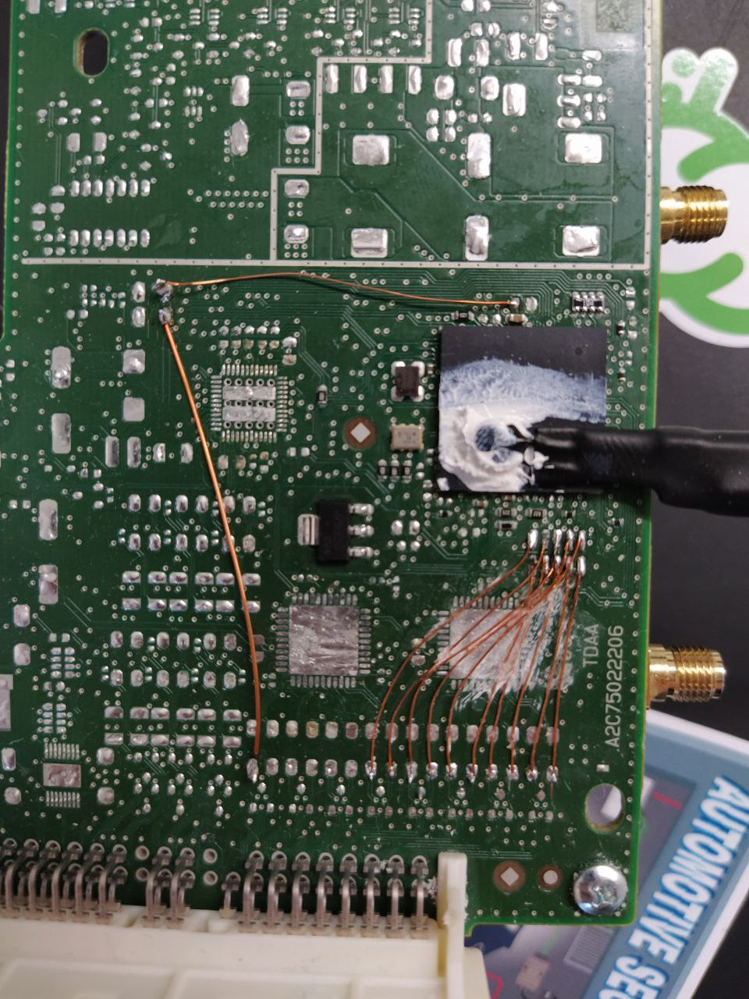
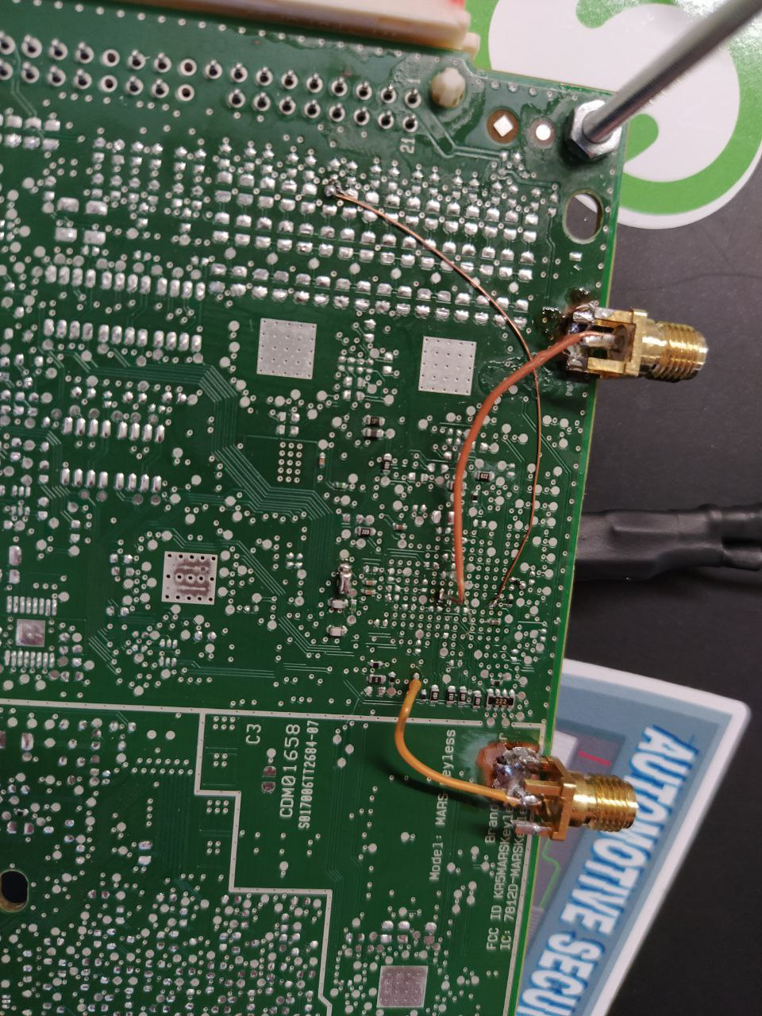
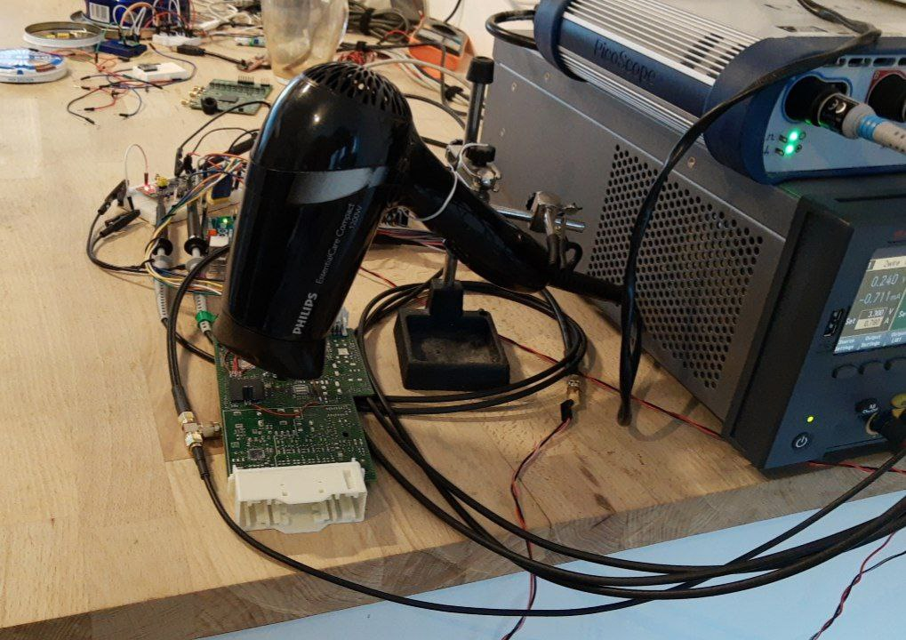
Our first Fault Injection Projects
Notes:
Initially we made use of voltage glitching but even though we good results, it was hard to automate our work because
- it required heavy modifications to the targets to become practical
- hard to reproduce, depended on temperature
- we tried to manipulate the temperature with a hairdrier
- we even made got PCBs manufactured and re-balled the target MCU
… we switched to EMFI

Slide 5
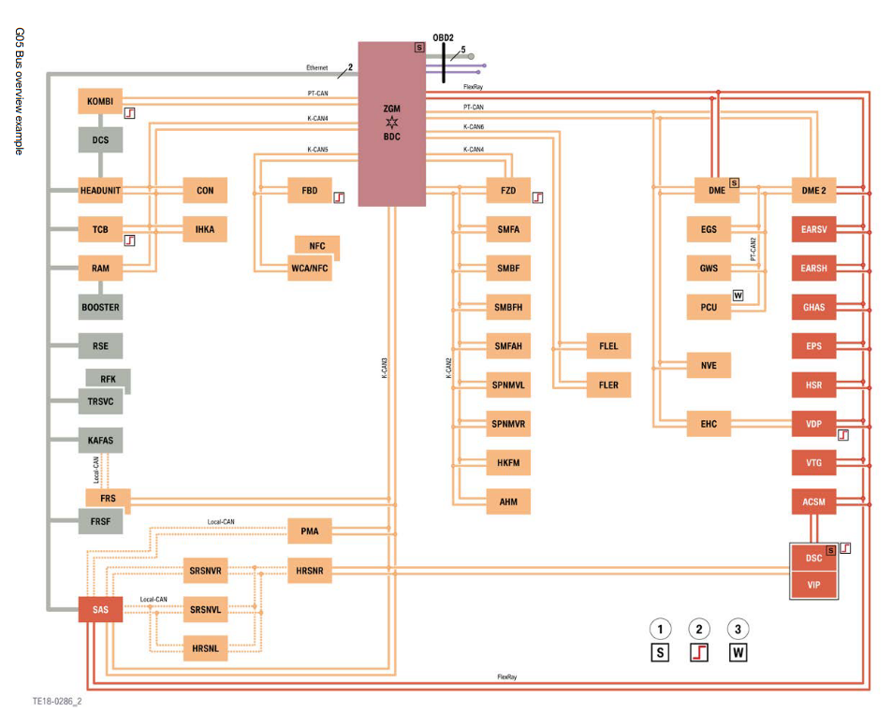
Our (first) EMFI target:
Gateway-ECU
Root of the Network
Trust anchor for certain services

Slide 6
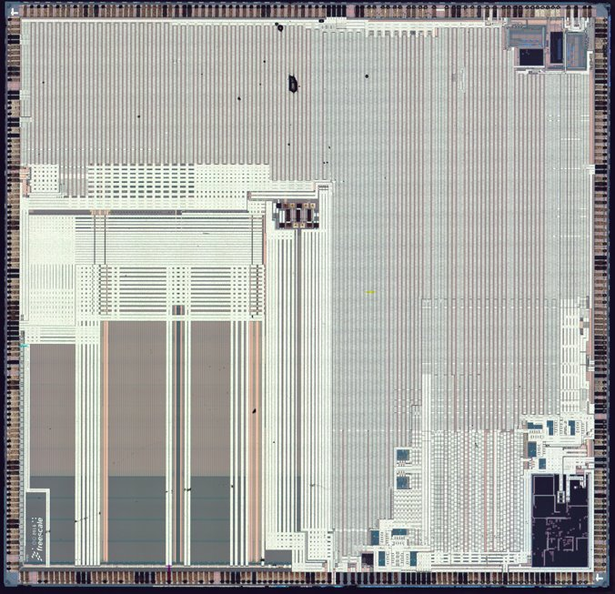
Safe and "Secure" microcontrollers
Silicon of the MPC5748G, courtesy of Texplained
Notes:
Props to NXP, sponsoring HWIO
Their MCUs were extremely resilient and we never blew one up
The same can’t be said about other automotive parts manufacturers

Slide 7
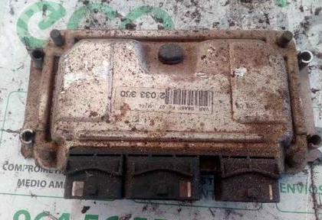
What makes an MCU "Automotive"?
It is tolerant to a wide range of temperatures.
It can withstand high voltage transients.
It doesn't break easily in the presence of electromagnetic pulses.

Slide 8
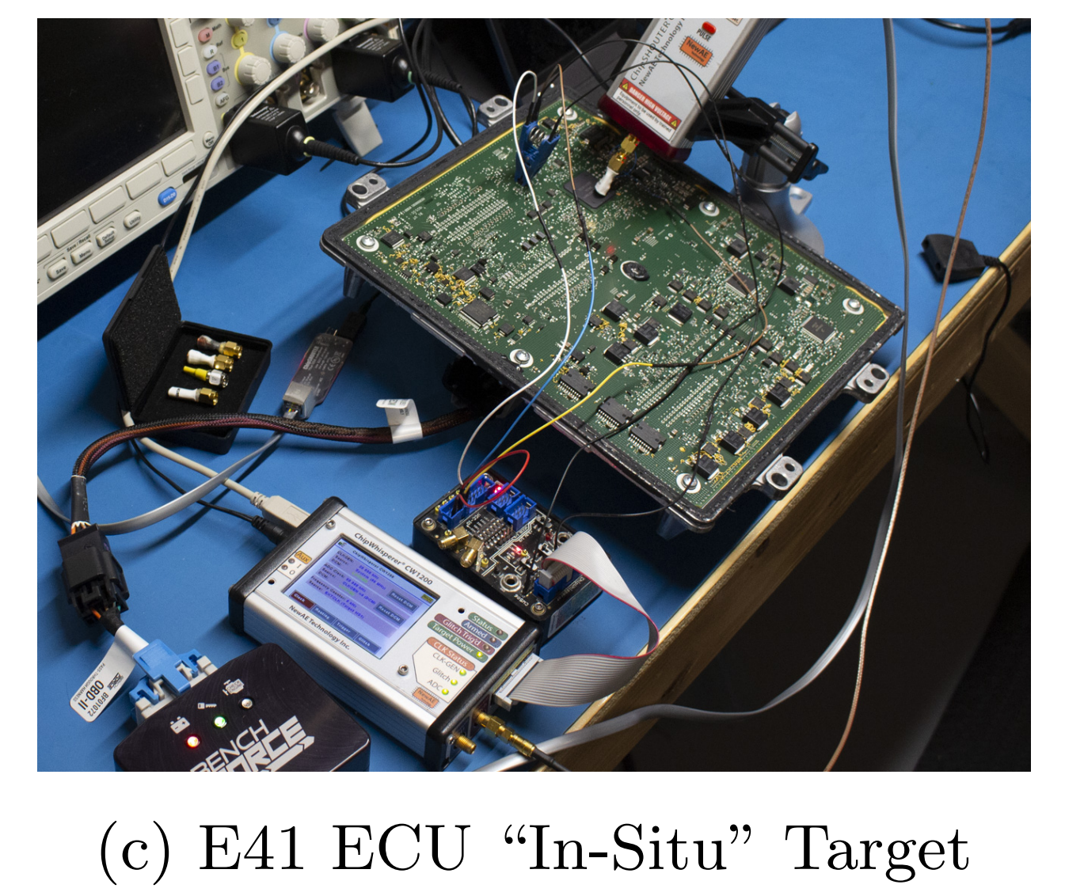
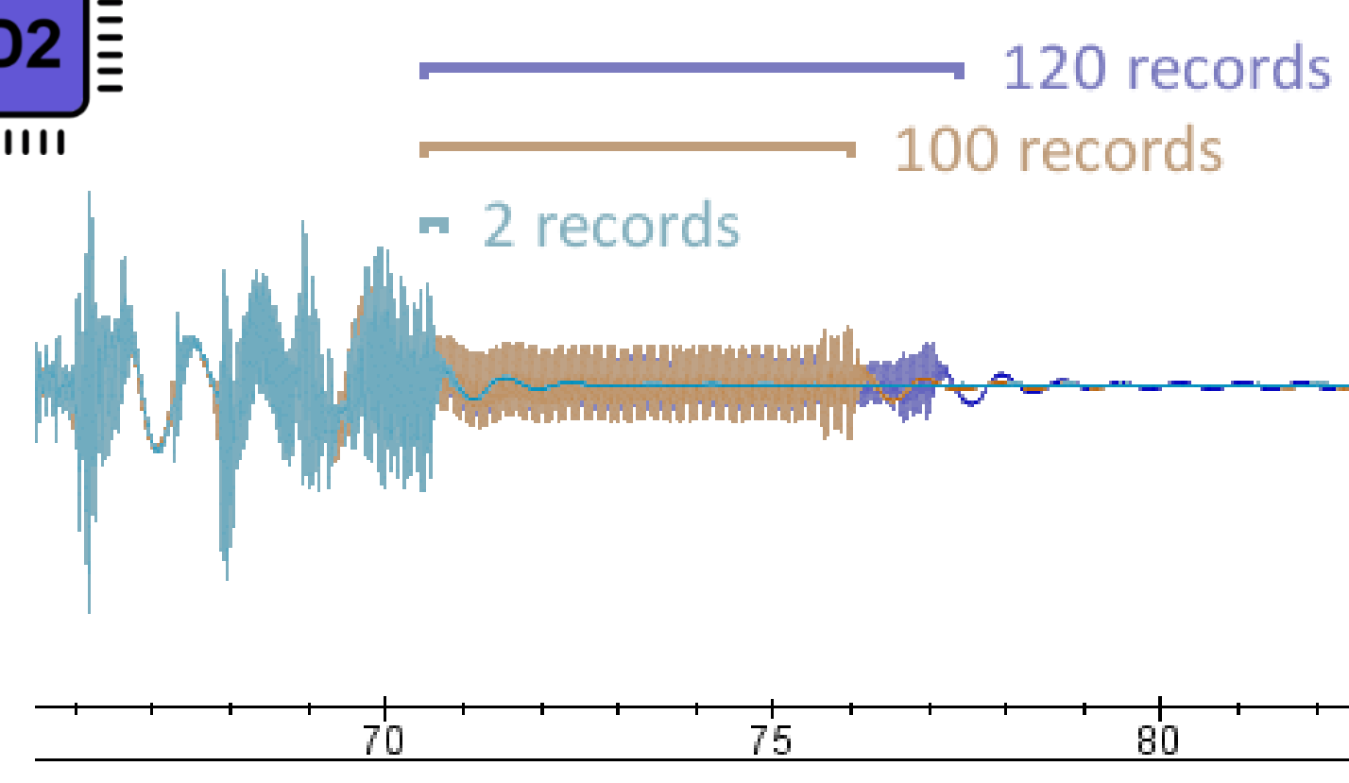
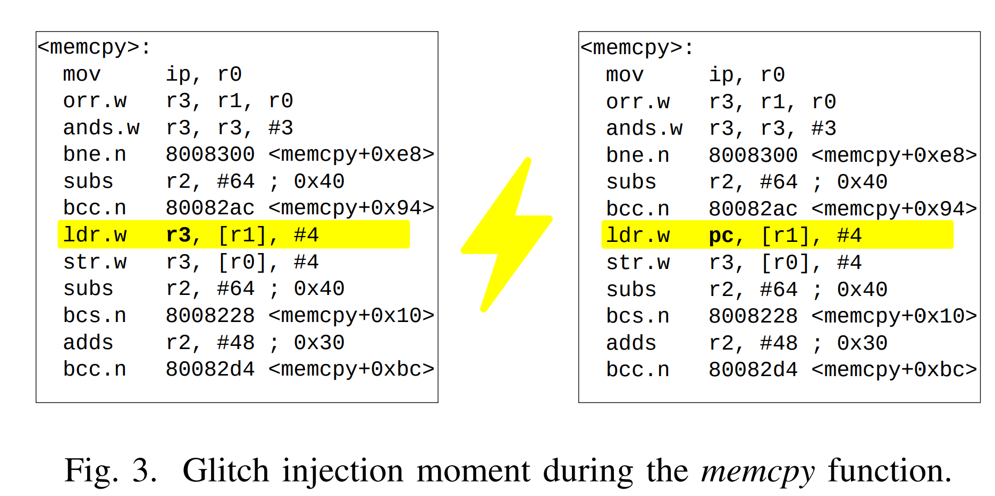
Existing glitching attacks on ECUs
Safety ≠ Security from Riscure (Attacking DCF Record Loading)
BAM BAM by Colin o'Flynn
Nasahl and Timmers used glitching attacks on an evaluation setup to obtain code execution on an AUTOSAR-based demonstration ECU
Notes:
First we tried to find existing attacks
Existing attack focus on:
- precisely attacking bootup process
- precisely timing the attack to hit some specific instruction
Requires reverse engineering,
knowledge of where the buffers with user controllable data are,
Hard to automate

Slide 9
Controlling PC by Fault Injection on ARM
Single flipped bit
Notes:
Classic example of how to load user data into PC, causing arbitrary code execution via fault injection
Instructions like these are spread across all the code, so there is a high chance of hitting one of these accidentally
Memcpy, memcmp are full of these

Slide 10
Controlling PC by Fault Injection on ARM
Single flipped bit
Notes:
Doesn’t work on powerpc,
PC in powerpc is a special register that requires special instructions to write
These instructions are much rarer, typically only found on switch statements and jumps to function pointers

Slide 11
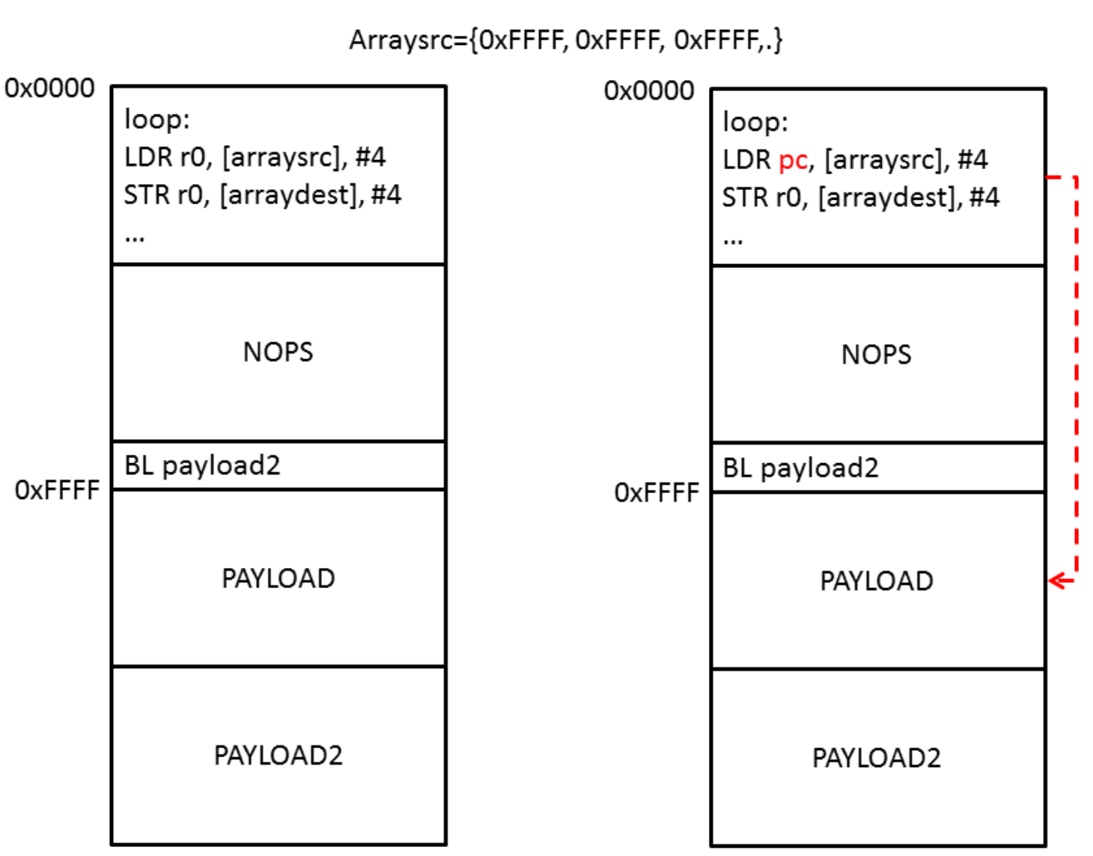
Wild Jungle Jumps
"Until now, wild jungle jumps were only exploitable in laboratory environments and considered impossible in practice" - Spensky et al. Glitching demystified: Analyzing control-flow-based glitching attacks and defenses
Picture by James Gratchof – Proving the wild jungle jump
Notes:
Another option: hit the target randomly until it jumps “somewhere we can control”
Much higher probability of happening on ARM compared to PPC, at least in similarly priced components with a similar end usecase

Slide 12
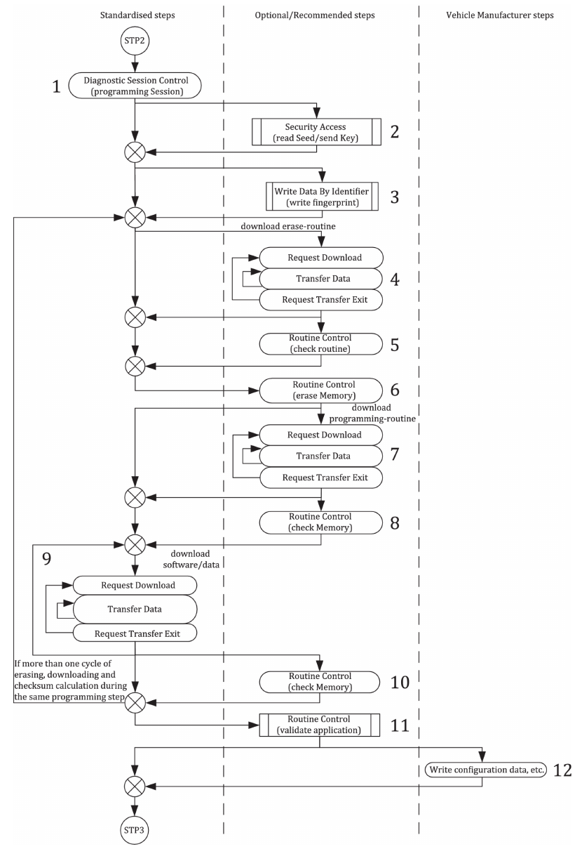
UDS / ISO 14229-1:2020
Communication with ECUs is mostly standardized
Modern ECUs supports UDS (Unified Diagnostic Services)
Configuration of ECUs
Reading Information and DTCs
Erasing / Flashing
UDS defines Flashing-Procedure
Small variations for each individual OEM

Slide 13
UDS Update Process
Bootloader
Signature is: OK
Application v1
PC

Slide 14
UDS Update Process
Bootloader
PC
Signature is: OK
Application v1

Slide 15
UDS Update Process
Bootloader
PC
Signature is: OK
Application v1

Slide 16
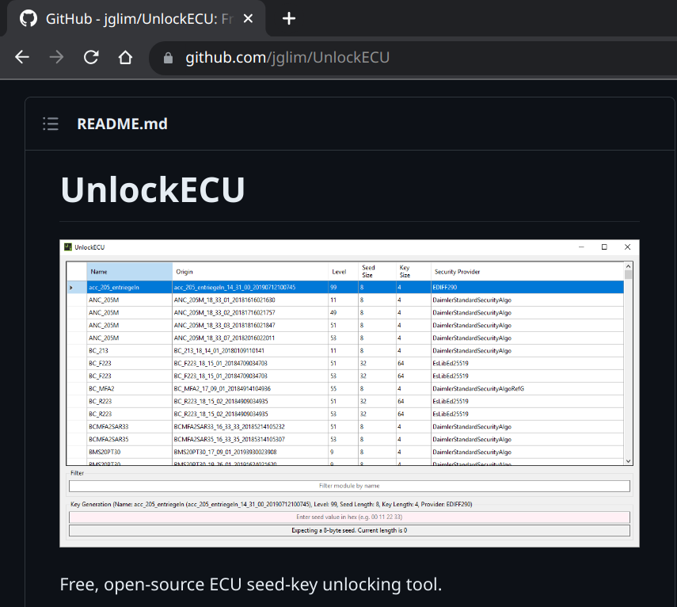
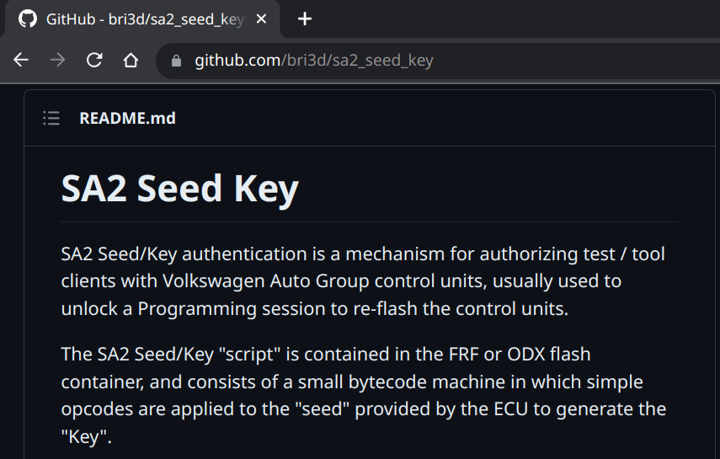
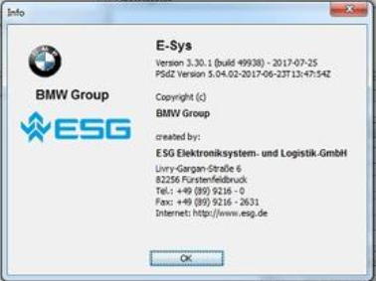
UDS Security Access
Security Access Algorithms are available on GitHub
OEM-Tools leak on shady internet forums
Many Security Access implementations are leaked or broken or easy to overcome
Notes:
Security Access is easy to bypass
Typically the real security is in the signature of the firmware

Slide 17
UDS Update Process
Bootloader
PC
Signature is: OK
Application v1

Slide 18
UDS Update Process
<empty flash space>
Bootloader
PC

Slide 19
UDS Update Process
Bootloader
PC
Signature is: Not OK
Application v2

Slide 20
UDS Update Process
Bootloader
PC
Signature is: OK
Application v2

Slide 21
UDS Update Process
Bootloader
Signature is: OK
Application v2
PC

Slide 22
If the application signature verification fails, the bootloader will not jump to the application
Bootloader
PC
Signature is: Not OK
Corrupted Application
/
Exploit Firmware

Slide 23
The attack: Use fault injection to jump from bootloader to unauthenticated payload
Bootloader
PC
Signature is: Not OK
Corrupted Application
/
Exploit Firmware

Slide 24
Bootloader
PC
Signature is: Not OK
Corrupted Application
/
Exploit Firmware
Picture by James Gratchof – Proving the wild jungle jump
Notes:
Turns out that these kind of bootloaders that delay the authentication of the update until when the entire update is delivered are the perfect target for Wild Jungle Jump attacks
We control approximately 0.1% of the 32bit address space of the processor, approximately 4MB out of 4GB

Slide 25
EMFI parameters (search space)
Injection coil: (shape, size, number and direction of turns),
Position (x, y, z) in space of the injection coil,
Duration of the activation of the coil,
Voltage across the coil (aka across the injector reservoir capacitor),
Offset from trigger signal,
if the target firmware has deterministic execution time, this is equivalent to choosing which instruction to attack!
Memory / state of the target
Depends on the messages exchanged before the fault.
Notes:
+ trigger signal is usually a UDS request that takes a relatively long time to respond to, indicating that it is executing a lot of code,
Optionally it can be the reset, but then it takes more time to retry.
Generally we aim for UDS services that are ready FAST after boot, we want to obtain a rate of 5+ faults per second

Slide 26
EMFI parameters (search space)
Injection coil: (shape, size, number and direction of turns),
Position (x, y, z) in space of the injection coil,
Duration of the activation of the coil,
Voltage across the coil (aka across the injector reservoir capacitor),
Offset from trigger signal,
if the target firmware has deterministic execution time, this is equivalent to choosing which instruction to attack!
Memory / state of the target
Depends on the messages exchanged before the fault.
Easy to automate!

Slide 27
EMFI parameters (search space)
Injection coil: (shape, size, number and direction of turns),
Position (x, y, z) in space of the injection coil,
Duration of the activation of the coil,
Voltage across the coil (aka across the injector reservoir capacitor),
Offset from trigger signal,
if the target firmware has deterministic execution time, this is equivalent to choosing which instruction to attack!
Memory / state of the target
Depends on the messages exchanged before the fault.
These don't depend on the target software, only on the hardware

Slide 28
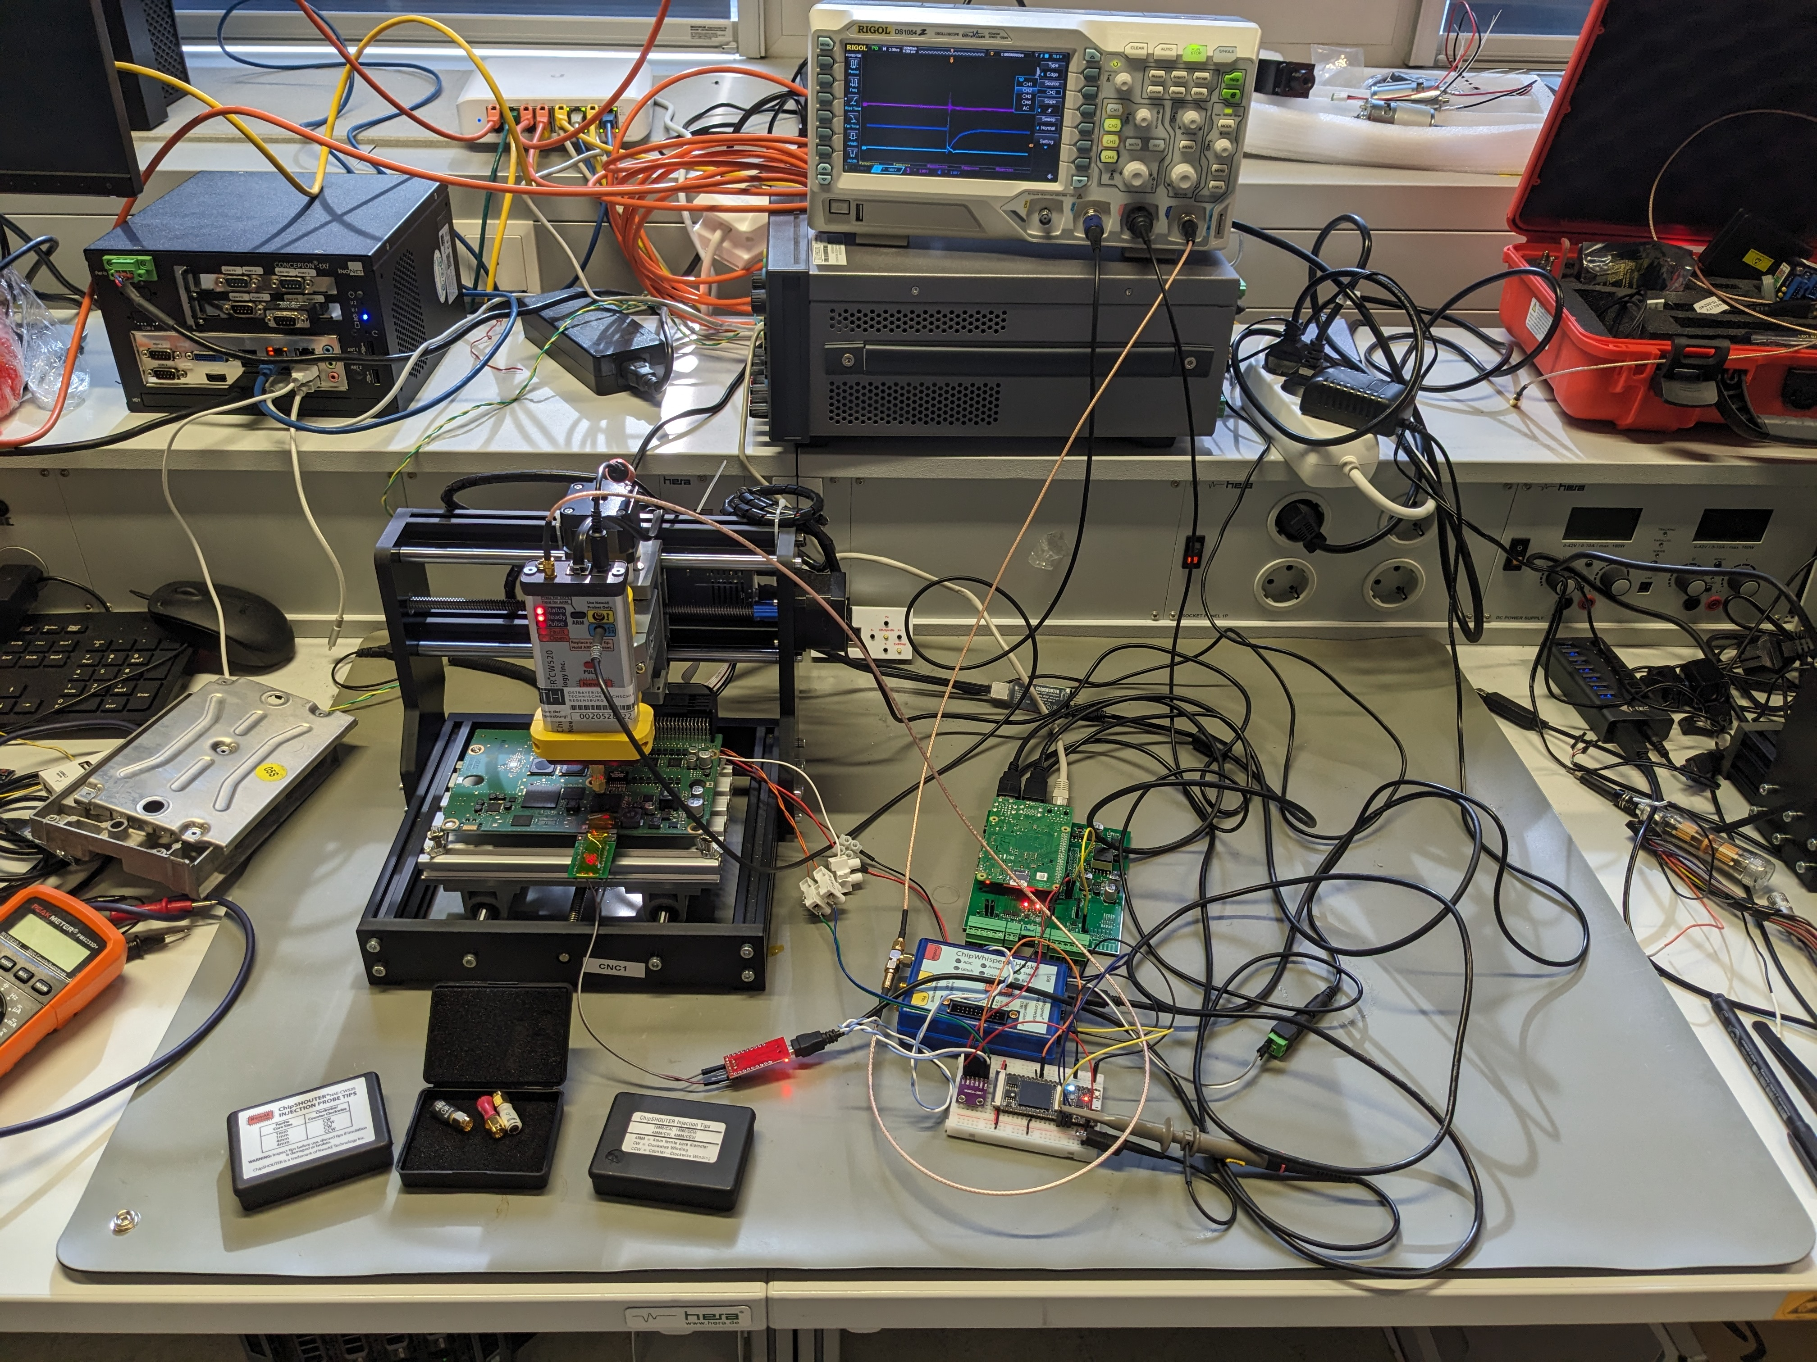

Slide 29
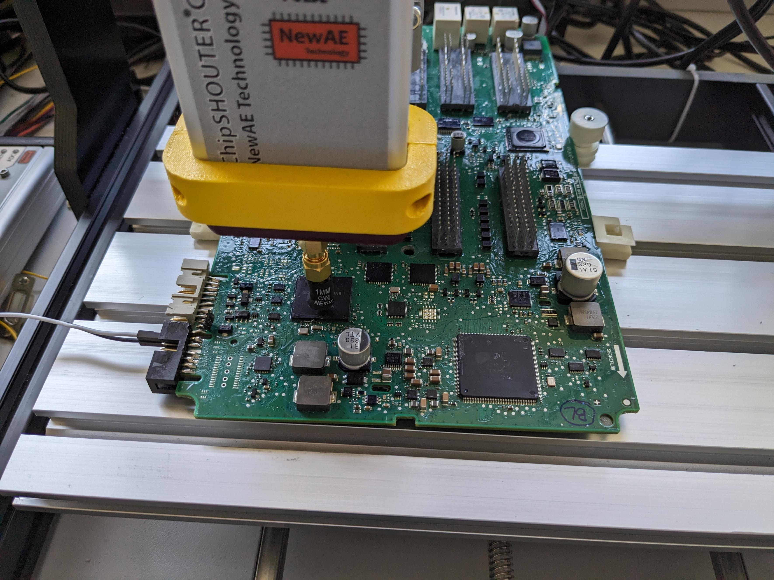
Fault Outcomes
Normal Response
Corrupted CAN response
ECU resets, no response
Possible emission of an exception with Stack Trace over UART

Slide 30
Example of a stack trace
Machine Check Exception
Exception number: 1
Exception address: 0105D1EE
Stack pointer: 40006F98
R0 010F2FB8 R8 400070EC R16 00000000 R24 400070EC
R1 40006F98 R9 013996A8 R17 00000000 R25 4004FAD8
R2 013DF918 R10 00000005 R18 00000000 R26 00000002
R3 02029200 R11 FFF1E400 R19 00000000 R27 00000002
R4 0000FFF1 R12 400070DC R20 00000000 R28 0000E400
R5 00000000 R13 4001DD90 R21 00000000 R29 0000FFF1
R6 010F3130 R14 00000000 R22 00000000 R30 40007090
R7 0000FFF1 R15 00000000 R23 00000000 R31 4003EFA8
--------------------------------------------------------------
XER 00000000 CR 80000000 LR 010F2FB8
USPRG0 00000000 CTR 010F2EF4 IP --------
--------------------------------------------------------------
SPRG0 00000000 SRR0 013D1FD6 IVPR 01000100 MSR 00000200
SPRG1 400200C8 SRR1 02029200 DEAR 00000000 PVR 81530000
SPRG2 00000000 CSSR0 00000000 ESR 00000000
SPRG3 00000000 CSSR1 00000000 MCSR 00088008
MCSSR0 0105D1EE MCAR 00000078
MCSSR1 02021200
PID0 00000000
--------------------------------------------------------------
PIR 00000000
S T A C K T R A C E
> 0x010F2FB8
> 0x010F307A
> 0x010F1F1E
> 0x011281FC
...
If the ECU doesn't emit stack traces, it is usually possible to source the same component or a similar one to program with a toy example firmware and find most fault parameters

Slide 31
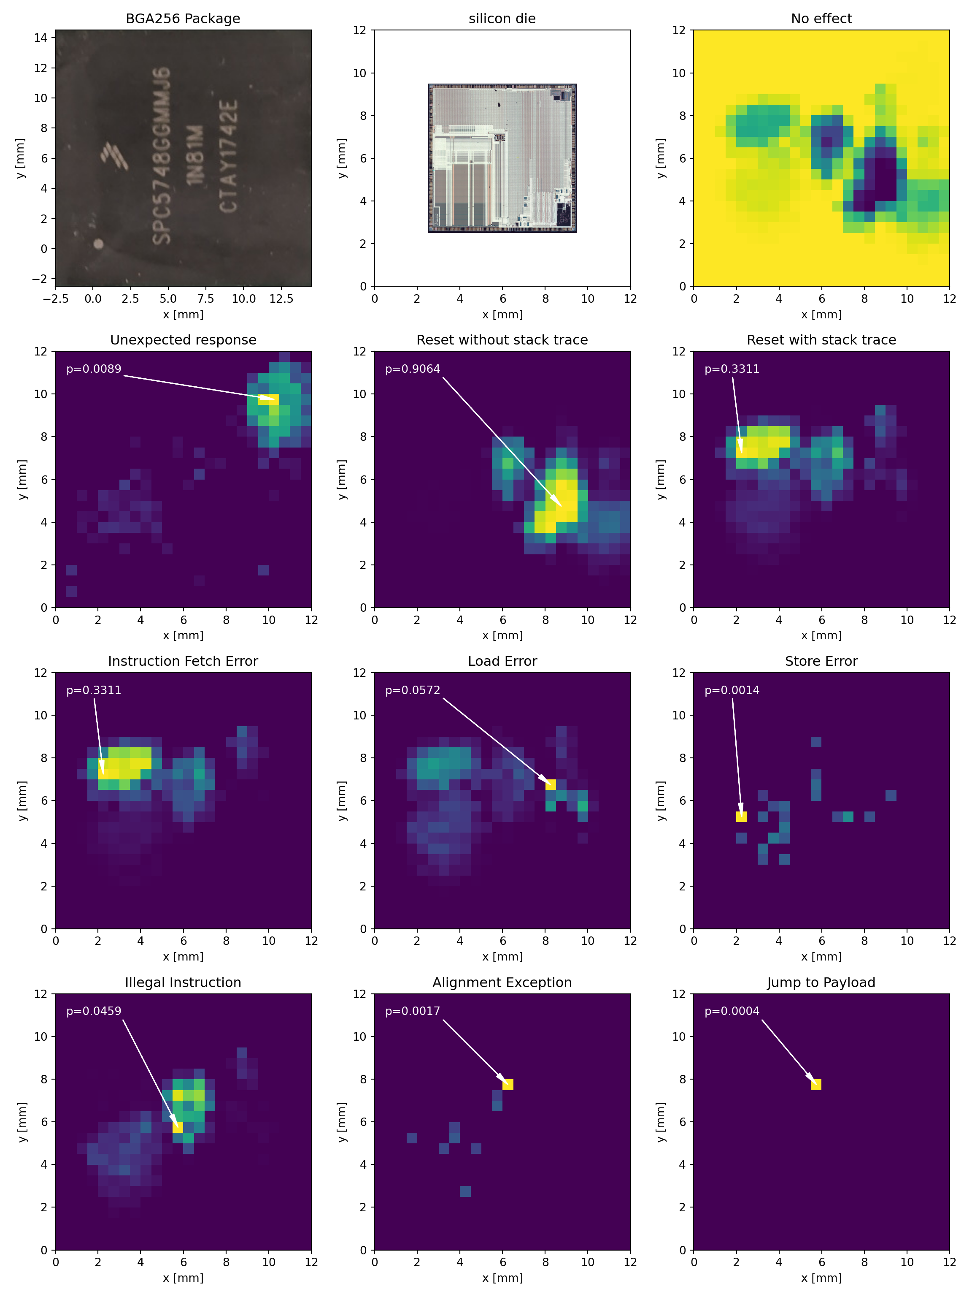

Slide 33
Other interesting data leakage through faults

Slide 35
Search Algorithm
Evolutionary Fault Injection Settings Search Algorithm (EFISSA)
Genetic Evolution
(may or may not count as AI)
Maximizes variety of feedbacks
Reward determined from stack trace

Slide 36
Search Algorithm Optimizations
Some parameters take longer to change (due to physical constraints)
Some feedbacks correlate better with code execution than others
Interrupt handlers are used as a feedback channel to rate glitches

Slide 37
Structure of the exploit firmware
Slide
Exploit
Slide

Slide 38
Structure of the exploit firmware
rept 1000
rept 113
se_nop // 2 bytes
endr
e_b _start // 4 bytes
endr
_start:
// The actual exploit code is written here
rept 2000
rept 113
se_nop // 2 bytes
endr
e_b _start // 4 bytes
endr
Slide
Exploit
Slide

Slide 39
Search algorithm performance
Notes:
Ìt’s surpsisingly similar to the CDF of success probability of a randomized attack, except it’s much faster

Slide 40
Program Counter corruption on PPC
The PPC VLE instruction set is commonly found on many ECU which are critical for security.
In PPC, 00 is an invalid instruction, and the CPU will immediately fault if zeroes are fetched as an instruction.
Moreover, in PPC, the program counter and linker register are special registers, so they can’t be written by normal MOV or LD instructions
Is PPC immune to fault injection attacks?

Slide 41
Disruption of Instruction Flow: Misaligning the Stack Pointer
Start of function
…
End of function

Slide 42
Exploitation
Dumping flash (bootloader – because we replaced most flash)
Uncensoring JTAG
Writing to Flash Memory
Access to HSM API
MPC / SPC Processors:
Manipulation of DCF Records (Chip Configuration)

Slide 43
Replicating this on further targets
If the target has detailed stack traces, only the stack trace parsing/rewarding algorithm needs to be changed
If the target doesn‘t emit stack traces on exception interrupts:
Obtain a new empty similar MCU
Develop a simple „toy example“ fimware that has exception stack traces
Train the algorithm on the toy firmware
Finally, apply the found parameters to the real target, only randomizing the injection time

Slide 44
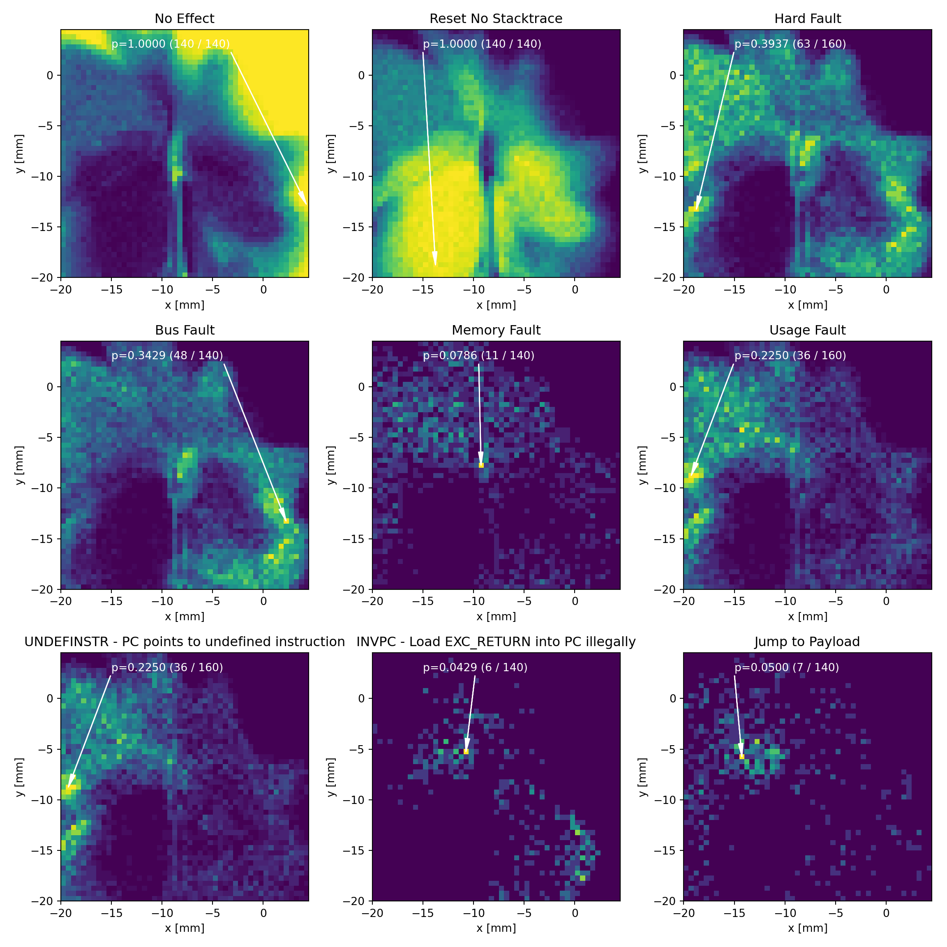
How about ARM?
Next generation of ECU Processors will be ARM
Higher likelihood of PC corruption

Slide 45
Results
Attack replicated on several targets:
5 different targets, with different firmwares
3 different MCU manufacturers
3 different MCU architectures
...and counting

Slide 46
Summary
Fault injection can be easier than it seems
Just need some luck, or some time
Attack is almost completely automatable after the construction of the physical setup
No firmware reverse engineering was required
(Some Hardware reverse engineering is required to discover the target MCU architecture and memory map, and to develop the actual exploits)
The attack is very low effort
(Except for the development of the „training firmware“ when the target doesn‘t output exception stack traces)

Slide 47
Summary
Efficient fault injection attacks demonstrated for code execution on real-world targets.
EFISSA enables feasible black-box attacks
Code injection into victim device's flash allows unauthorized execution via EMFI
Higher success probability with larger programmable flash.
Attack successful within minutes without knowledge of target software.
Reproducible on multiple ECUs with minimal code changes.
Cheap, available equipment; easy automation.
Algorithm (EFISSA) reduces fault finding time from weeks to <1 hour.

Slide 48
Mitigation
Use Memory Protection Units (MPU) => W^X
Disable execution early in boot process to minimize attack surface
Running the Bootloader in HSM might help:
Execution from functionally separated section of flash memory
Documentation for HSMs is kept secret, making exploit development harder
ISO14229 (UDS) Software Update Process needs to be revised

Slide 49
Thank you for your patience!

