Slide 1
EV CAN-bus Man-in-the-Middleing
for fun and profit
Emile Nijssen

Slide 2
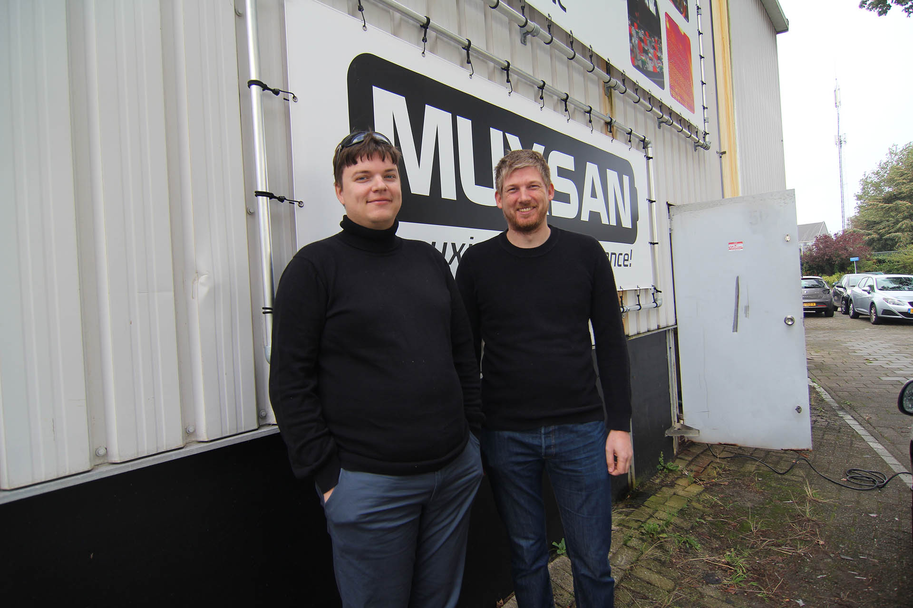

Slide 3
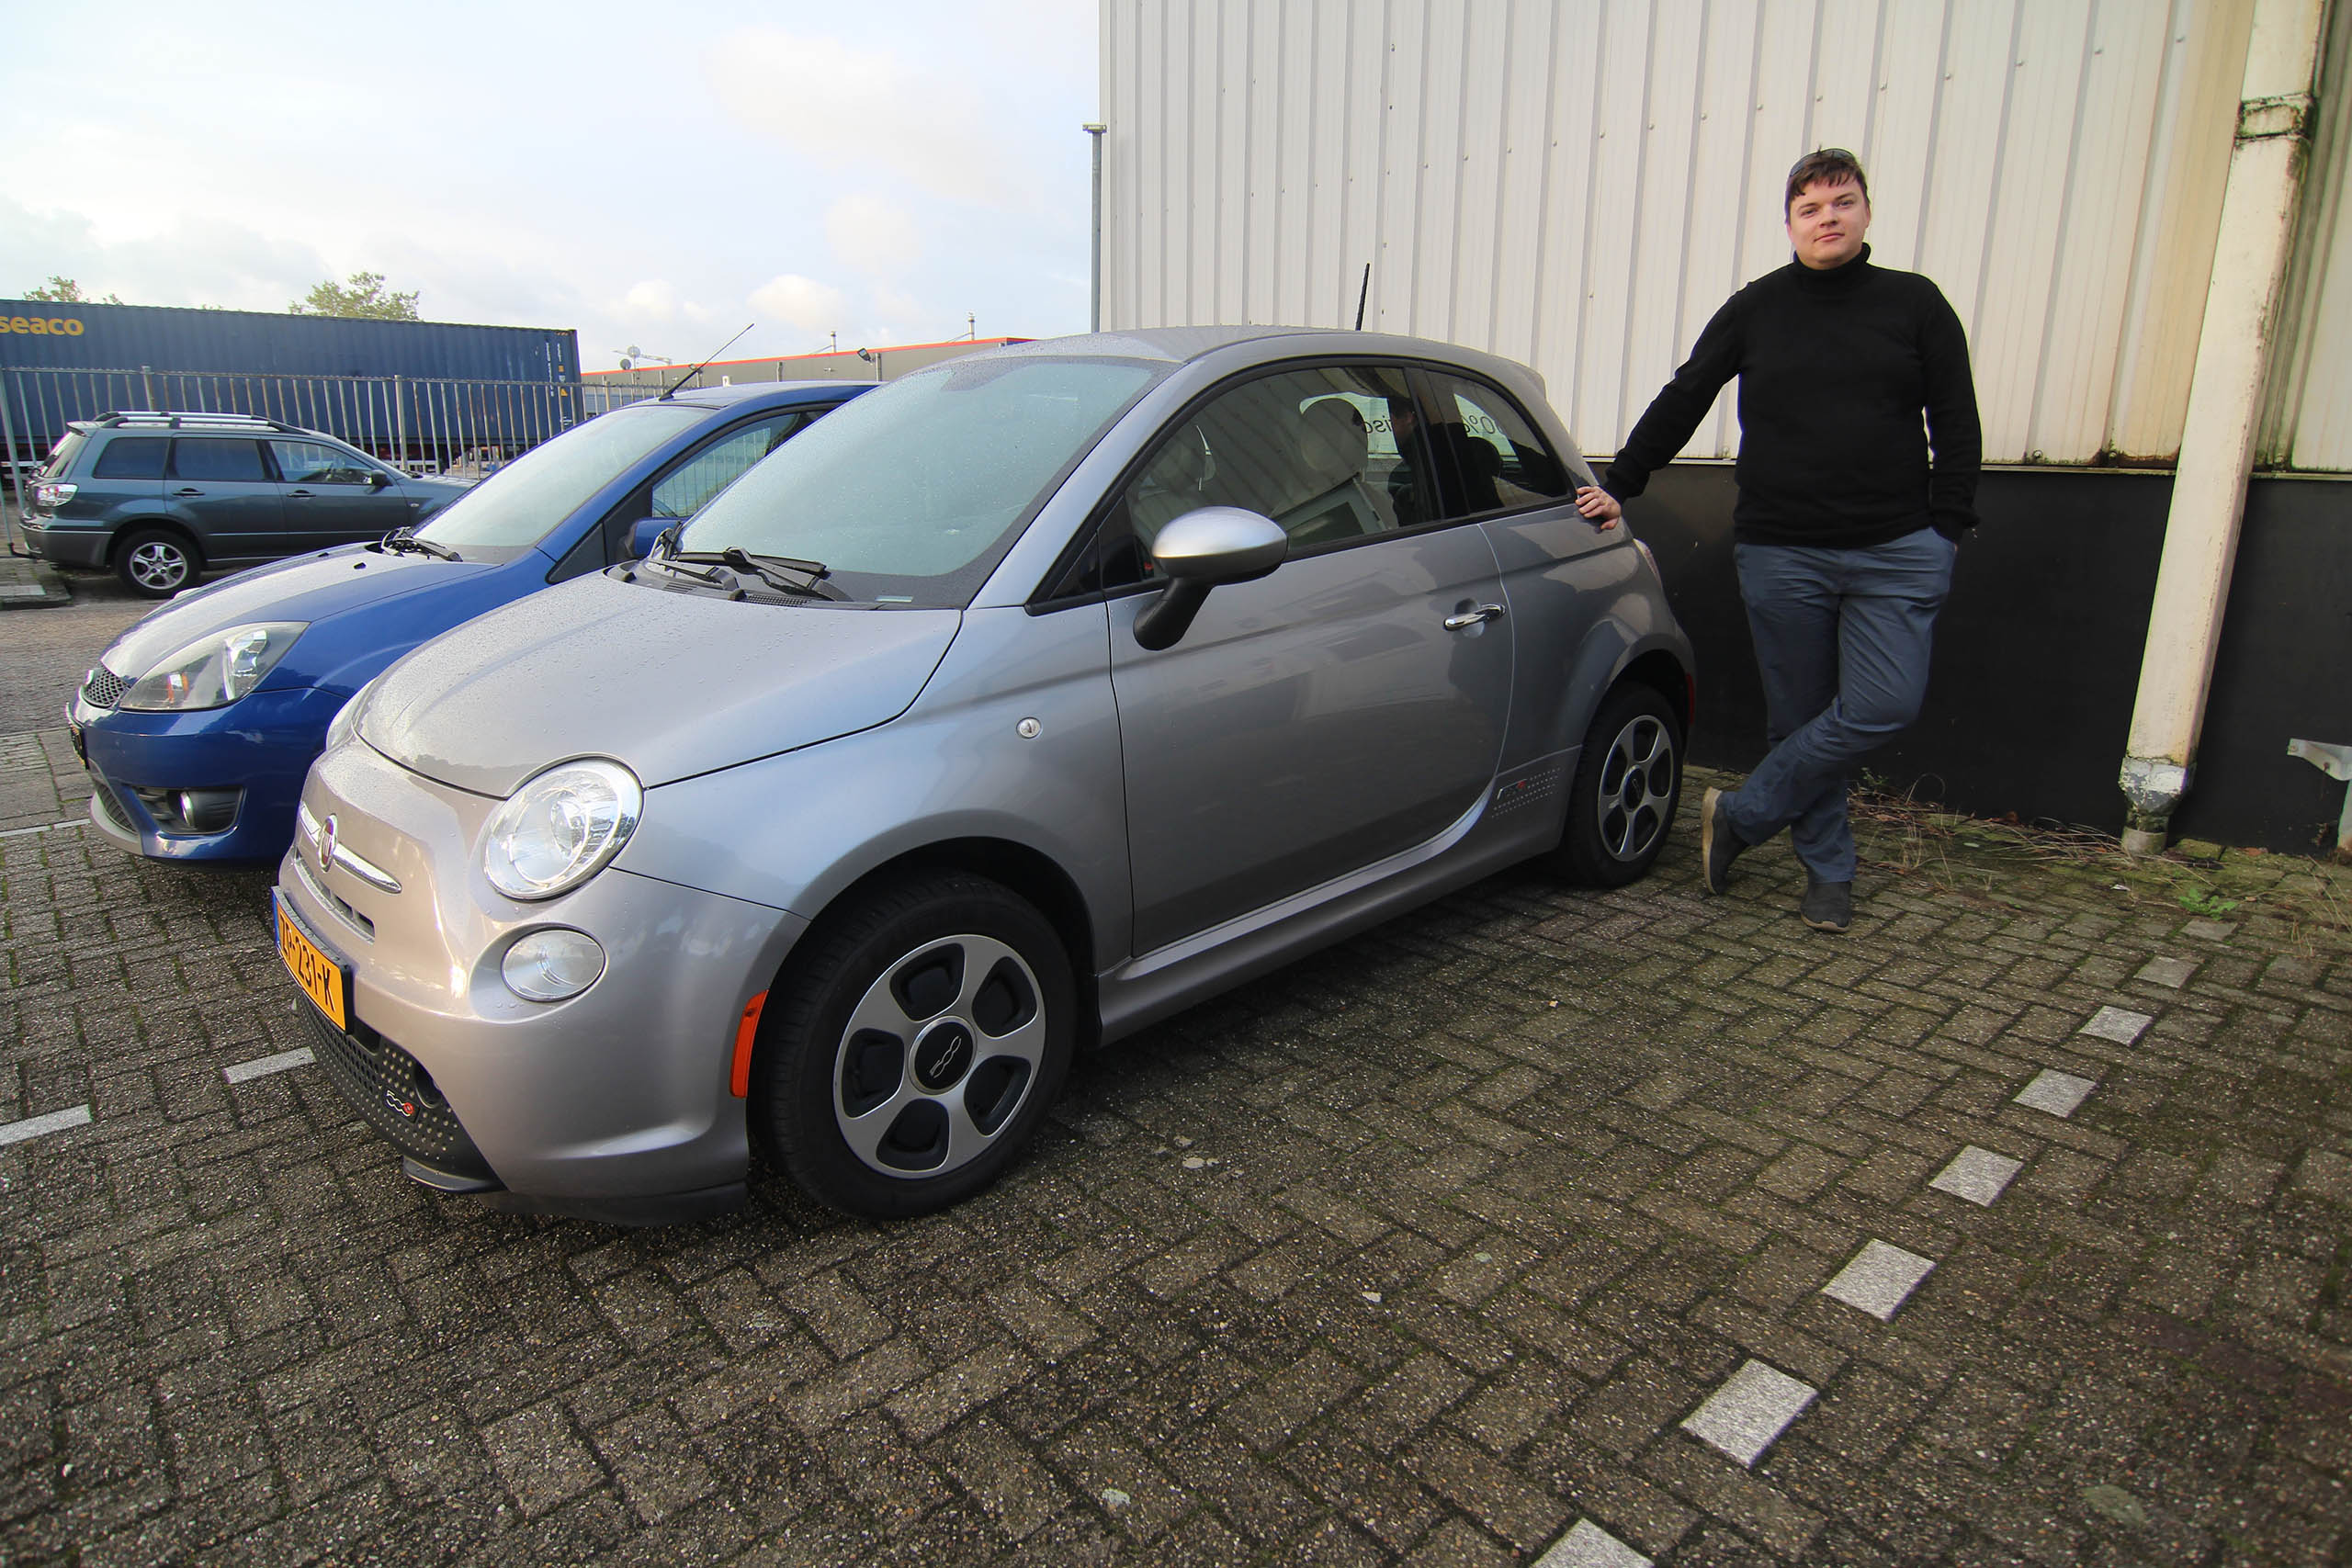

Slide 4
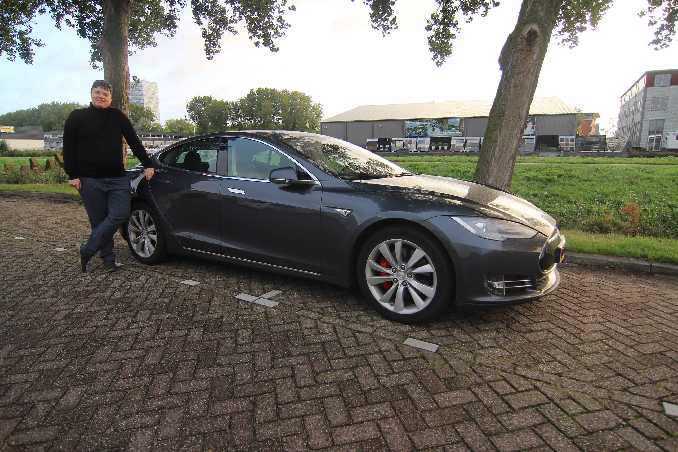

Slide 5
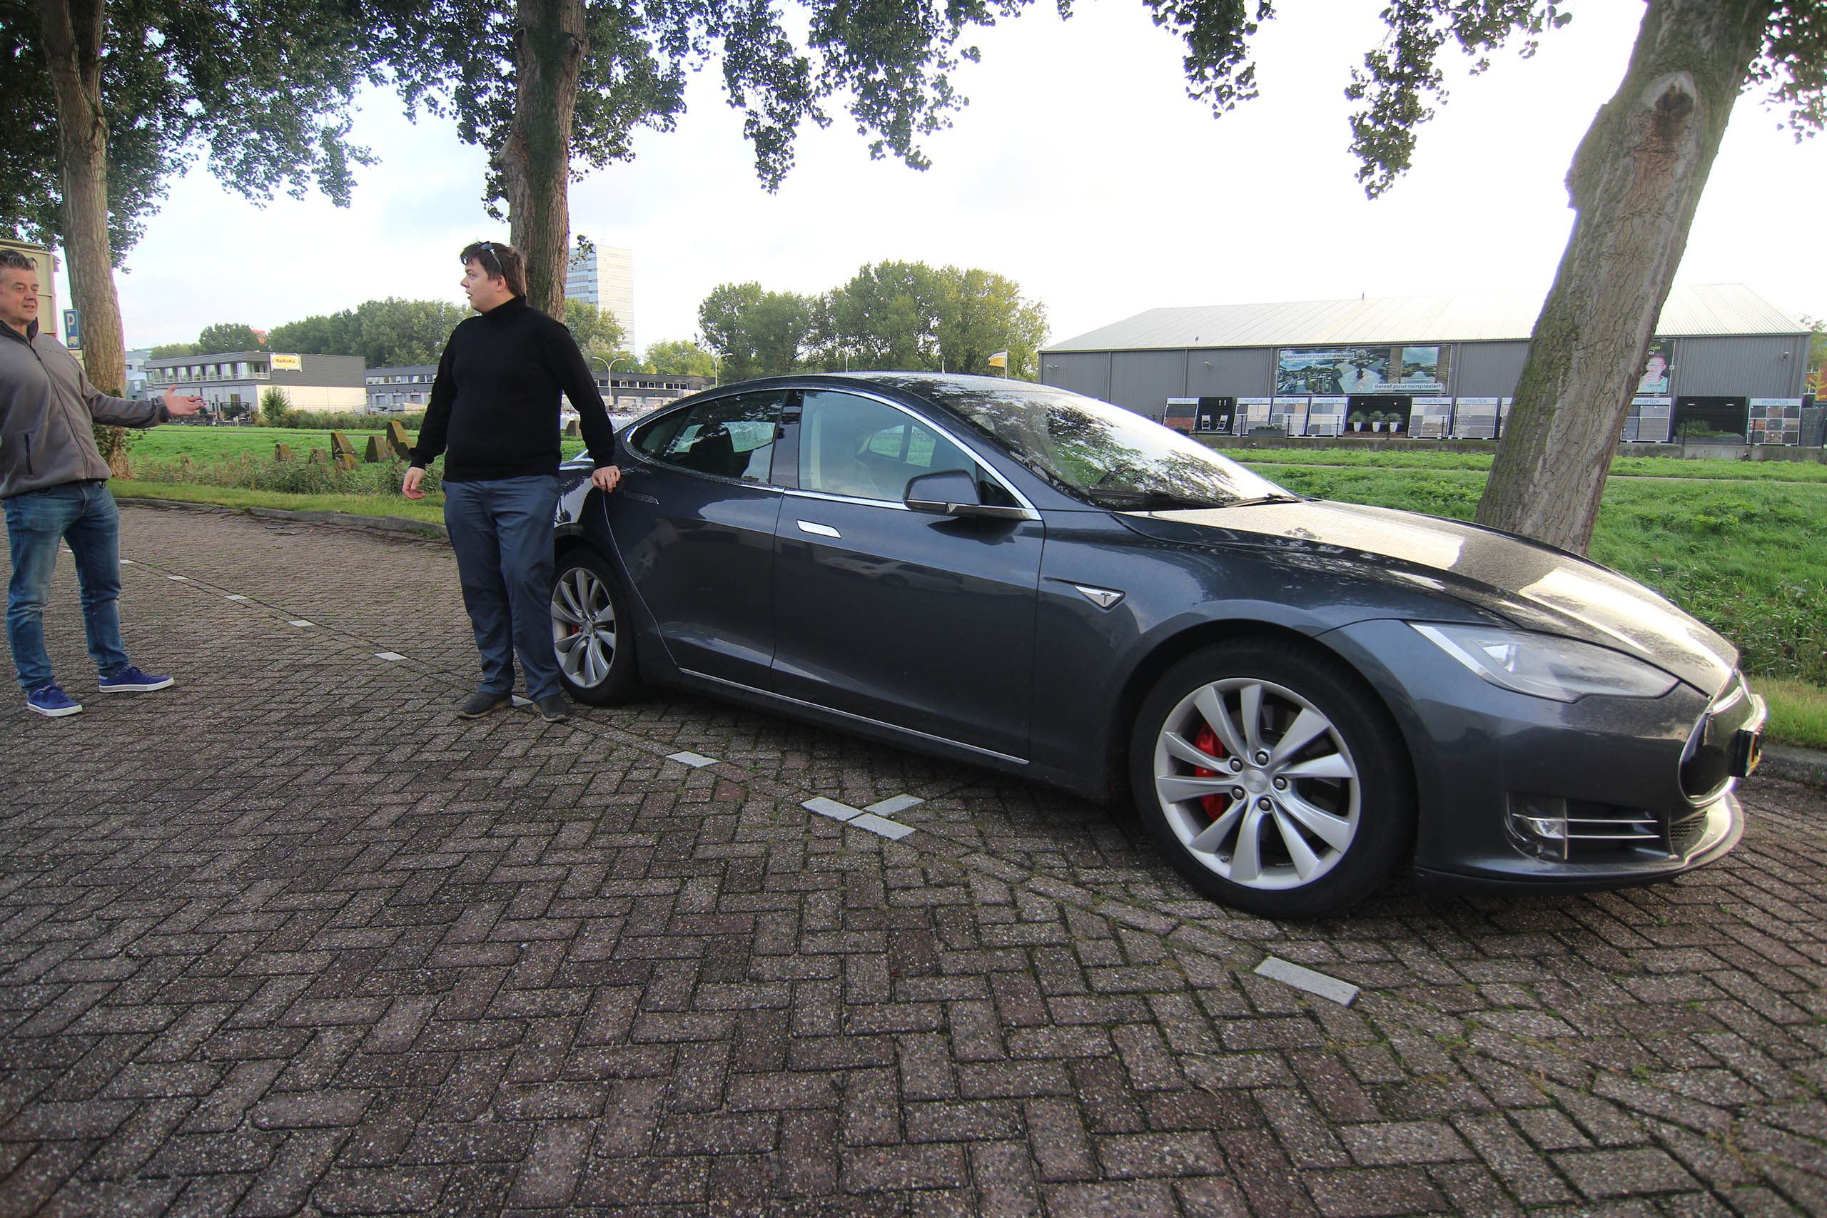

Slide 6
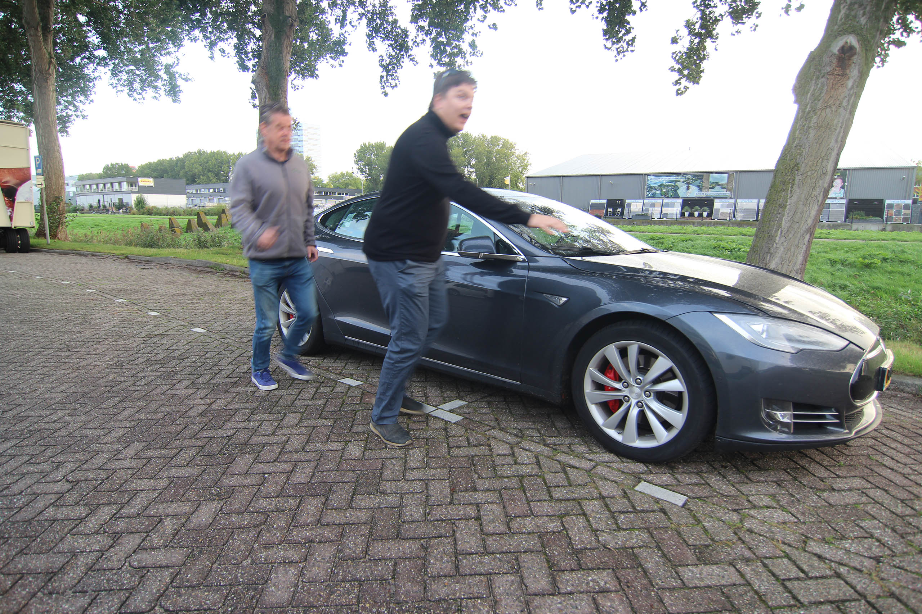

Slide 7
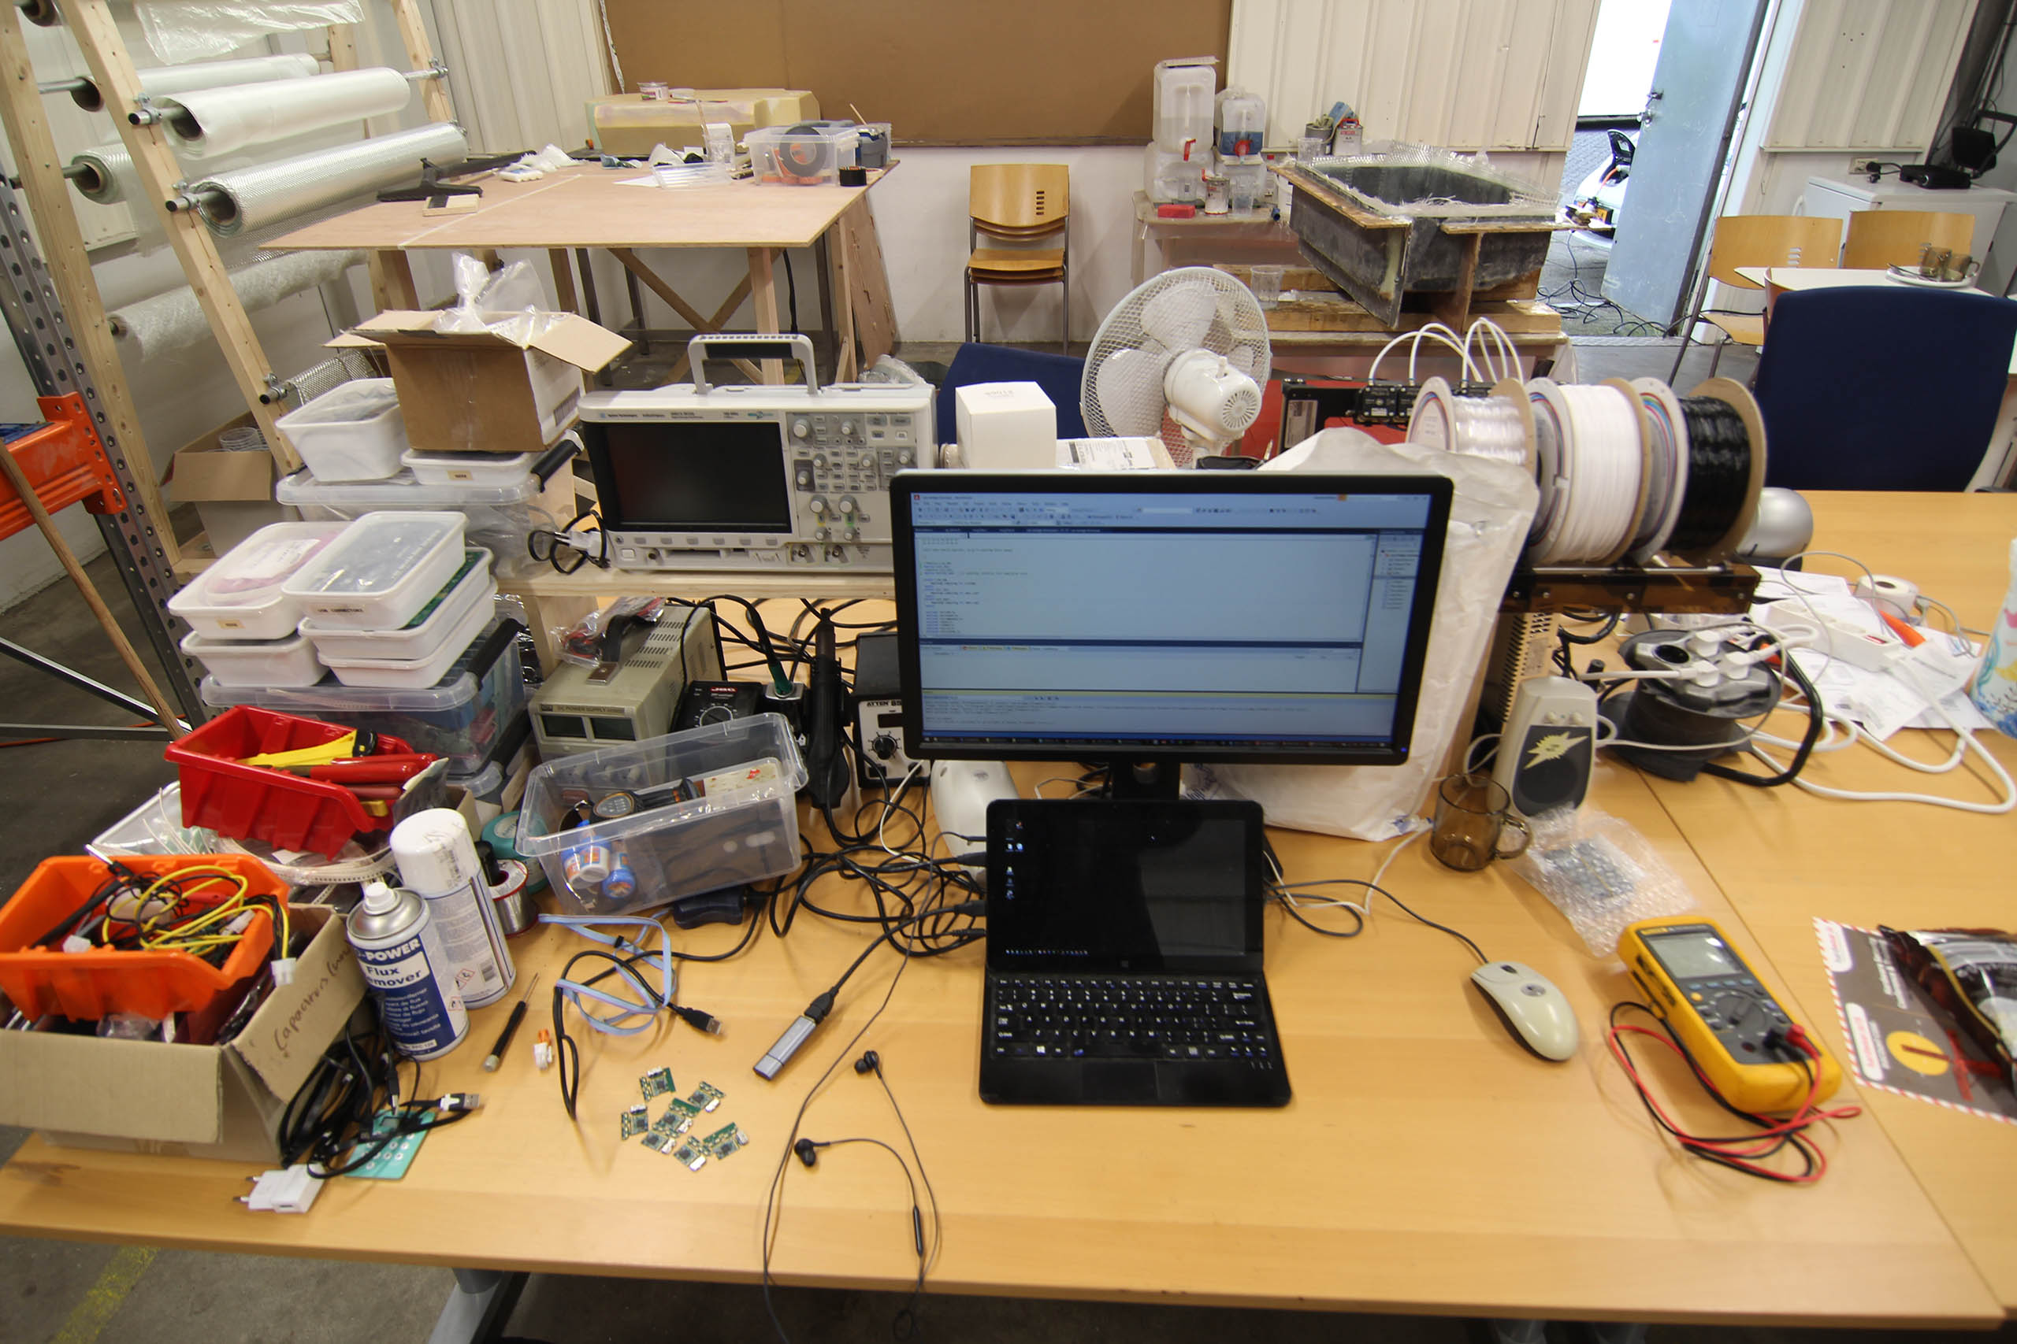
You’re probably an engineer

Slide 8
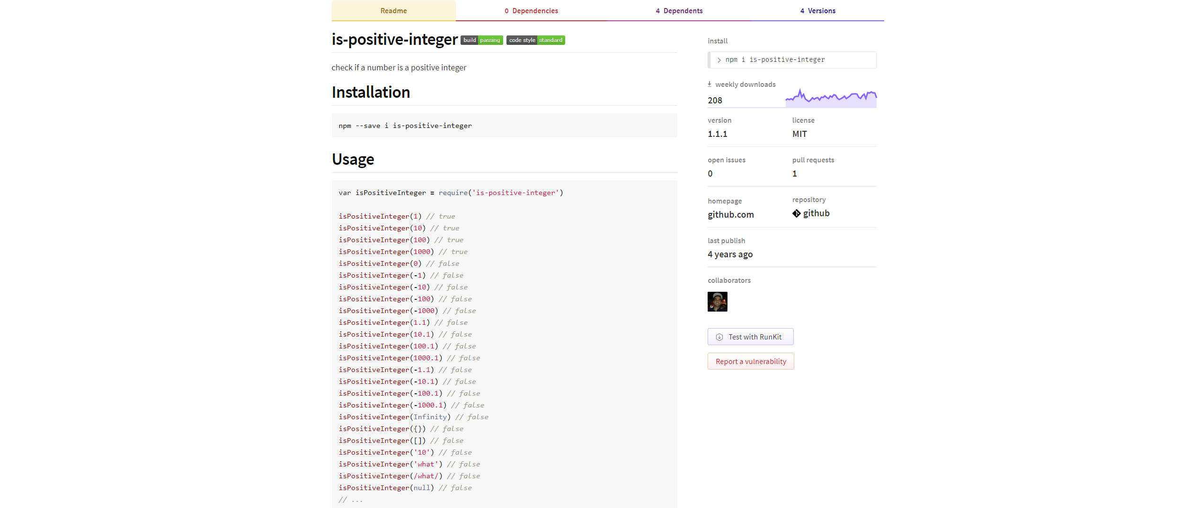

Slide 9
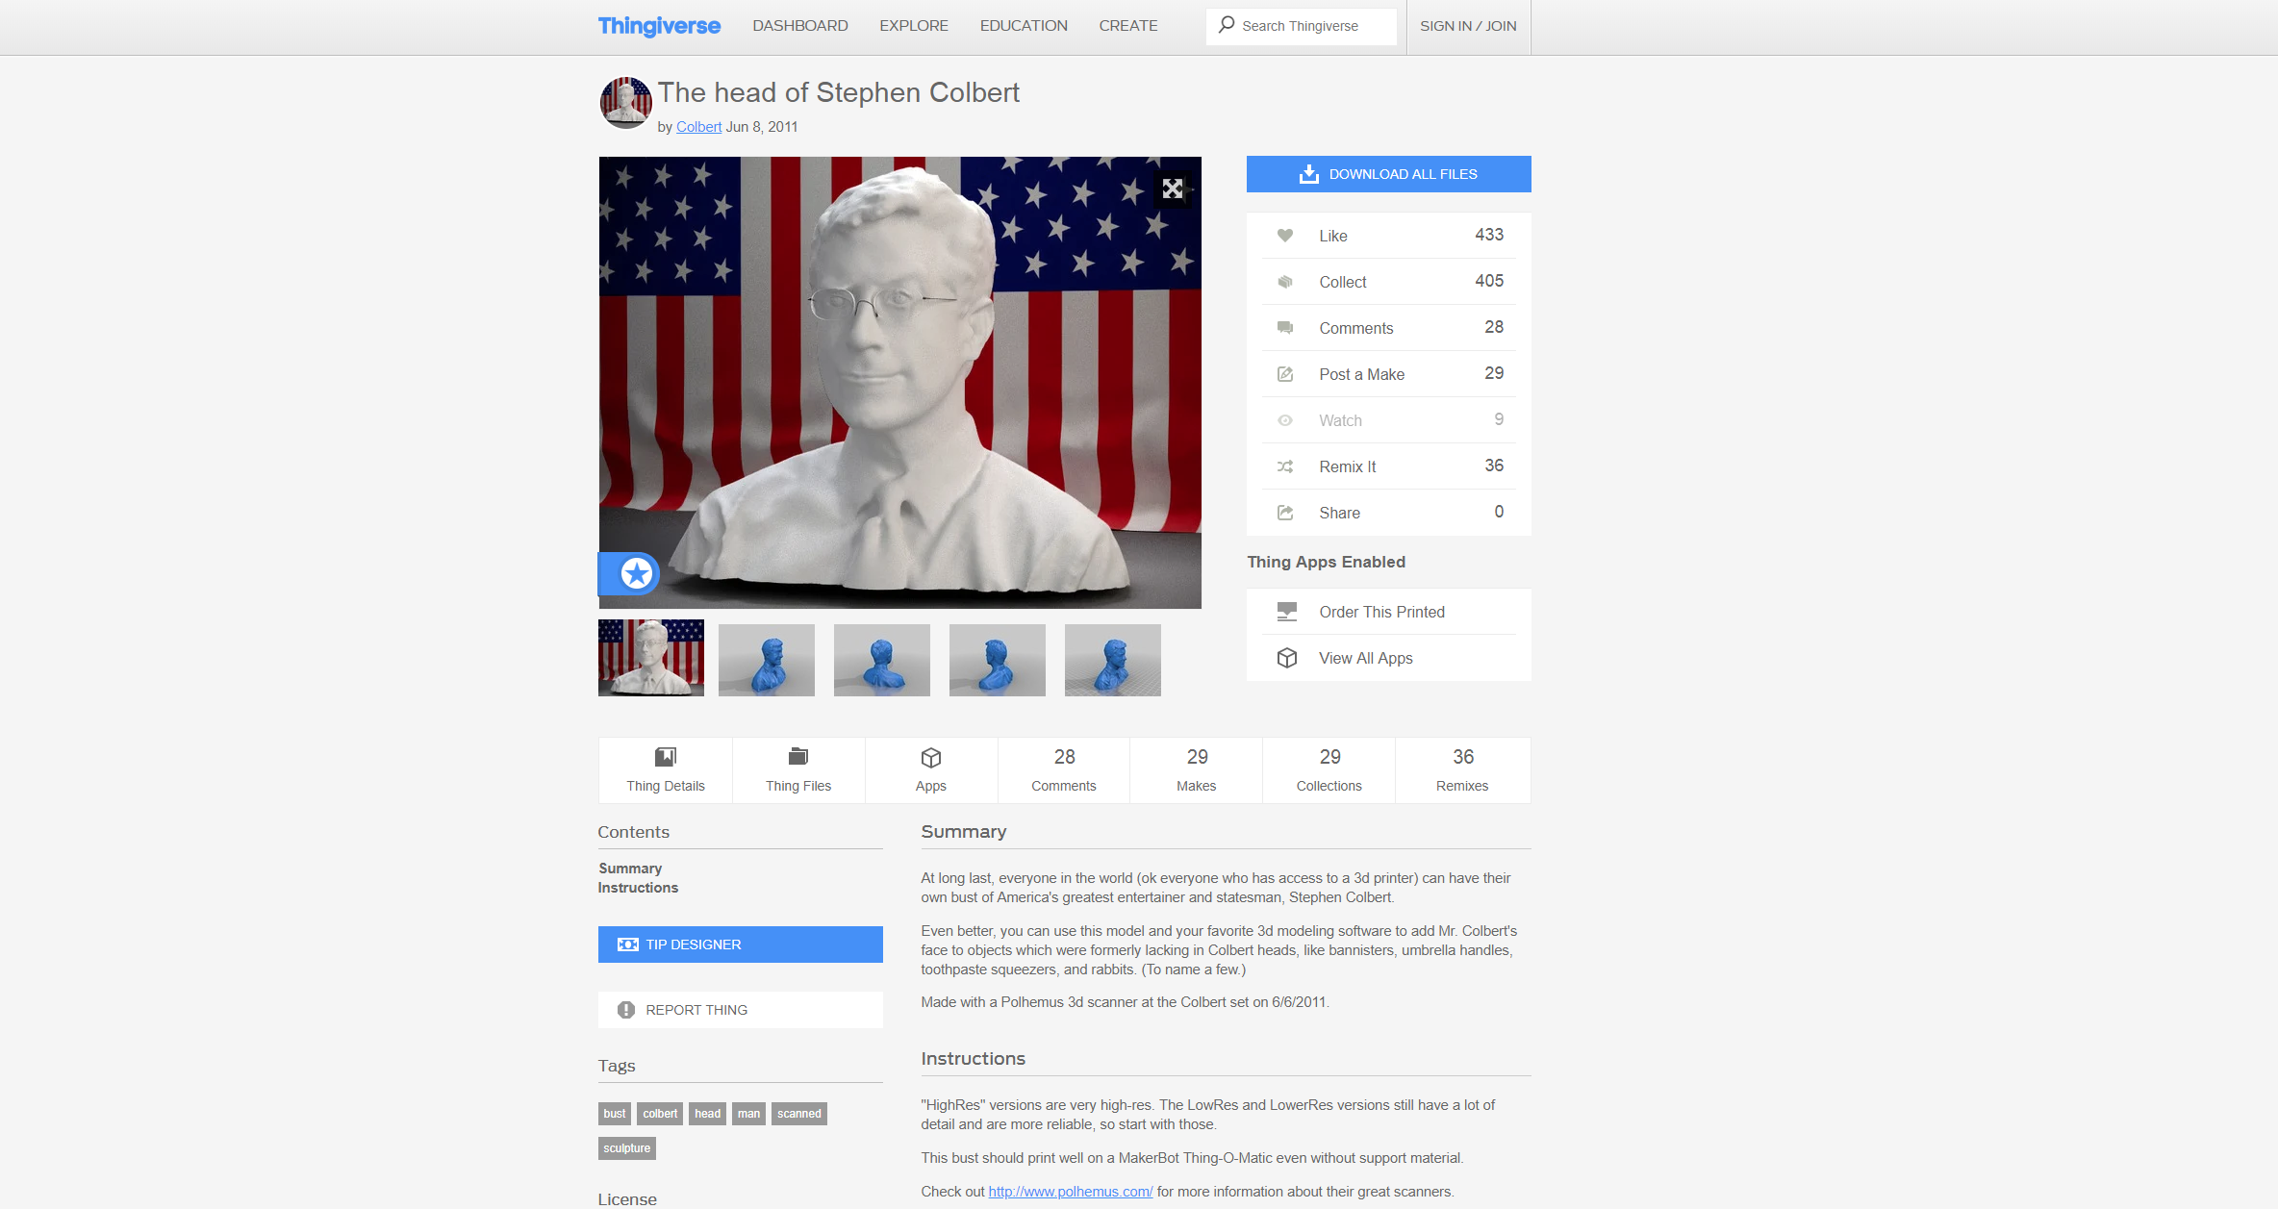

Slide 10
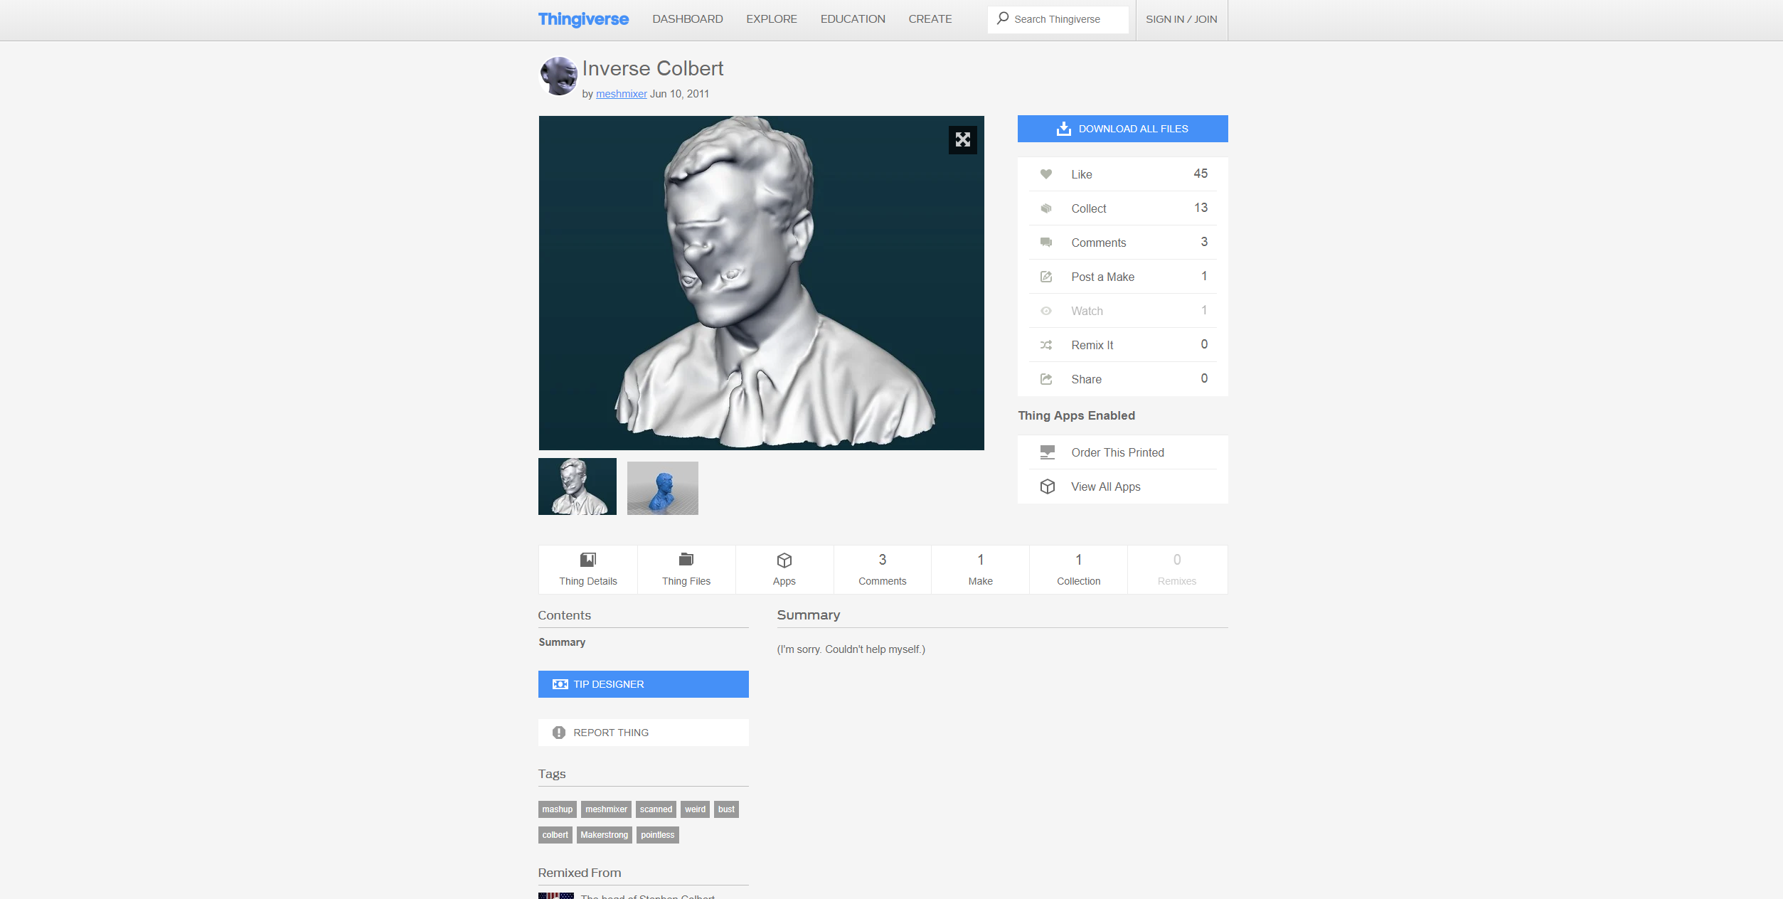

Slide 11
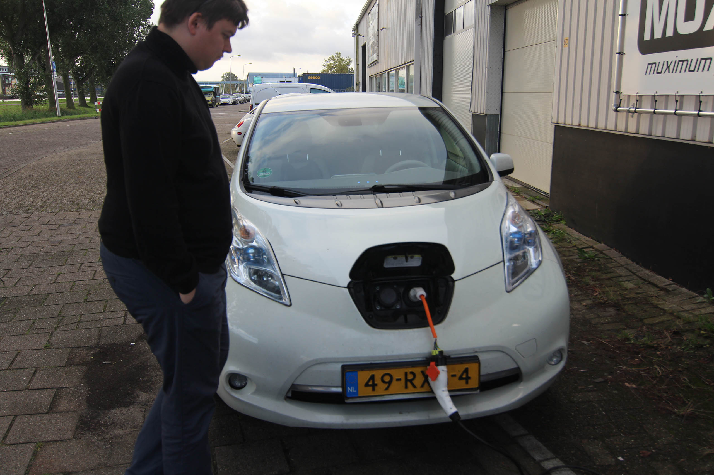

Slide 12
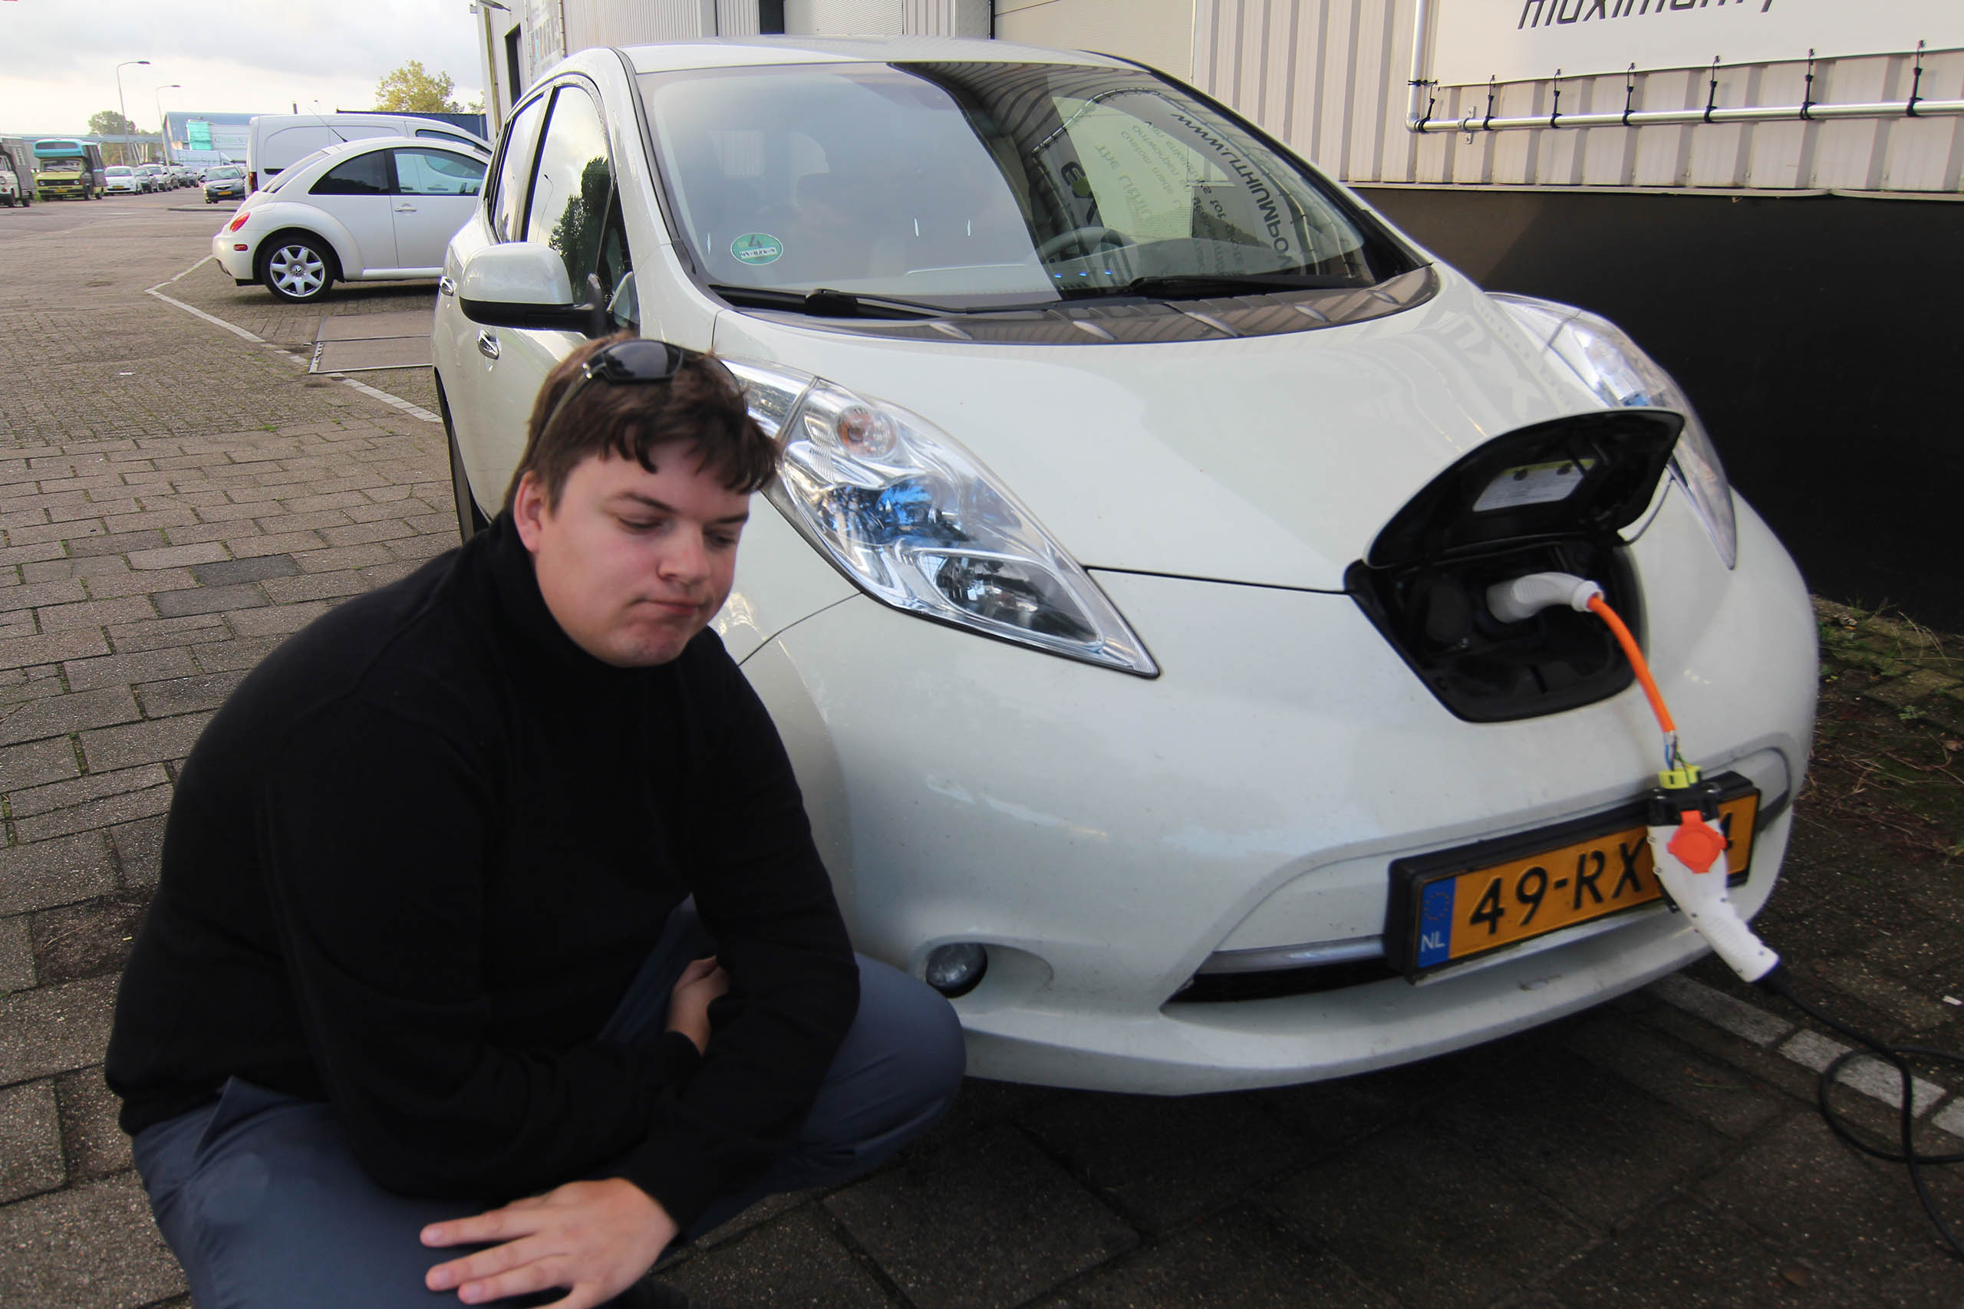

Slide 13
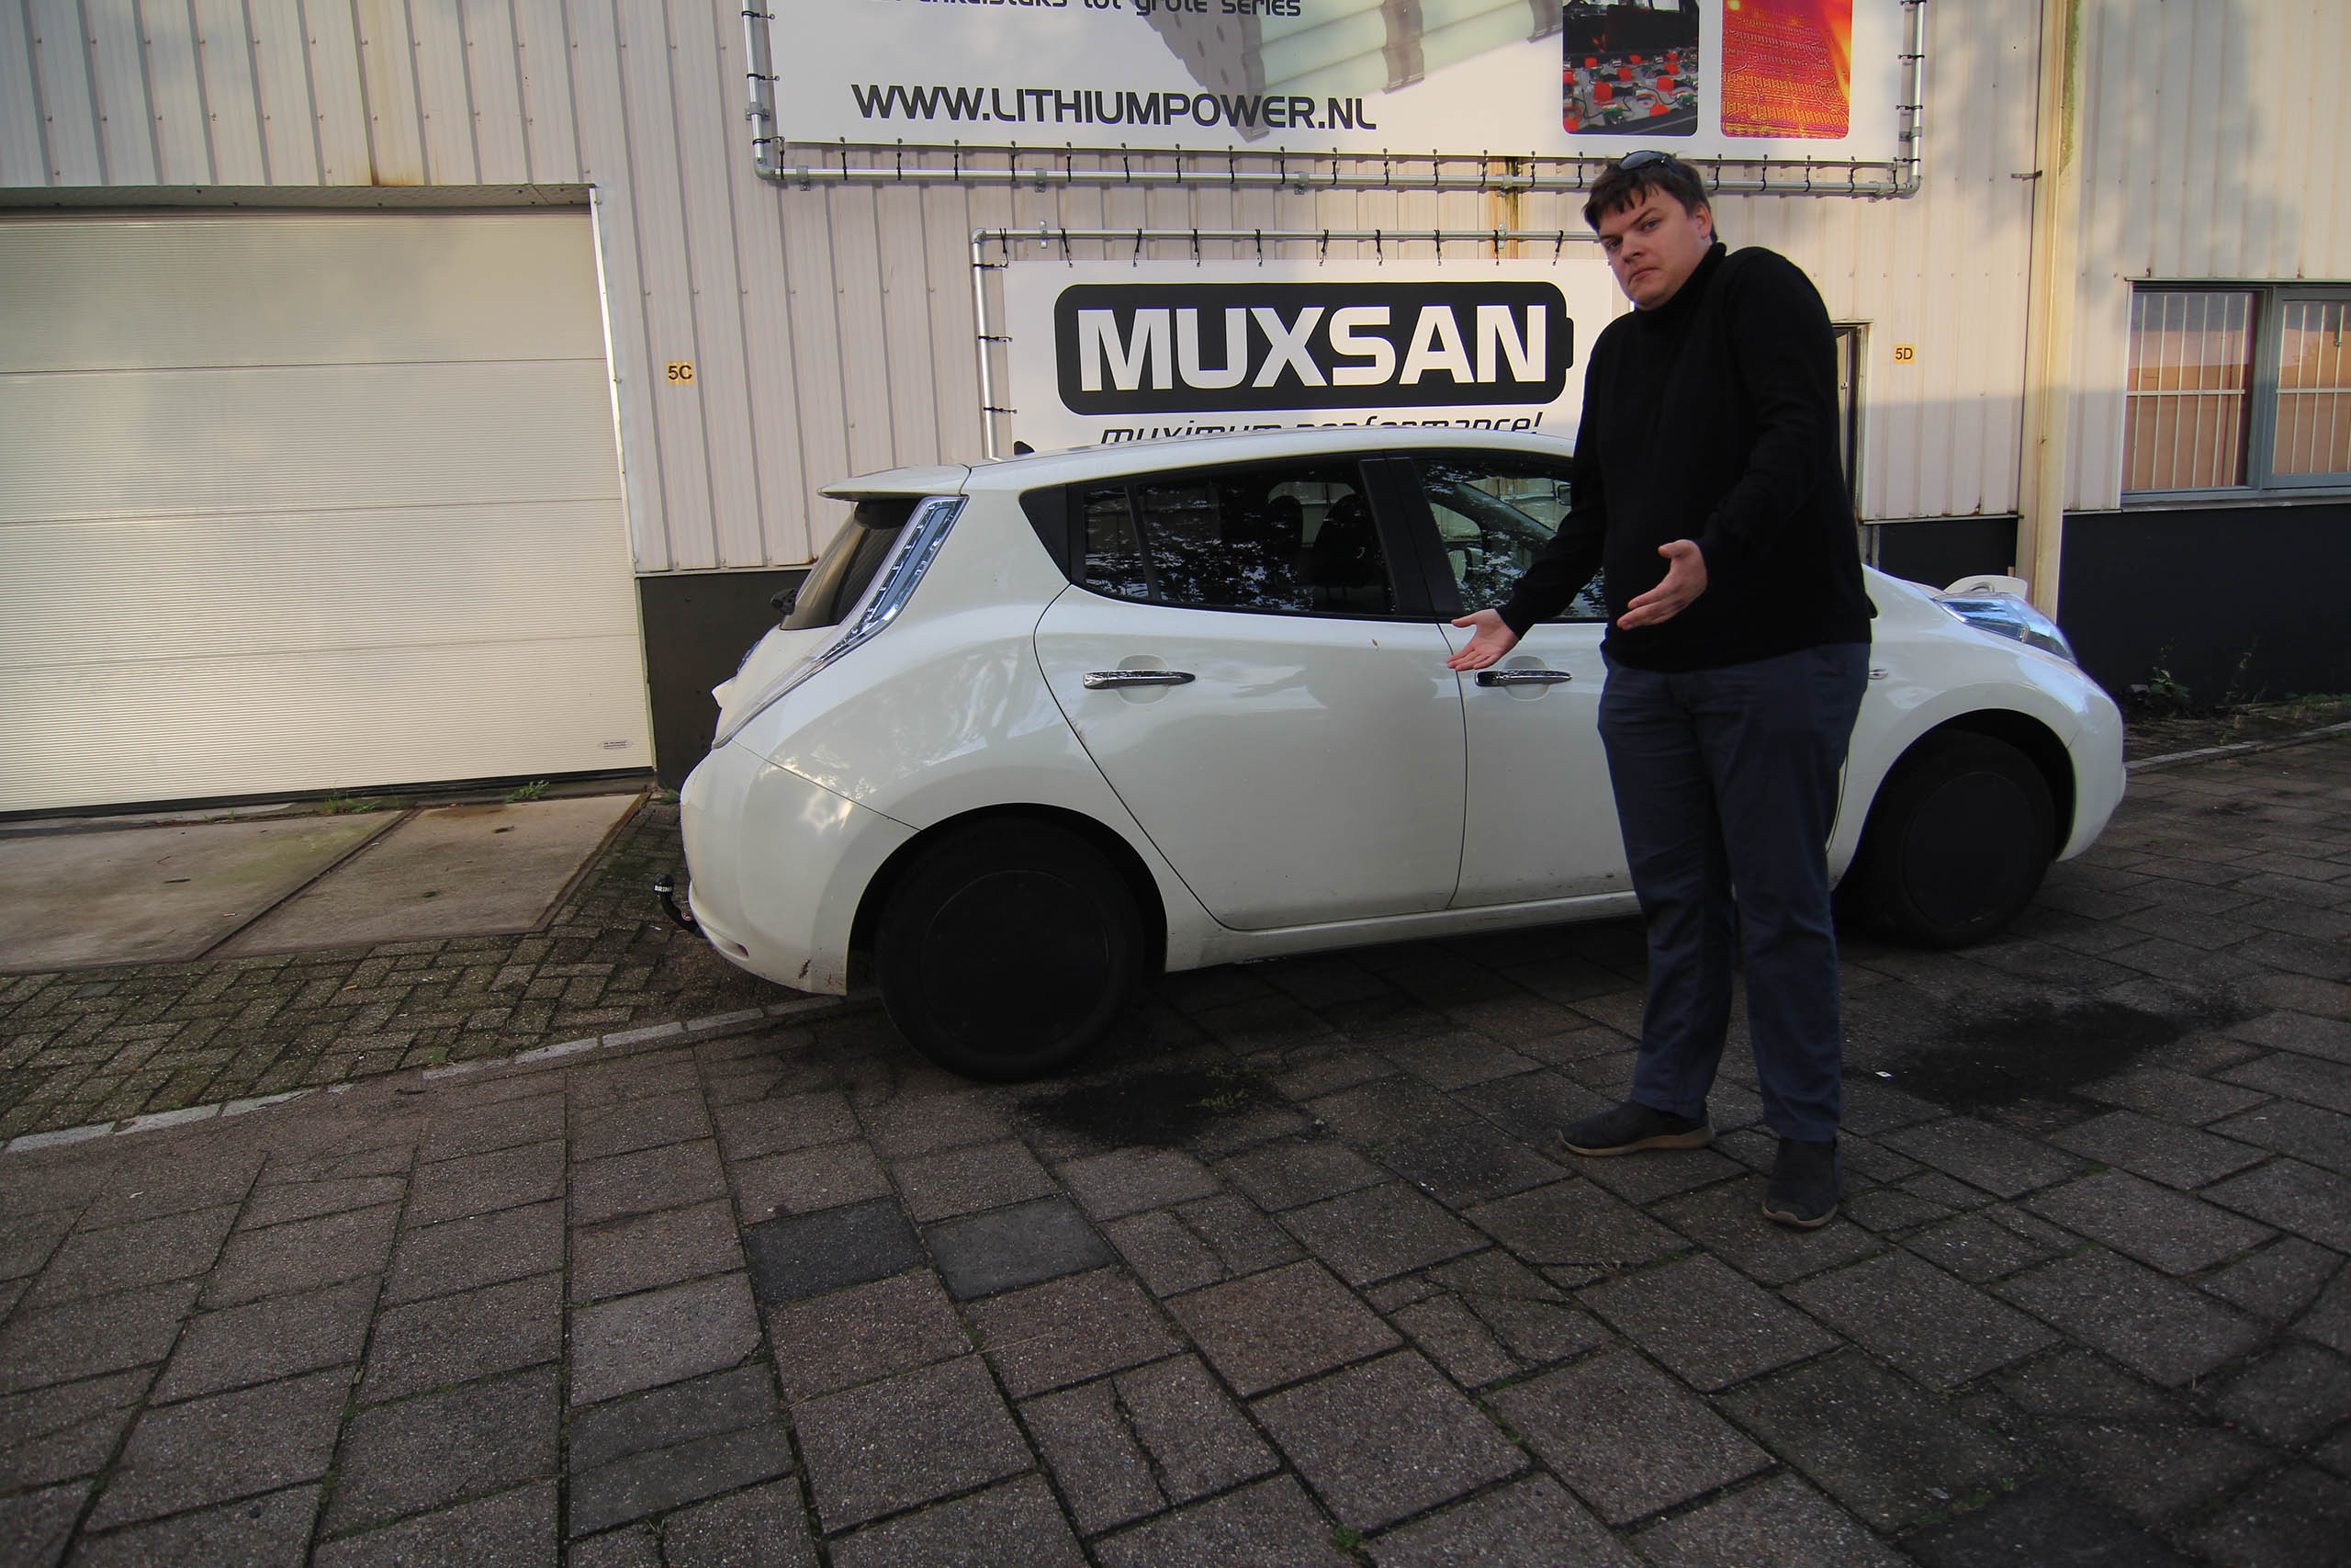

Slide 14
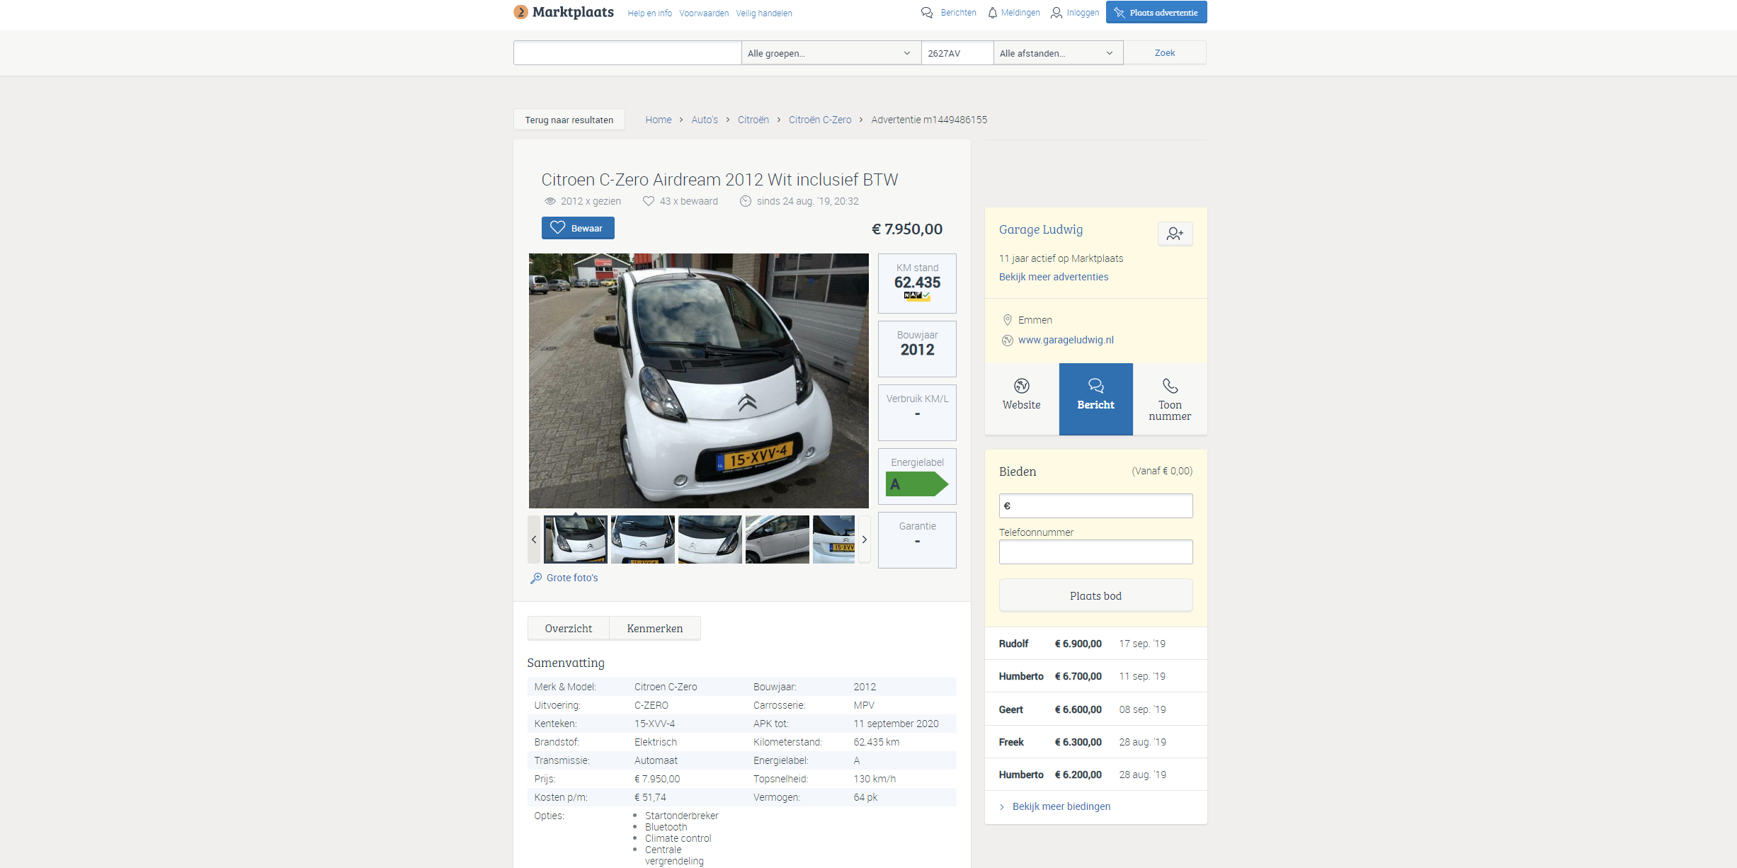

Slide 15
Problems with old electric cars
Limited range
Slow charging
No cool new gadgets

Slide 16
Not solutions
Solutions
Add extra batteries
Increase charging speed
Add cool gadgets
Buying a different car

Slide 17
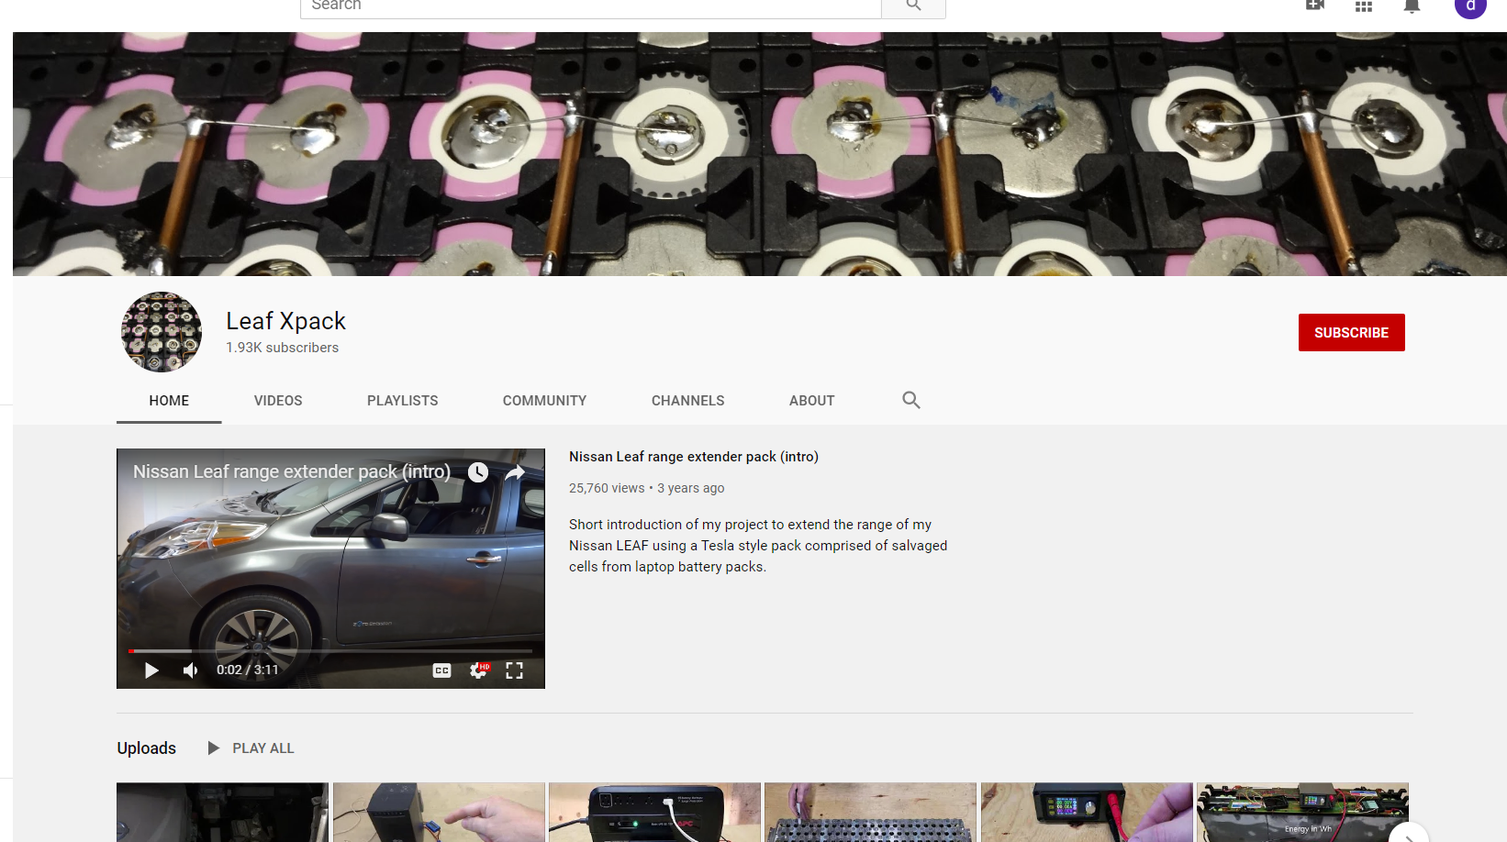
Solutions in practice?

Slide 18
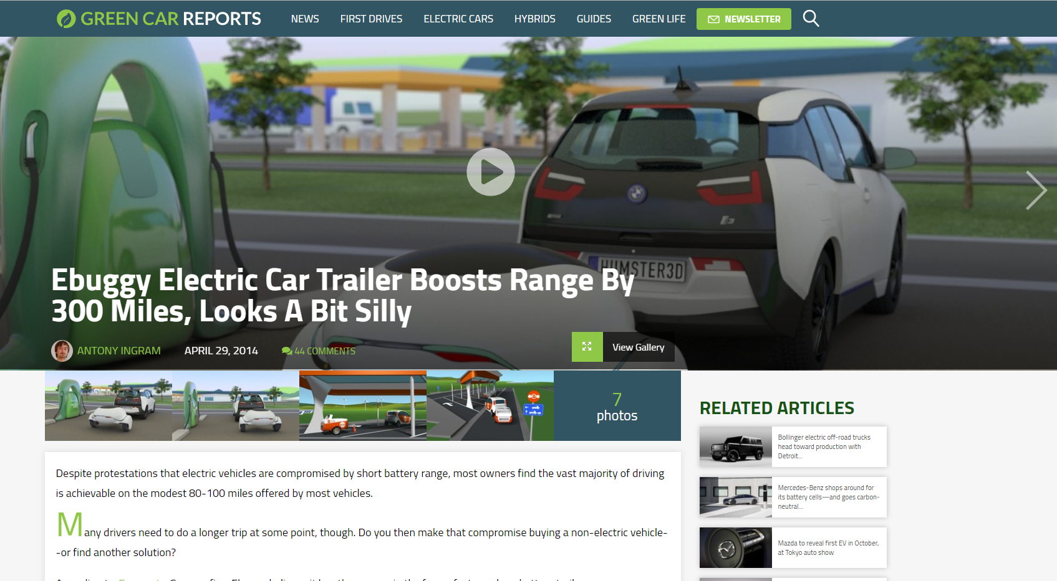

Slide 19
So you say it’s possible?

Slide 20
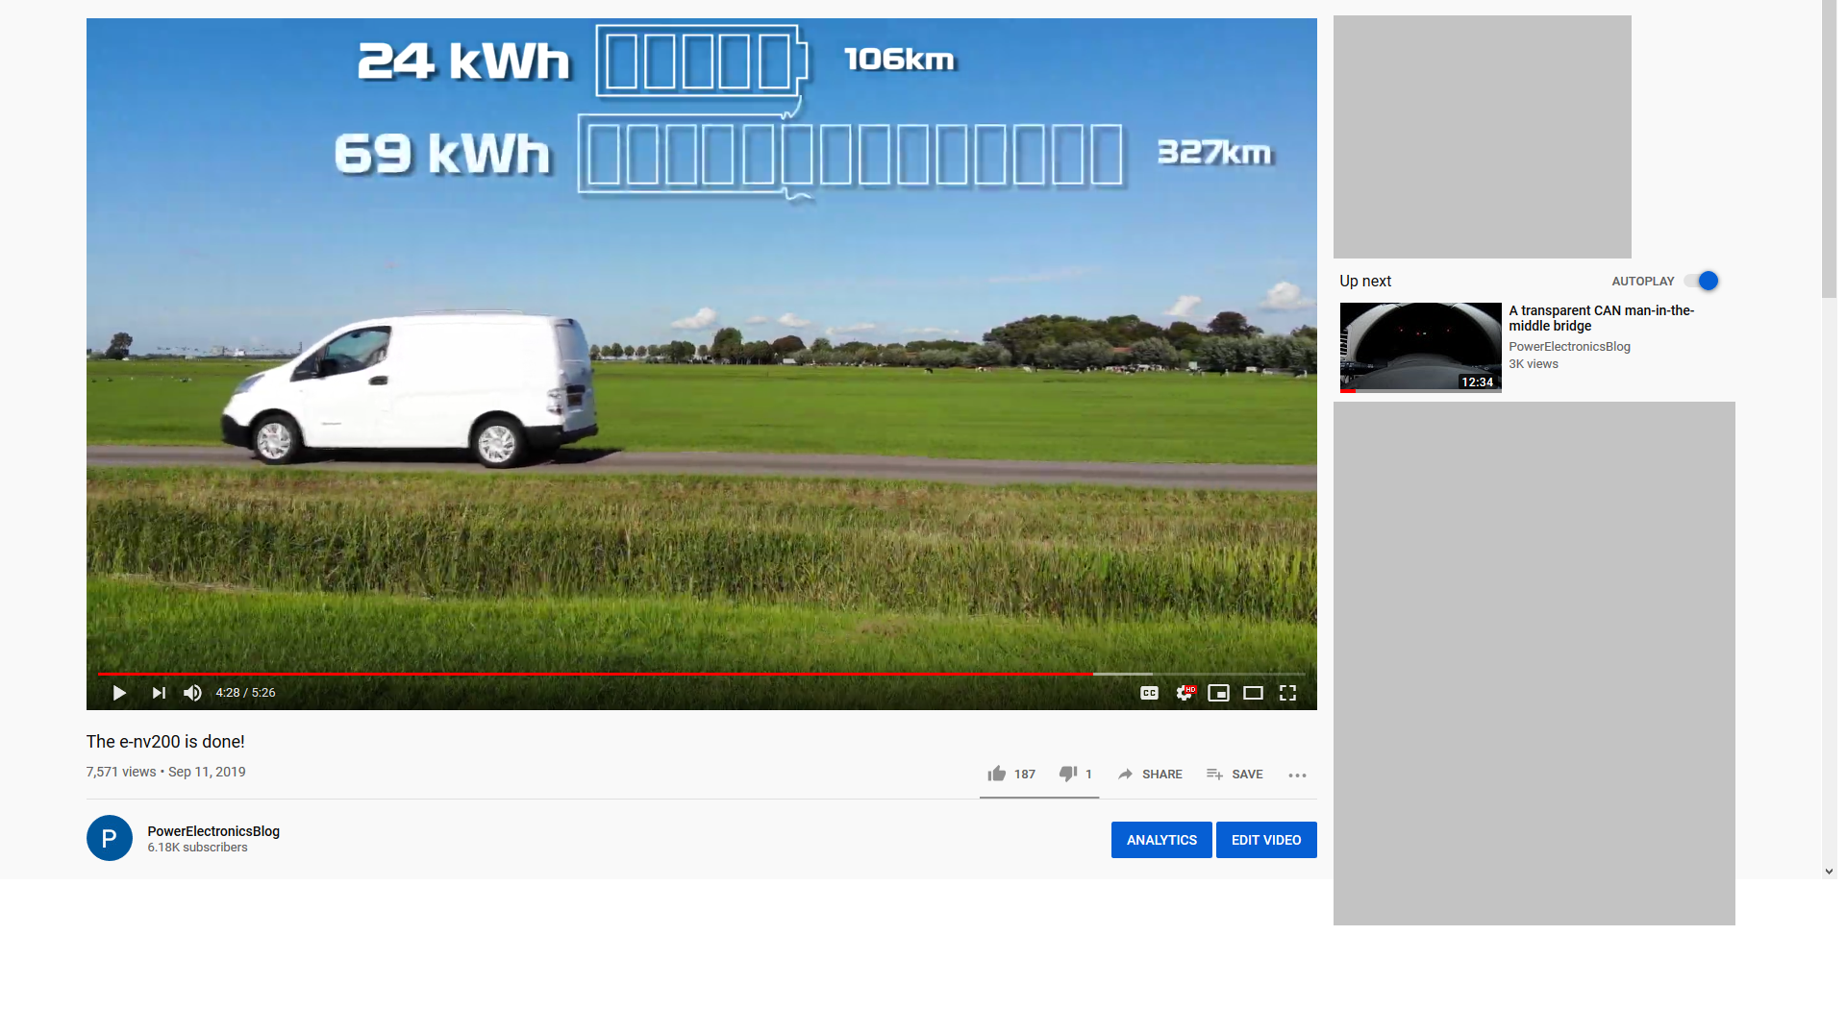
Commercial incentives push projects to completion

Slide 21
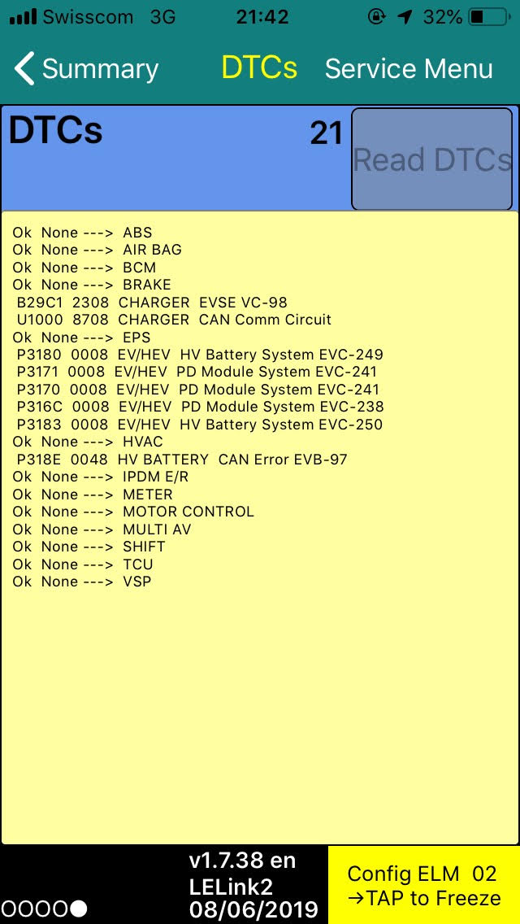
Why?

Slide 23
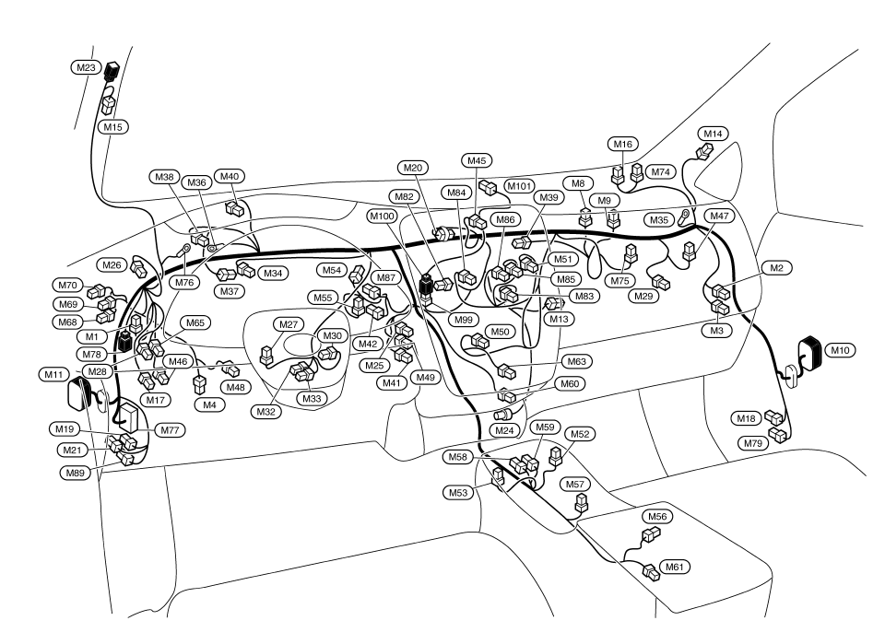

Slide 24
CAN-bus 101
Two-wire differential bus
All devices share the bus
Extremely rugged
Differential signalling over twisted pair
Built-in CRC
Bit-stuffing
Automatic retransmit
Bus-off/passive modes for startup
Fairly slow, up to ~1Mbit/s

Slide 25
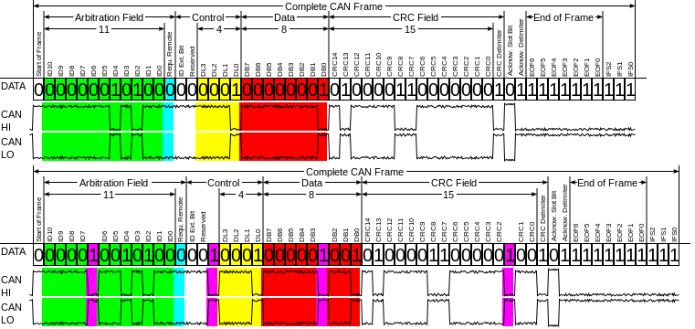
But CAN is also very simple
ID
(11 or 29 bits)
Data
(1-8 bytes)

Slide 26
Consequences of CAN
Bus is shared
> no directionality (everybody can be bus master)
> nodes have to wait for others to stop talking
> no definite timing or ordering
Messages are short
> you have to be thrifty with your messages
> no real opportunity for encryption or handshaking

Slide 27
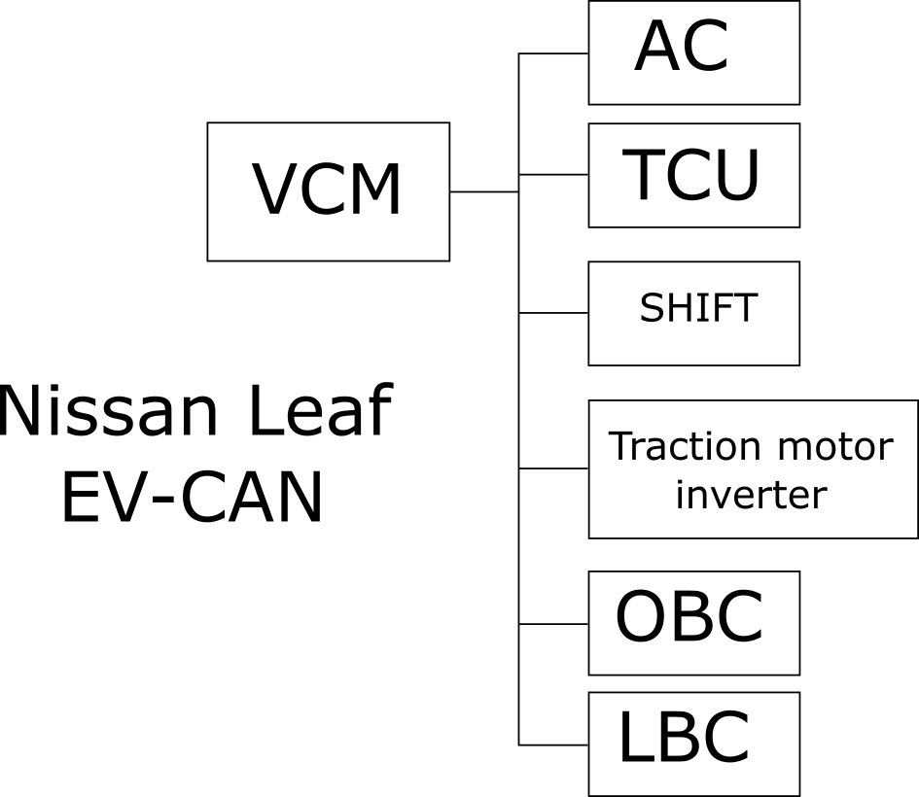

Slide 28
Electron/brake pedal?

Slide 29
Electron/brake pedal

Slide 30
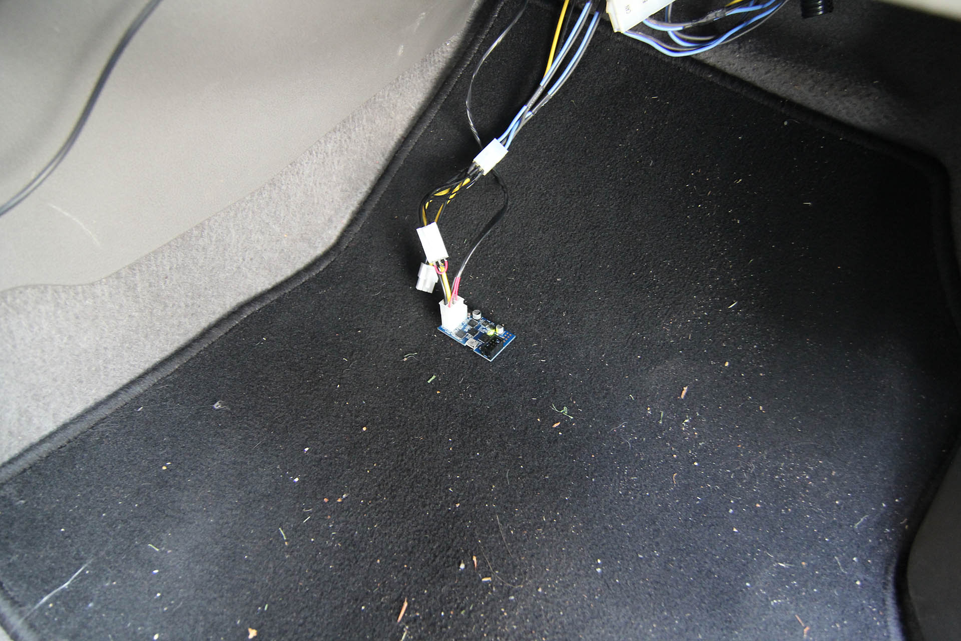

Slide 31
MITM here

Slide 32
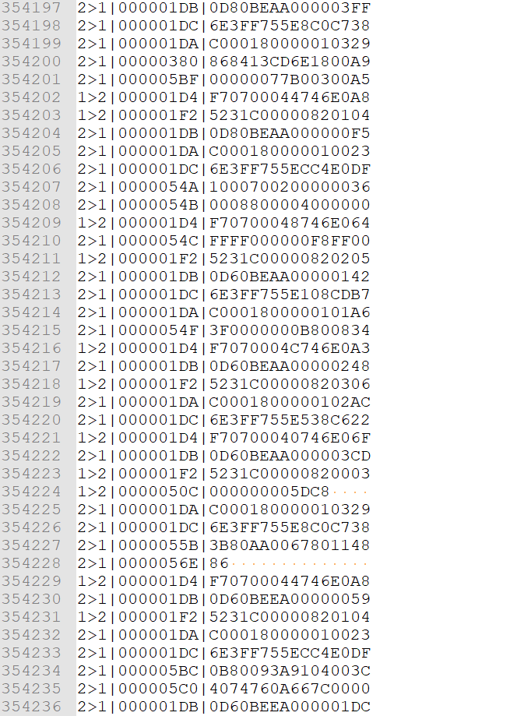

Slide 33
First column shows direction of messages

Slide 34
Second column shows ID

Slide 35
Third column shows data

Slide 36
So, we’re interested in motor control messages
Gotta be pretty frequent
Have to go from VCM to inverter
Plausible motor control data?

Slide 37
The 1>2 direction comes from the VCM
(this is how I wired it up)
So forget about all 2>1 messages

Slide 38
Hey, there are only three Ids
Two of which happen frequently: 1D4 and 1F2

Slide 39
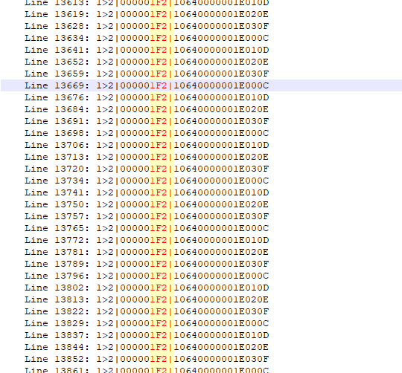
Do a trace while driving
1F2 doesn’t do squat while driving. So motor control message has to be 1D4

Slide 40
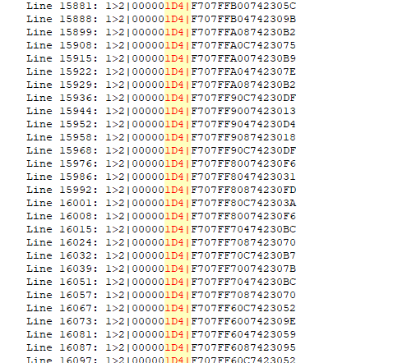
1D4 trace
Byte 0,1,4[3:0],5,6 are static

Slide 41
1D4 trace
Last byte varies WILDLY

Slide 42
1D4 trace
CRC!
Why? CAN has a CRC built in. This is a waste of a valuable byte!

Slide 43
1D4 trace
Around Byte 4 is periodic

Slide 44
1D4 trace
This HAS to be the motor control word

Slide 45
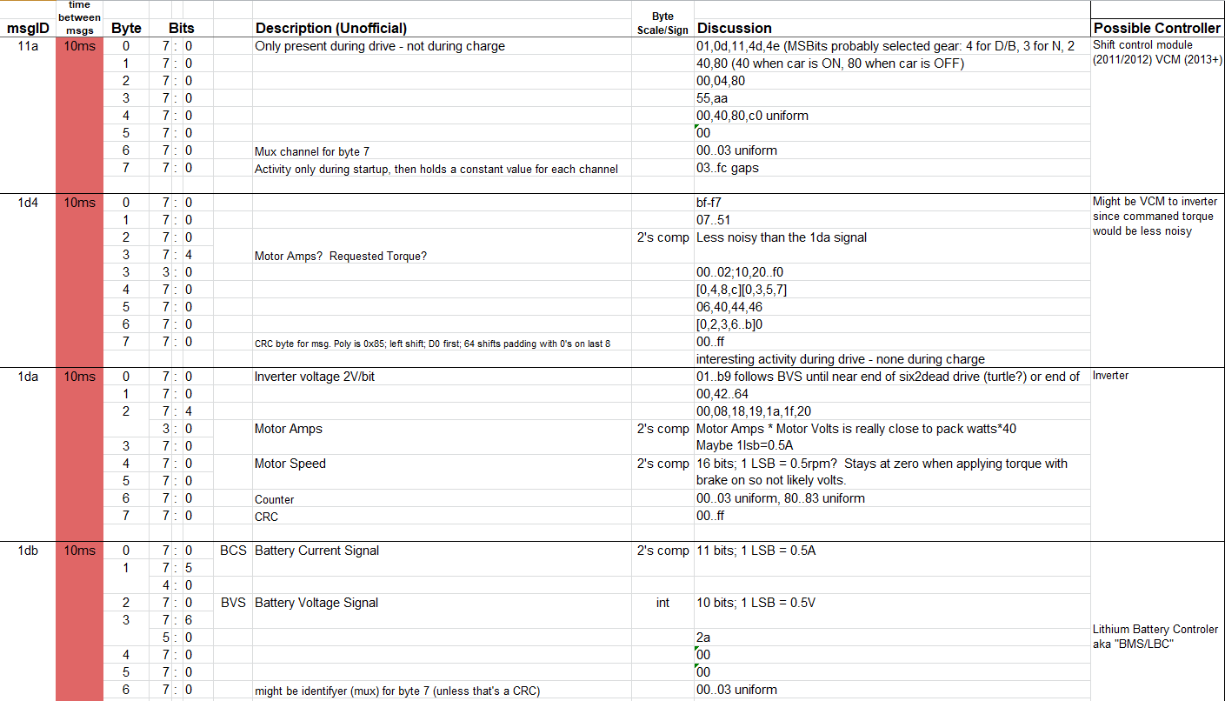

Slide 46
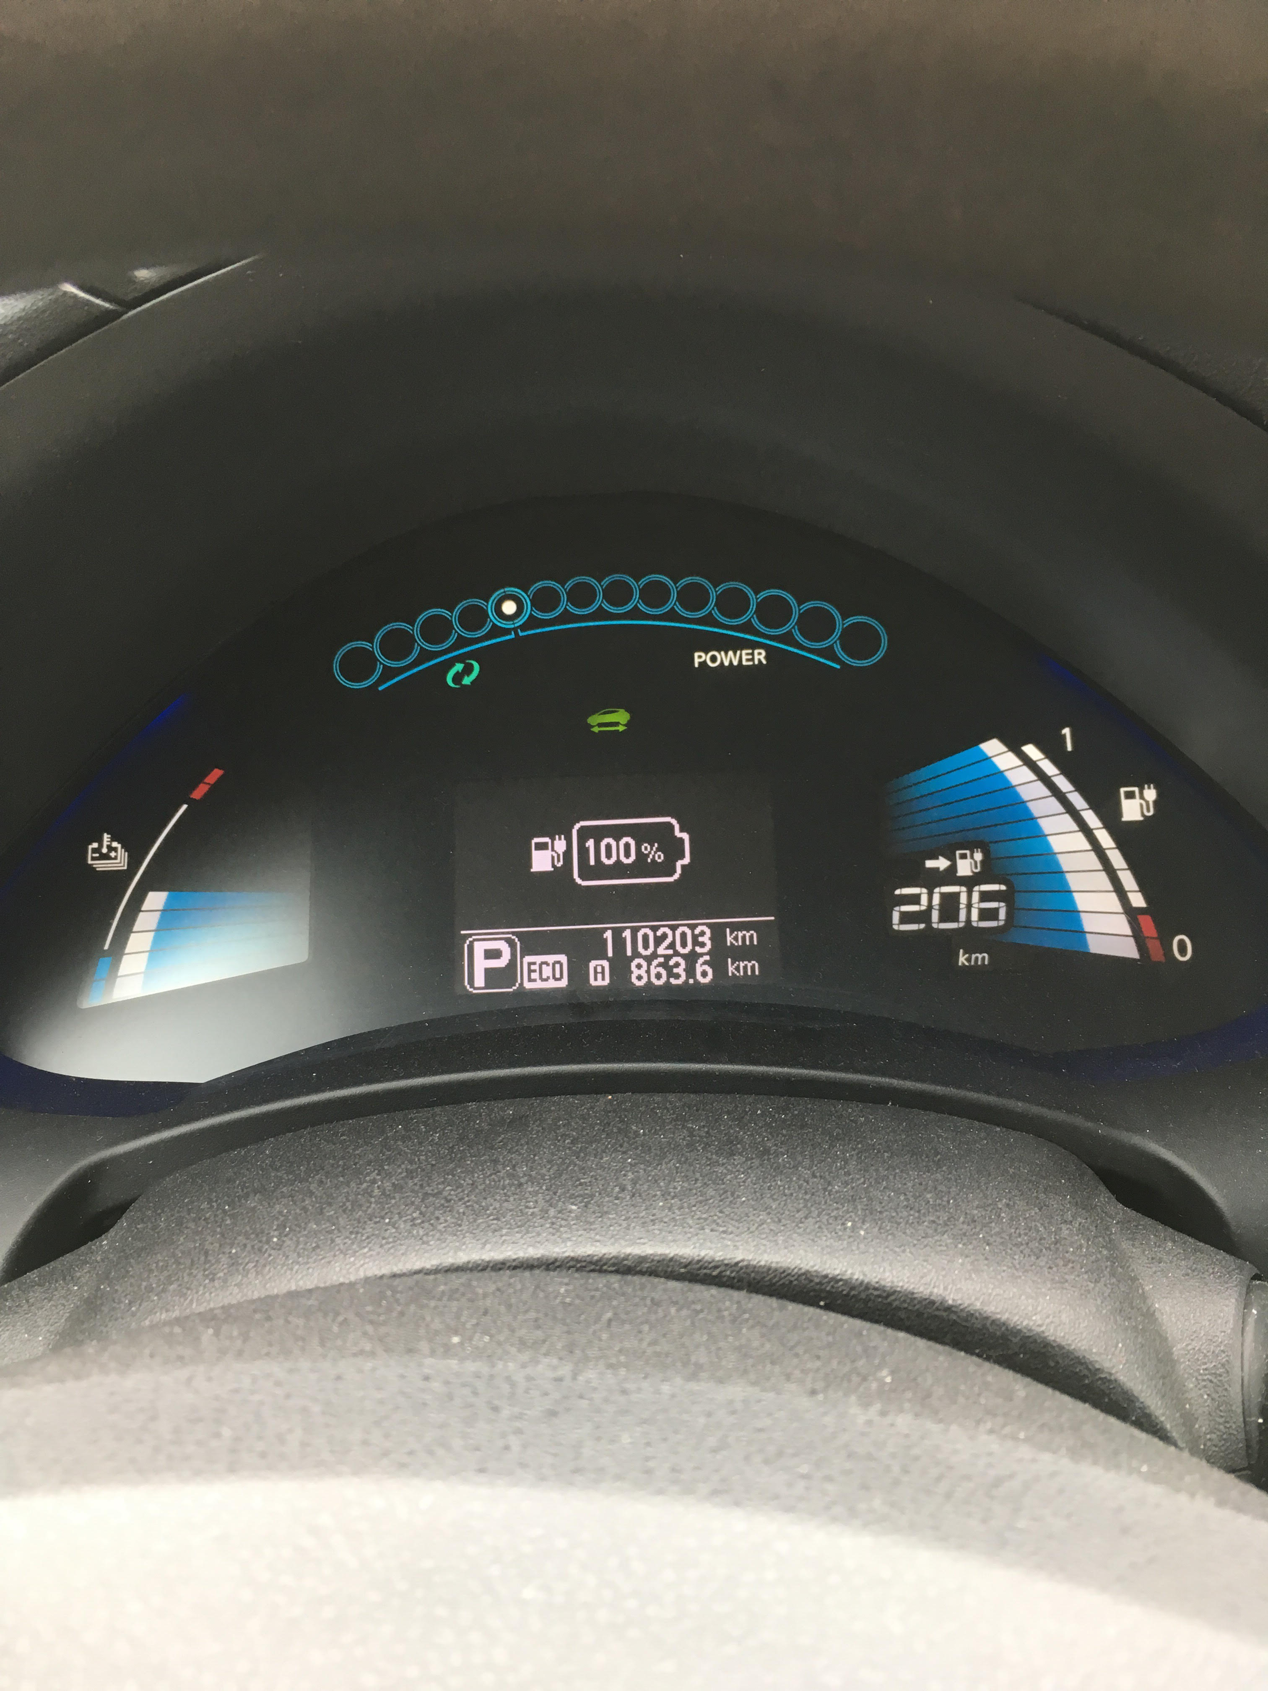
Increase reported battery capacity
By modifying CAN message 5bc byte 0-1[7:6]

Slide 47
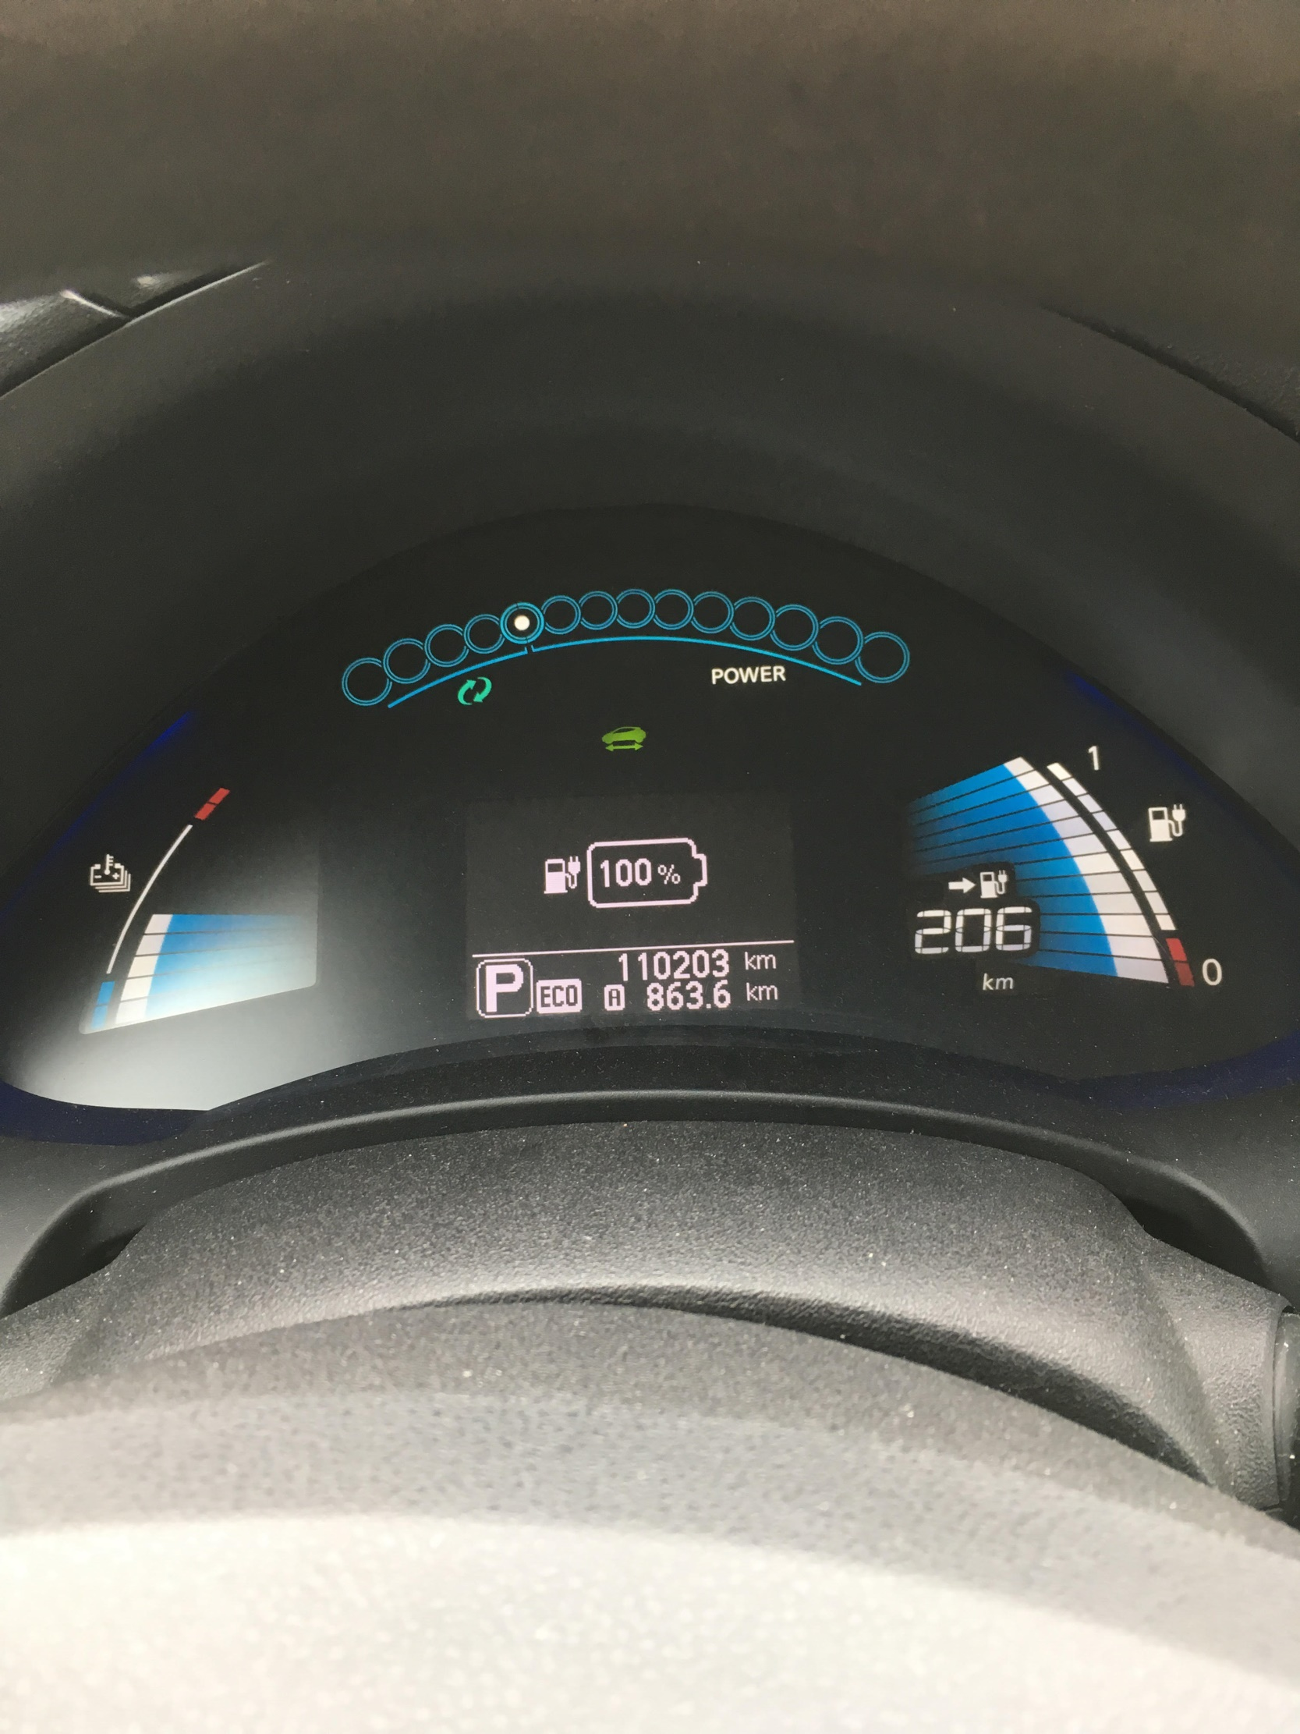
Increase regenerative braking

Slide 48
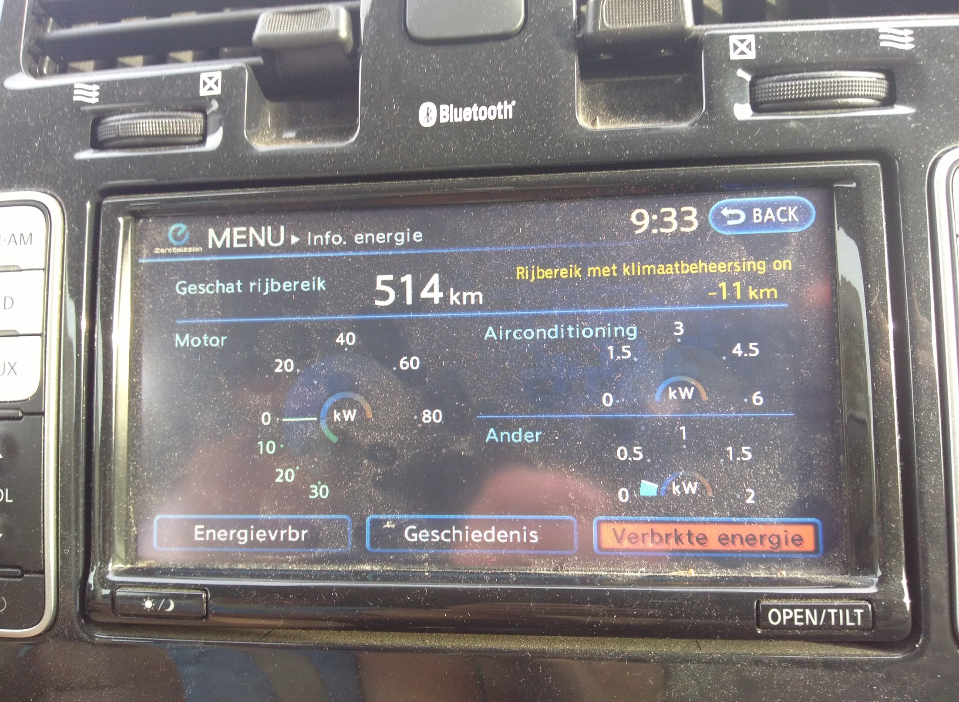
Give an 8 year old leaf the range of a Tesla Model 3

Slide 49
If there’s still time: TCU

Slide 50
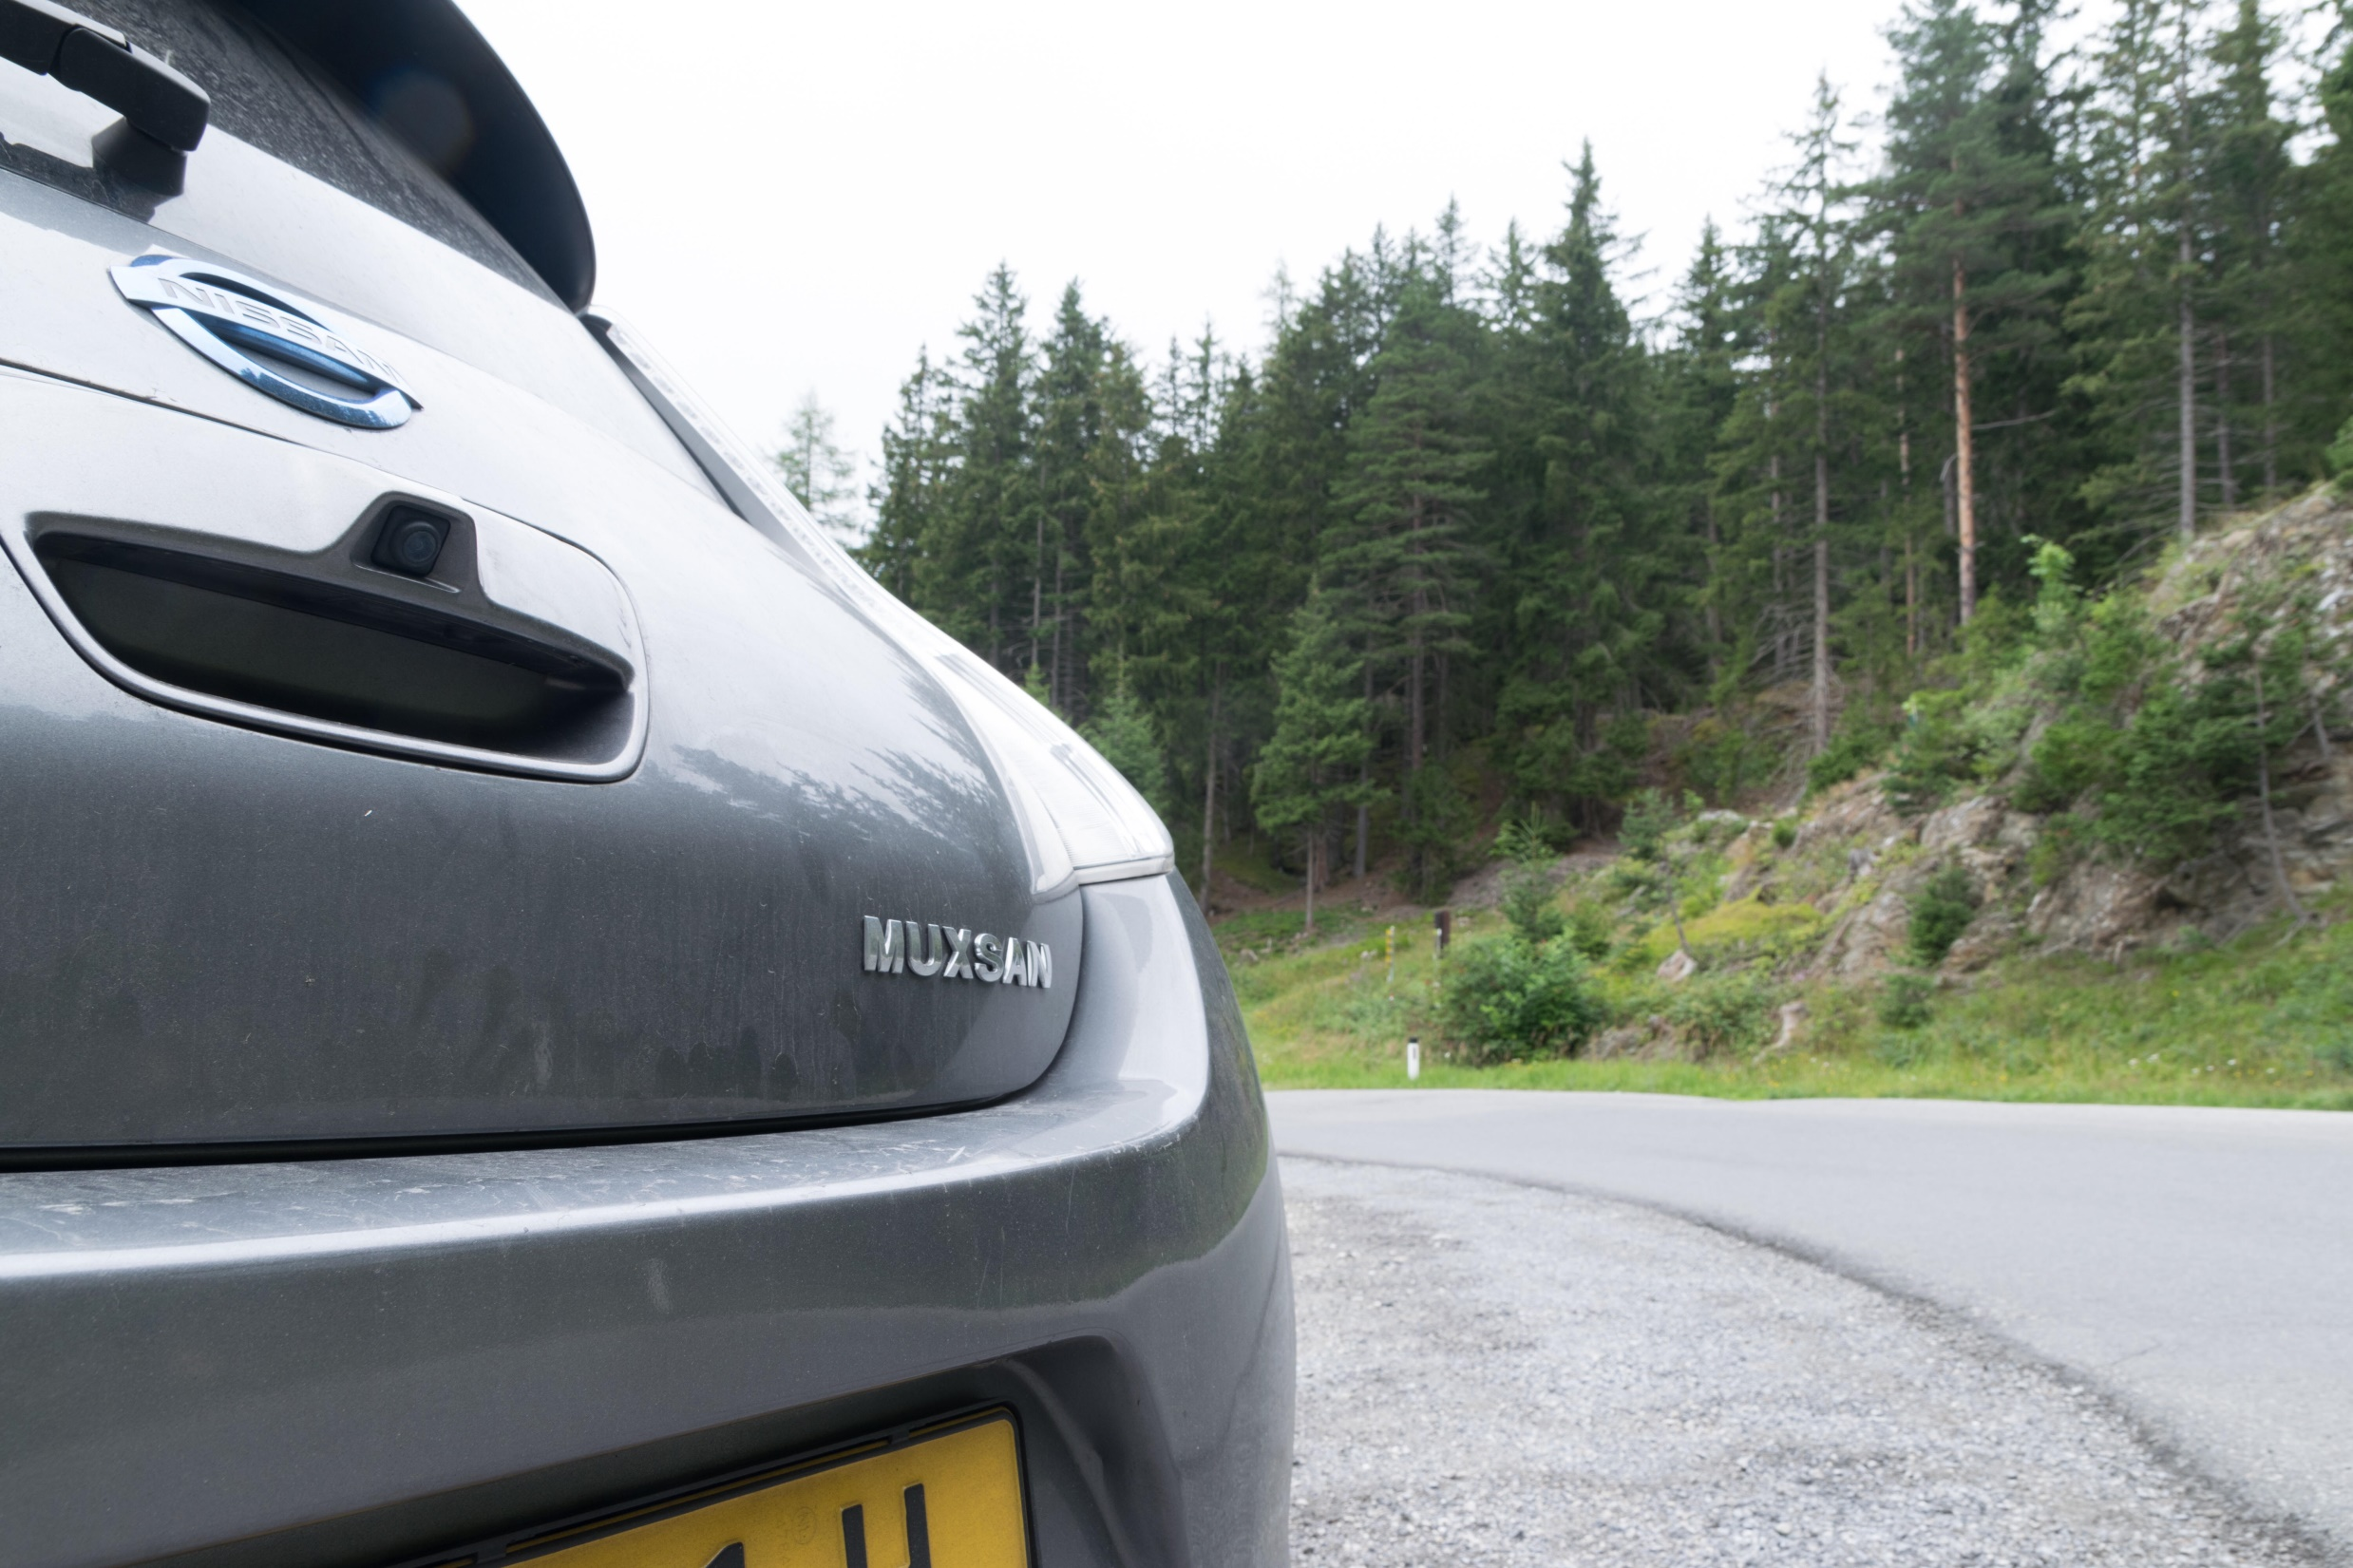
MITM is not just a security issue

