Slide 1
Black Box Debugging of Embedded Systems

Slide 2
Introduction: Alexandru Ariciu
Background in hacking
“Worked” as a hacker for my whole life
Worked in corporate security before (Pentester)
Currently an ICS Penetration Tester / Vulnerability Researcher for Applied Risk
Linkedin: https://www.linkedin.com/in/alexandru-ariciu-856bb566
Twitter: @1n598

Slide 3
Target Device
Data acquisition and transmission device
Used in distributed control systems
Over 300 directly connected to the internet.
More connected internally, mostly in level 0 and level 1 SCADA networks
Prerequisites
ARM knowledge
Reverse engineering
Some hardware hacking (we will cover that part)

Slide 4
Goal
Provide a means to develop additional advanced functionality to this device; such as execution of arbitrary code
By means of:
Injecting the device with modified firmware, to enable debugging on the device, and step trough custom code without bricking the device
Complication:
There is no datasheet of the chip available, firmware is proprietary

Slide 5
ARM crash course
ARM is a 32 bit RISC processor
Processor is little endian
Opcodes are 32bit, and align on a 4 byte boundary
All code, data and peripherals share the same 32 bit memory address space
After a (re)boot code starts running from 0x00000000
ARM has 16 32-bit base registers and a CPSR (current program status register)
Most opcodes can be modified by condition fields
A 3 stage pipeline is used, so PC is 2 instructions (8 bytes) ahead of the currently executed instruction
A branch flushes the pipeline

Slide 6
Used ARM Instruction Set
Mnemonics
Description
ADD
add two 32 bit values
AND
logical bitwise AND of two 32 bit values
B
branch relative +/- 32MB
BL
relative branch with link
CMP
compare two 32 bit values
LDR(B)
LDMFD
load a single value from a virtual
address in memory
store multiple 32 bit registers to memory
MOV
move a 32 bit value into a register
MRS
move to ARM register from a status
register (cpsr or spsr)
MSR
move to a status register (cpsr or spsr)
from an ARM register
ORR
logical bitwise OR of two 32 bit values
STMFD
store multiple 32 bit registers to memory
STR(B)
store register to a virtual address in memory
SUB
subtract two 32 bit values
LSL
left shift a 32 bit register

Slide 7
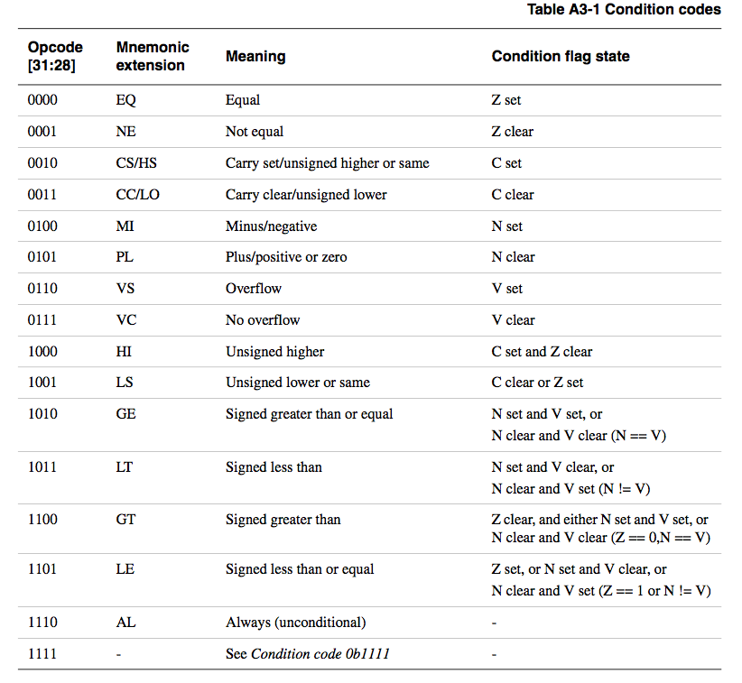
ARM Condition field modifiers

Slide 8
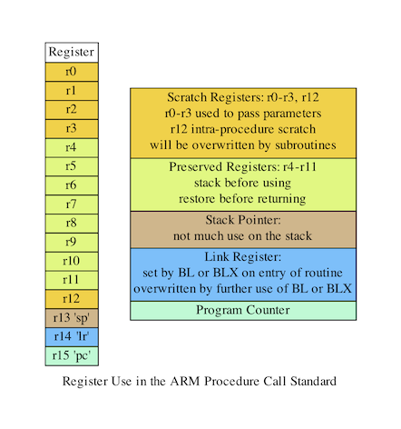
ARM Registers

Slide 9
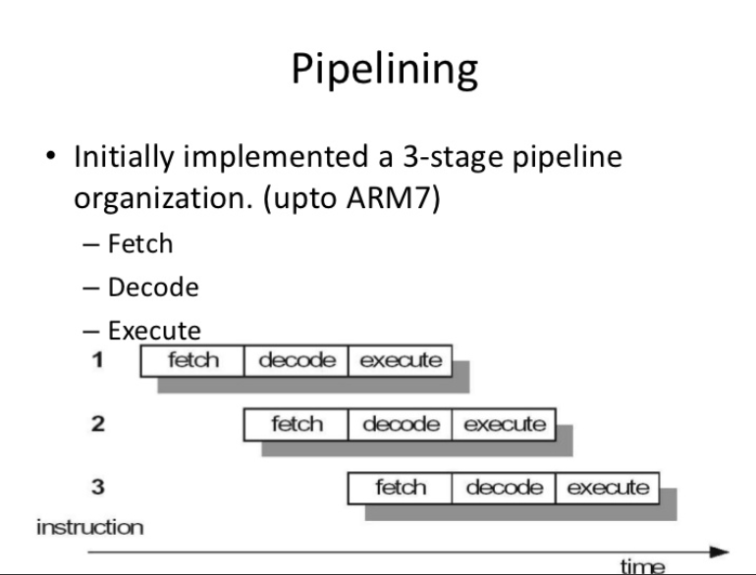

Slide 10
Outline
Output console
Initial Infection
Initial firmware patch with basic debugger
Advanced debugging capabilities implementation

Slide 11
The process we will follow
Evaluate ways to interact with the device (UART, webserver, …)
Evaluate ways to make the device run custom code (buffer overflow, firmware modification, …)
Find a suitable place to inject code, to create reliable behavior(e.g. when calling a certain function)
Reverse engineer how the device interacts with the interfaces, and find functions such as printf that we can reuse
Combine existing functionality with our custom code, to provide (printf) feedback to our code execution
From here on out we can reverse engineer more functions to perform more advanced actions such as;
getc, so we can interact with our running code
read/write memory to evaluate and modify other system behavior

Slide 12
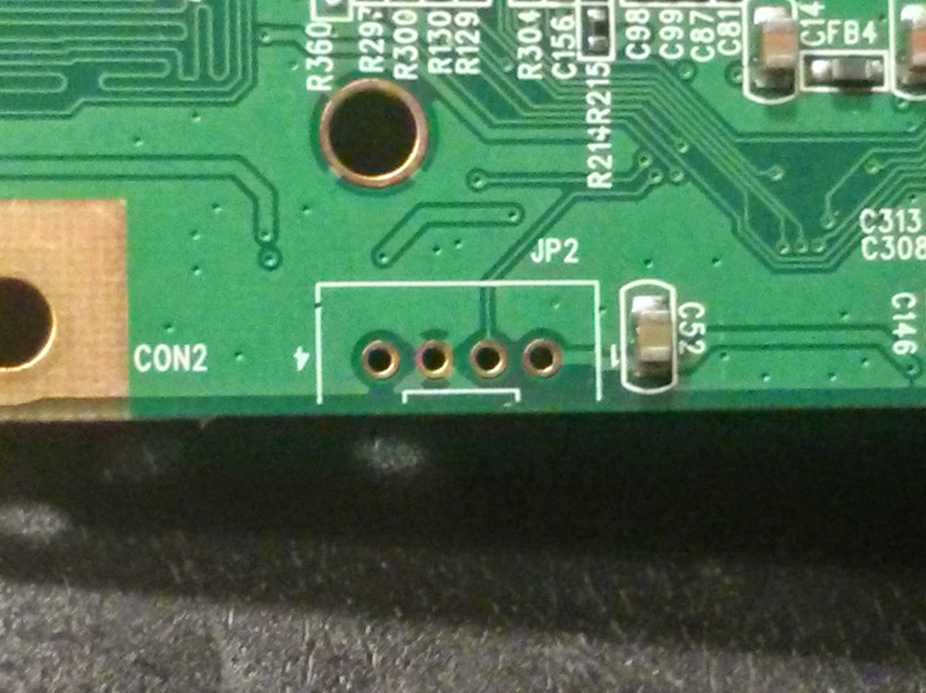
Process: Step 1
Evaluate ways to interact with the device (UART, webserver, …)

Slide 13
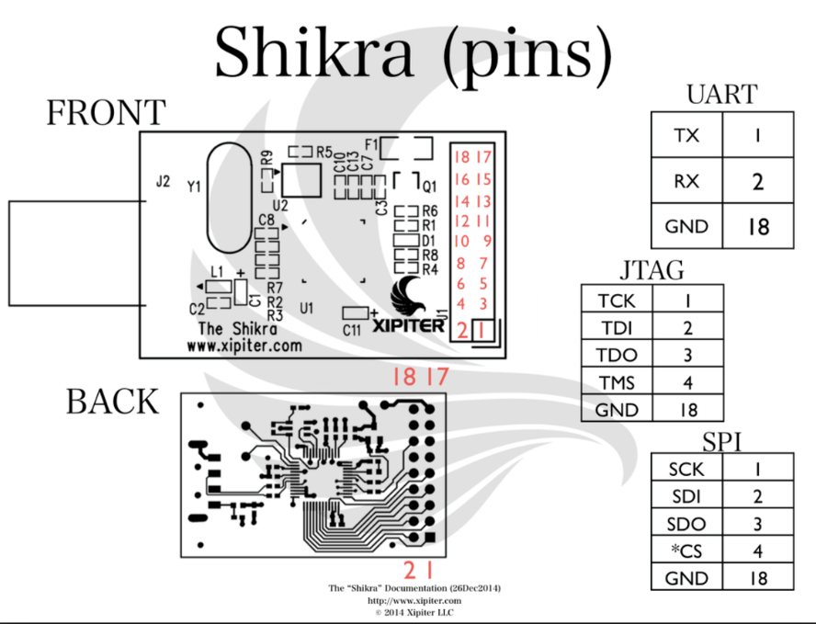
Interacting with the device: Output Console
UART, Serial, JTAG, others

Slide 14
Process: Step 2
Evaluate ways to make the device run custom code

Slide 15
Process: Step 3
Find a suitable place to inject code, to create reliable behavior

Slide 16
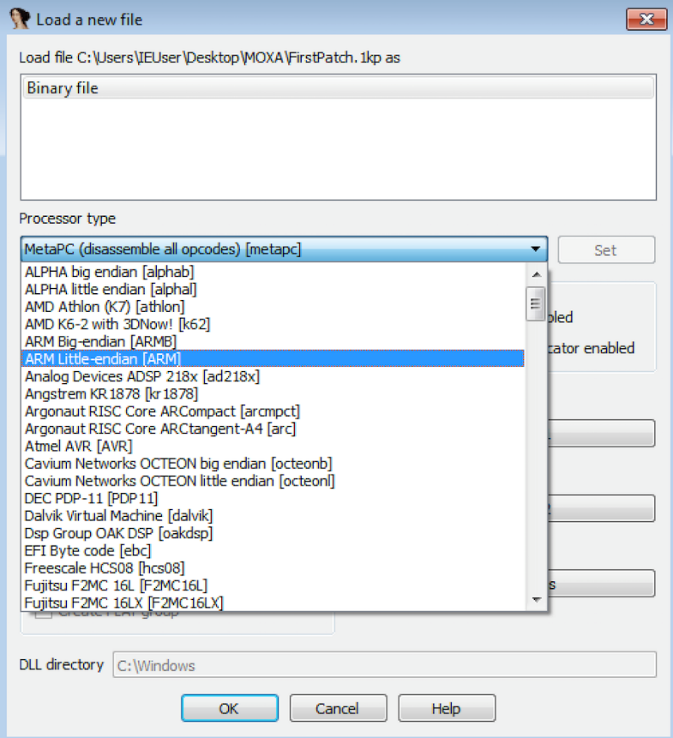
Finding where to put our code: Initial basic debugger
Load the code into IDA
Select ARM Little Endian as the processor type
Select 0x20 as file offset
Click OK

Slide 17
Initial basic debugger
The idea now is to find a function that is printing stuff in the console
We will patch that function to print a string whenever we call that console command
We used sys mem (function for displaying memory in the console)

Slide 18
Initial basic debugger
We will modify this so that when we call sys mem in the console ”Hello !” will appear

Slide 19
Initial basic debugger
Let’s find the function in IDA

Slide 20
Initial basic debugger
This is the assembly for the function “sys mem”
We will patch this to jump to our ”initial patch”

Slide 21
Process: Step 4
Reverse engineer how the device interacts with the interfaces, and find functions such as “printf” that we can reuse

Slide 22
Initial basic debugger
It seems our sys mem function already calls a printf function we can reuse

Slide 23
Process: Step 5
Combine existing functionality with our custom code, to provide (printf) feedback to our code execution

Slide 24
Initial basic debugger
The initial patch will contain three simple elements 1. Load in R0 a string of our choosing 2. Call to printf 3. A return to where we left off (so that the device continues working)
Let’s dive into some more details

Slide 25
Initial basic debugger
We will modify the BL sub_0x644c0 to jump to our code
Our code will be hosted in a place in the binary (our choosing)

Slide 26
Initial basic debugger
BL is relative
That is, it will jump not to definitive addresses but to addresses that are calculated relative to the PC position at the moment of the jump
BL is more like ADD PC, PC, #jump
It also stores the current address in the link register so that the processor knows where to come back

Slide 27
Initial basic debugger
The BL instruction has the ARM opcode 0xEB
The remainder of the three bytes are the address where to make the jump
We need to calculate this

Slide 28
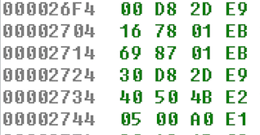
Initial basic debugger
If we are at position X in the binary (0x2714 for us)
And we want to jump at Y
Then the address where to make the jump is like this (Y-X)/4-0x2
This is because we can only jump 4-bytes at a time(1 instruction=4 bytes), and the PC is always 2 instructions ahead due to instruction pipelining
For BL to 0x6440 this would be (0x644C0-0x2714)/4-0x2 = 0x18769

Slide 29
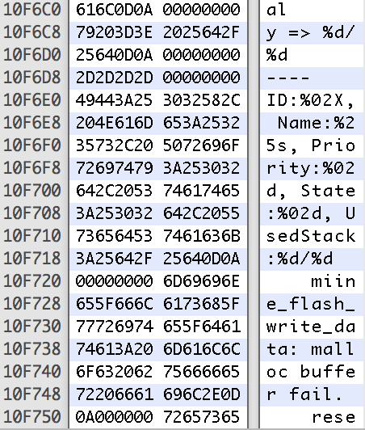
Initial basic debugger
Find space to host the shellcode (for the initial infection)
We will terminate one of the strings early so that we don’t modify the length of the binary
A good place is where the Free/Memory string is

Slide 30
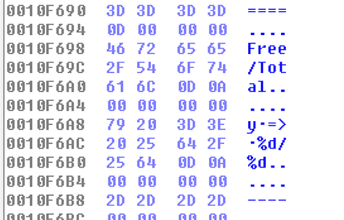
Initial basic debugger
We will modify the string at address 0x10F6A2 (with the initial offset it will be 0x10F6A2 +0x20 )
Add 0D 0A 00 00 00 00 (We will end the string with a null terminator)

Slide 31
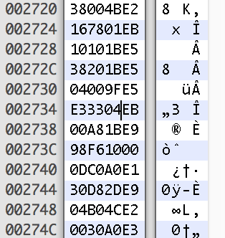
Initial basic debugger
We will store the shellcode starting with 0x10F6A8
So our BL should be like BL *(0x10F6A8)
Based on the calculation it is (0x10F6A8-0x2714)/4 – 0x2 = 0x433E3
So the opcode should be 0xEB0433E3
Let’s patch and watch in IDA

Slide 32
Initial basic debugger
When opening in IDA, the assembly should point to our location if we did the right calculations
It seems it’s working

Slide 33
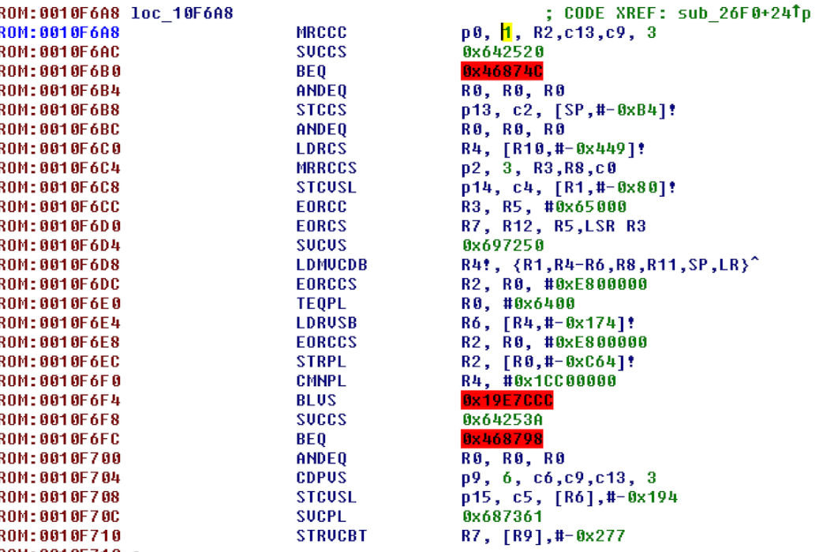
Initial basic debugger
Well the code is not really what we expected
But we didn’t patch it to contain our code
Yet

Slide 34
Initial basic debugger
This location must be patched to do the following:
Patch a string in memory
Load a string in the R0 register
Jump to printf
Return (load link register in PC)

Slide 35
Initial basic debugger
Loading a string can be done using
SUB R0, PC, 0x22
This basically will load in R0 a string located 22 bytes before the program counter.
So we need to calculate (0x10F6A8 + 0x8) - 0x22 = 0x10F68E
The string is Hello !
In the hexeditor, starting at address 0x0010F6AB modify the code to contain 0D 0A 00 48 65 6C 6C 6F 21 0D 00 00 00
We patched the „Hello!“ in the memory without breaking stuff around

Slide 36
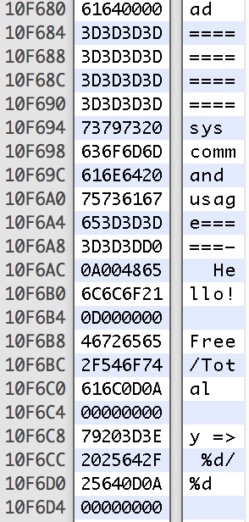
Initial basic debugger
It should look like this in the Hex Editor

Slide 37
Initial basic debugger
Load the String in R0
0x0010F6C8 : 22 00 4F E2 # SUB R0, PC, 0x22
Let‘s load again in IDA

Slide 38
Initial basic debugger
We need to jump to printf
The BL is relative to 0x10F6A8
The opcode is 0x0010F6CC : 83 53 FD EB # BL printf(0x644C0)

Slide 39
Initial basic debugger
Now we need to return
0x0010F6D0 : 0E F0 A0 E1 # MOV PC, LR (RET)
Looks perfect

Slide 40
Process: Moving on to advanced debugging
From here on out we can reverse engineer more functions to perform more advanced actions
What we developed so far can be used for debugging, in case something goes wrong.
We will focus on reverse engineering;
getchar(), so we can interact with our running code
read/write memory functions to evaluate and modify system behavior

Slide 41
Advanced Debugging Capabilities: Goals
We want to create an interactive debugger using the serial input and output
We will implement a loop that in pseudocode would be similar to this: While (1): char = getchar()
if char == 0: exit
if char == 6: print ”tst”
if char == x:
do_y()
We already have the printf() – for writing output
We need the getchar() function – for capturing user input

Slide 42
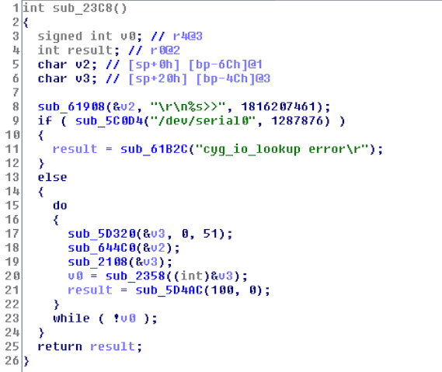
Advanced Debugging Capabilities: finding getchar()

Slide 43
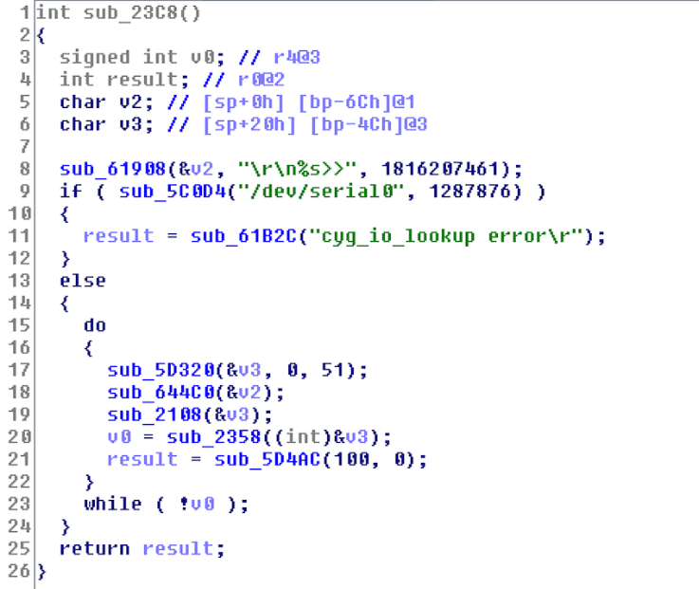
Advanced Debugging Capabilities: finding getchar()

Slide 44
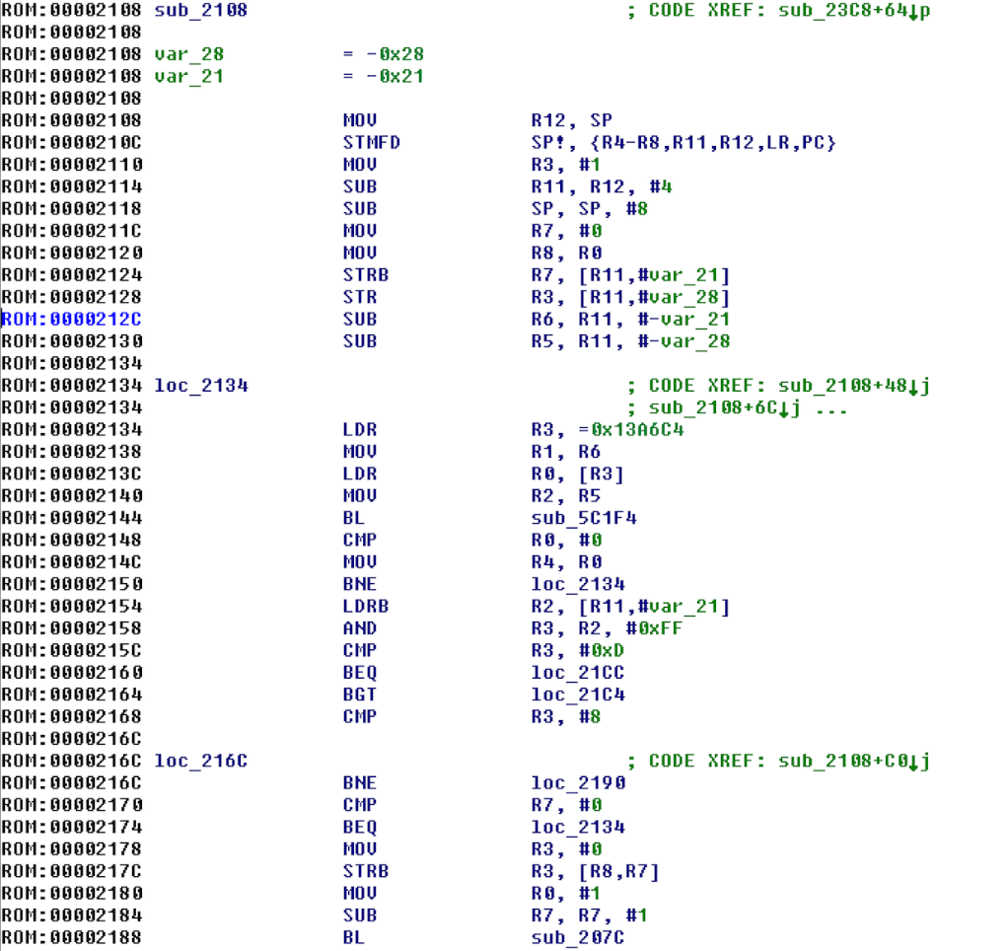
Advanced Debugging Capabilities

Slide 45
Advanced Debugging Capabilities
The address 0x13a6c4 is the buffer where the characters that are read from the serial are saved
The function 0x5c1f4 is cyg_io_read(handle, buf, len )
Len is set to 1, so only 1 char is read
The result is stored in the buffer where R1 points to

Slide 46
Advanced Debugging Capabilities

Slide 47
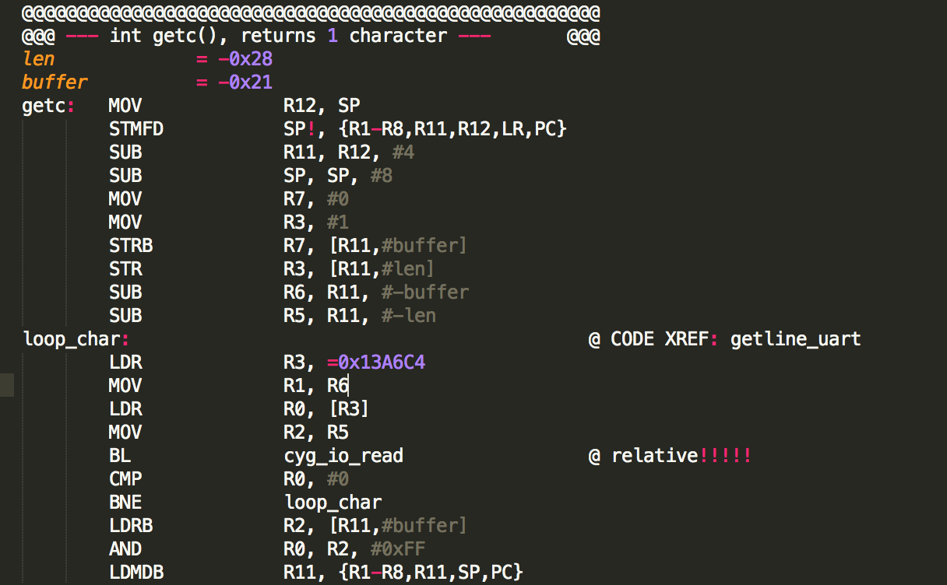
Advanced Debugging Capabilities: our getchar()
Byte getchar(void), returns 1 char in R0

Slide 48
Advanced Debugging Capabilities: the assembler
We need the assembler to know where cyg_io_read is (and also printf)
The ORG directive helps us doing that
The _start directive tells the assembler at what memory address the code is located, so that Branches can be calculated accordingly

Slide 49
Advanced Debugging Capabilities: calling getchar()
Basic loop that will read a character and exit if it’s 0
If the character is 6, then the shellcode will print “tst”

Slide 50
Advanced Debugging Capabilities: printf()
If the character is 6, then the shellcode will print “tst”
we define the string; 'tst/n‘, at the bottom, in the code section

Slide 51
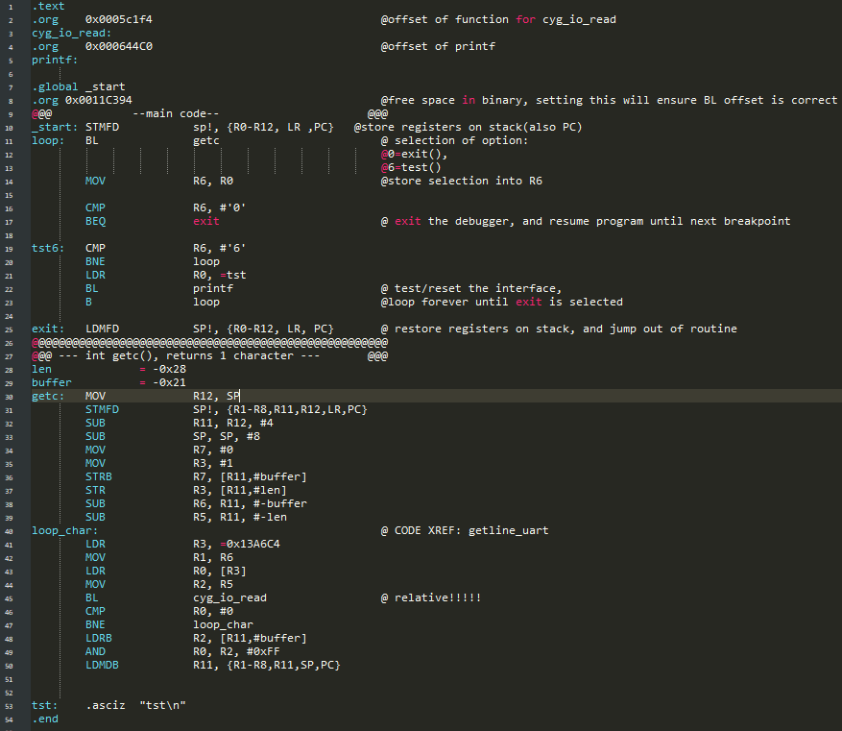
Advanced Debugging Capabilities: first compile
Write the whole assembly code in a text file

Slide 52
Advanced Debugging Capabilities
Assemble everything
Link and convert the object code to binary
Split the file, so that only the shellcode at 0x11C394 is left

Slide 53
Advanced Debugging Capabilities
We have getc
We have printf
We can exit
The initial loop is done (just with exit functionality)
Time to add some debugging capabilities

Slide 54
Advanced Debugging Capabilities
Adding functionality for reading words (so that we can use them to read/write memory addresses)

Slide 55
Advanced Debugging Capabilities
Adding read memory capabilities (read and display memory to the user)

Slide 56
Advanced Debugging Capabilities
Adding write memory capabilities (write into the device memory)

Slide 57
Advanced Debugging Capabilities
Breakpoints: stop normal execution for analysis of current processor state, and code stepping
Creating our breakpoint mechanism:
stopping code execution
calling our debugger from the running code
We just patch a branch-instruction from where we want to call our debugger, and restore the original instruction on exit

Slide 58
Advanced Debugging Capabilities: calling our debugger
Storing registers on the stack on initial call
Restoring the registers on exit

Slide 59
Advanced Debugging Capabilities
Adding read register capabilities

Slide 60
Advanced Debugging Capabilities
Adding write register capabilities

Slide 61
Advanced Debugging Capabilities
Adding breakpoint capabilities: restoring the original code

Slide 62
Advanced Debugging Capabilities
Literal pools and string definitions

Slide 63
Advanced Debugging Capabilities
Adding breakpoint capabilities: writing a new breakpoint

Slide 64
Advanced Debugging Capabilities
Adding breakpoint capabilities: writing a new breakpoint, and storing the old instruction for restoration on the next call

Slide 65
Advanced Debugging Capabilities
We now have a basic debugger that can read/write memory, read/write registers and set breakpoints.
We have written everything in Assembler language, now we need to assemble it again

Slide 66
Advanced Debugging Capabilities
Uploading the debugger on the device requires some more manual tasks to prepare the binary with a hex editor
The sys mem function jump that we used at the beginning must be patched to jump to our shellcode, by hex editor
The shellcode must be added to the firmware file at a suitable place such as the address 0x11c394 by hex editor
Check the code in IDA before uploading. Make sure the code works as expected (it should look almost identical with the code in code.s)

Slide 67
Advanced Debugging Capabilities
Upload the firmware on the device
Run sys mem in the console
Press 6 to check if it works. The console should display “tst”
Test other capabilities
Next steps…

Slide 68
Conclusions & implications
Use proper firmware verification
Use hardware based integrity verification checks
Don’t connect ICS to the internet ☺

Slide 69
Questions?

