Slide 1
Semantics-aware Intrusion Detection for Industrial Control Systems
Ömer Yüksel
Jerry den Hartog
Sandro Etalle
Notes:
TU/e Security group

Slide 2
About Me
Ömer Yüksel
PhD candidate in Eindhoven University of Technology, Security group (2014- )
Research interests: intrusion detection, data analytics

Slide 3
SpySpot Project
Scientific Partners
Industrial Partners
http://security1.win.tue.nl/spyspot/
Notes:
Dutch national, Vis&Sec

Slide 4
Targeted attacks
Exfiltration
Initial compromise
Propagation
Privilege
escalation
Attacker
Sabotage

Slide 5
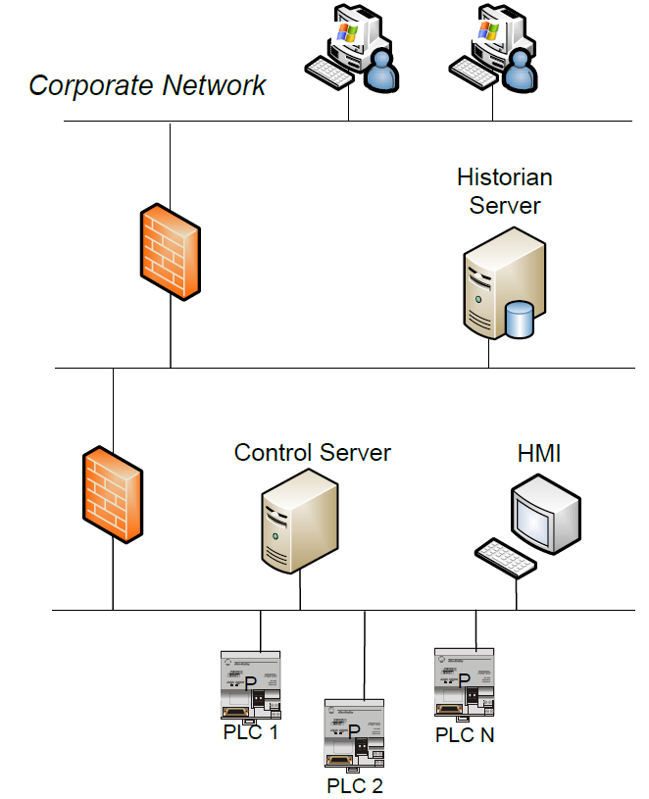
Industrial Control Systems (ICS)
Notes:
ICS used in energy distribution, power plants, manufactoring etc.
Building blocks, explain layers, HMI, PLC, Historian

Slide 6
Industrial Control Systems (ICS)

Slide 7
Threat Model
Assets to protect:
Network hosts: PLC, HMI, Control Server, …
Field devices: Heater, sensors, pipeline, …

Slide 8
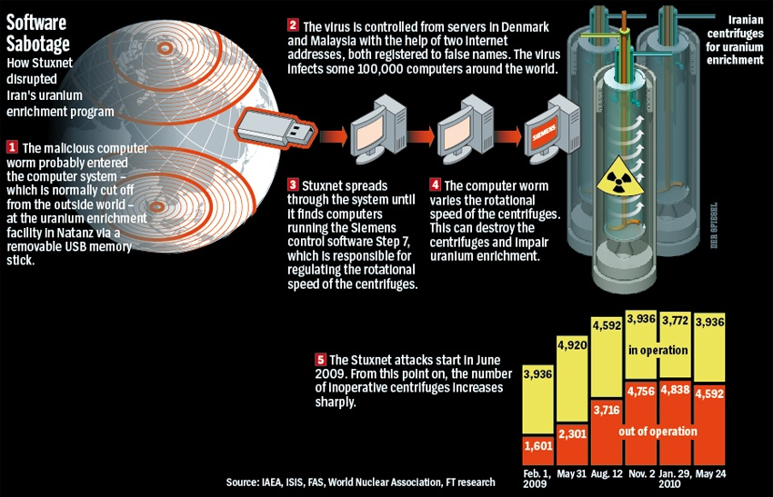
Threat Model
System-related attacks
e.g. Buffer overflow
Process-related attacks
e.g. “Change the rotation speed”
Reconnaissance
e.g. Map out all valid register addresses
Notes:
Stuxnet -> threat categories

Slide 9
Protection of ICS Networks
Attack patterns are unpredictable.
Cannot rely on signature-based systems
Availability must not be impaired.
Cannot use preventative systems (e.g. access control)
Attacks can be carried out by sending a single malicious message.
Cannot rely on flow-based detection
Networks traffic contains large and diverse communication patterns.
Manual whitelisting is infeasible
Notes:
1-Need anomaly detection 2-Need IDS 3-Need to look at the content (payload) 4-Need it to be automated

Slide 10
Protection of ICS Networks
Attack patterns are unpredictable.
Cannot rely on signature-based systems → Anomaly detection
Availability must not be impaired.
Cannot use preventative systems (e.g. access control) → IDS
Attacks can be carried out by sending a single malicious message.
Cannot rely on flow-based detection → Payload-based
Networks traffic contains large and diverse communication patterns.
Manual whitelisting is infeasible → Data-driven
Notes:
1-Need anomaly detection 2-Need IDS 3-Need to look at the content (payload) 4-Need it to be automated

Slide 11
Anomaly-based Approaches
Payload information
IP Header
TCP Header
Payload
Src :10.10.10.11 Src:502 0a030203e8...
Dst: 10.10.10.20 Dst: 50269
Src :10.10.10.11 Src:502 0a030203e8...
Dst: 10.10.10.20 Dst: 50269
Network&transport header
Byte string
Protocol syntax
Protocol semantics
Previous work
Unit id
Function
Par. Length
Return value
Src :10.10.10.11 Src:502 0x0a 0x03 0x02 0x03e8
Dst: 10.10.10.20 Dst: 50269
Return value
(numeric)
Src :10.10.10.11 Src:502 0x0a 0x03 0x02 1000 Dst: 10.10.10.20 Dst: 50269
Unit id
(nominal)
Function
(nominal)
Par. Length
(numeric)
Return value
(numeric)
Our approach
Src :10.10.10.11 Src:502 10 read (3) 2 1000
Dst: 10.10.10.20 Dst: 50269
Notes:
Issues: single message attacks, false alerts, black box, limited setting, extensive domain knowledge

Slide 12
Current Issues
Payload information
Unable to detect certain single-message attacks,
Too many false alerts to work in practice,
Model or alerts are not user-understandable,
Limited to a specific protocol or setting,
Requires extensive domain knowledge.
Network&transport header
Byte string
Protocol syntax
Protocol semantics

Slide 13
Semantics-aware Intrusion Detection
We propose a payload-based network intrusion detection framework that is:
Semantics-aware
Considers the protocol fields and value types in the payload.
Anomaly-based
Uses network traffic data to build a model of the “normal traffic”.
General purpose
Can be instantiated on any protocol where a parser is available (we test on S7 and Modbus)
White-box [1]
User-understandable model based on simple probabilities.
Can be updated or corrected by an operator.
Displays meaningful alerts.
Unit id
(nominal)
Function
(nominal)
Par. Length
(numeric)
Return value
(numeric)
Src :10.10.10.11 Src:502 10 read (3) 2 1000
Dst: 10.10.10.20 Dst: 50269
[1] Costante, E., Hartog, J. den, Petković, M., Etalle, S., & Pechenizkiy, M. (2014). Hunting the Unknown.

Slide 14
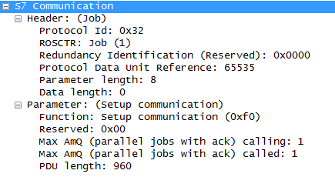
General Framework
Message: The PDU of an ICS-specific protocol.
The messages are interpreted by external component, e.g. Wireshark protocol dissector.
We focus on single-message attacks in this work.

Slide 15
Feature Extraction
We use protocol fields to extract features from the traffic.
Feature categories:
Elementary:
Numeric: e.g. parameter length
Nominal: e.g. function, protocol identifier
Compound: e.g. <function, parameter length>

Slide 16
Feature Selection
Feature selection is performed by the expert setting up the model.
Non-helpful features are discarded, such as those that are:
seemingly random (e.g. nonces)
sequential (e.g. counters)
have an erratic behavior (displaying a high variance/entropy etc.)
✗

Slide 17
Detection Model
Our model of normal traffic consists of probability distributions per feature.
We build the model using samples from normal traffic.
Rare values are considered anomalous.
Function
Register address

Slide 18
Profiling
PLC-1
HMI-1
Normal traffic contains a mixture of different behavior patterns.
Profiling allows detecting contextual anomalies.

Slide 19
Binning
Numeric features tend to yield a large number of unique values.
Therefore we consider the distribution of ranges instead.
data length

Slide 20
Alerts
IP Header
TCP Header
Unit id
(nominal)
Function
(nominal)
Src :10.10.10.11 Src:502 10 diagnostics(8)
Dst: 10.10.10.20 Dst: 50269
If a feature yields a rare value (or bin), an alert is raised.
We use a threshold to determine the model’s strictness.
i.e. raise an alert if a value has a less than 10% probability of occurrence.
The framework displays the features causing the alert.

Slide 21
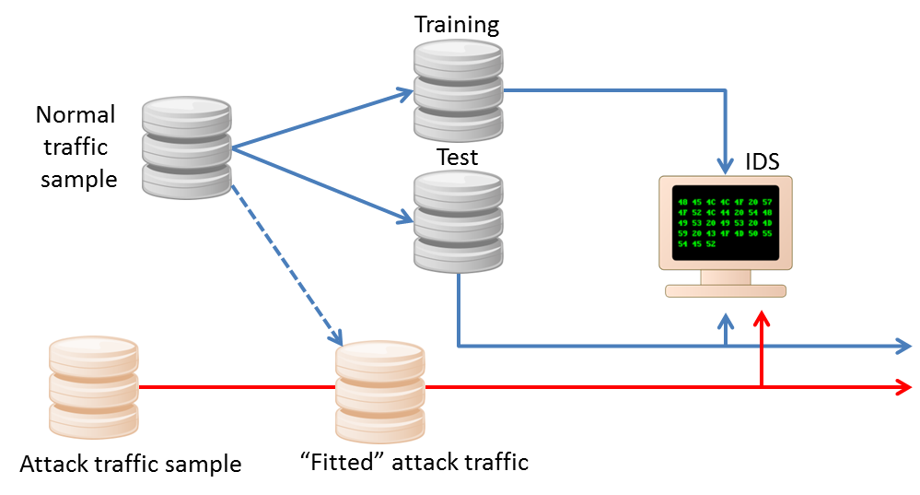
Evaluation
False Positive Rate
Detection Rate

Slide 22
Evaluation
Datasets:
Modbus-RTU: Serial communication
Lab setting (Mississippi State University)
Preprocessed by the providers, raw traffic not available
S7 Communication: Siemens devices
Operational ICS
Raw network traffic, parsed with Wireshark
Attacks:
Modbus-RTU: Reconnaissance and process-related
S7: Reconnaissance and system-related attacks
Publicly available at (http://descrics.com/)

Slide 23
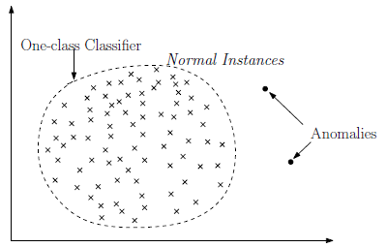
Compared Approaches
McPad [1]
N-gram analysis
Attributed token kernel [2]
N-gram analysis
Utilizes protocol syntax
Both methods utilize one-class support vector machines (SVM) to model normal traffic.
[1] Perdisci, R., Ariu, D., Fogla, P., Giacinto, G., & Lee, W. (n.d.). McPAD : A Multiple Classifier System for Accurate Payload-based Anomaly Detection, (October 2008).
[2] Düssel, P., Gehl, C., Laskov, P., & Rieck, K. (2008). Incorporation of application layer protocol syntax into anomaly detection. Information Systems Security, 188–202.
Notes:
Text-based protocols

Slide 24
Results (I)
Experiments with elementary features only:
S7
Modbus-RTU
Approach | Detection Rate | False Positive Rate
McPad | 100% | 20.2%
Attributed token kernel | 99.9% | 33%
White-box framework | 100% | 0.04%
Approach | Detection Rate | False Positive Rate
Attributed token kernel | 91% | 27%
White-box framework | 97.3% | 0.08%

Slide 25
Results (II)
For Modbus-RTU dataset, we create compound features using semantically related elementary features, e.g. <SetPoint, DeltaSetPoint>
Approach | Detection Rate | False Positive Rate
White-box framework (elementary features only) | 97.3% | 0.08%
 | 100% | 16.7%
White-box framework (w/ compound features) | 100% | 0.57%

Slide 26
Alert causes
Features causing majority of the alerts in the detected attacks:
Modbus-RTU
Time Interval
Pipeline pressure
Set point
S7
Data length
ROSCTR (Remote operating service control)
Parameter count
Function

Slide 27
Performance
Time complexity:
Training: Linear to the dataset size
Detection: constant time
Can be scaled to larger networks by utilizing profiling.
Parsing is the main bottleneck in the current implementation.
Processing a single message: 0.97msec
Parser overhead: 0.7msec

Slide 28
Conclusions
N-gram analysis is not practical on binary protocols.
Utilizing the right features is more important than creating a complex model of normal behavior.
Using a simple model allows a human operator to correct and update the model, and results in alerts containing actionable information.

Slide 29
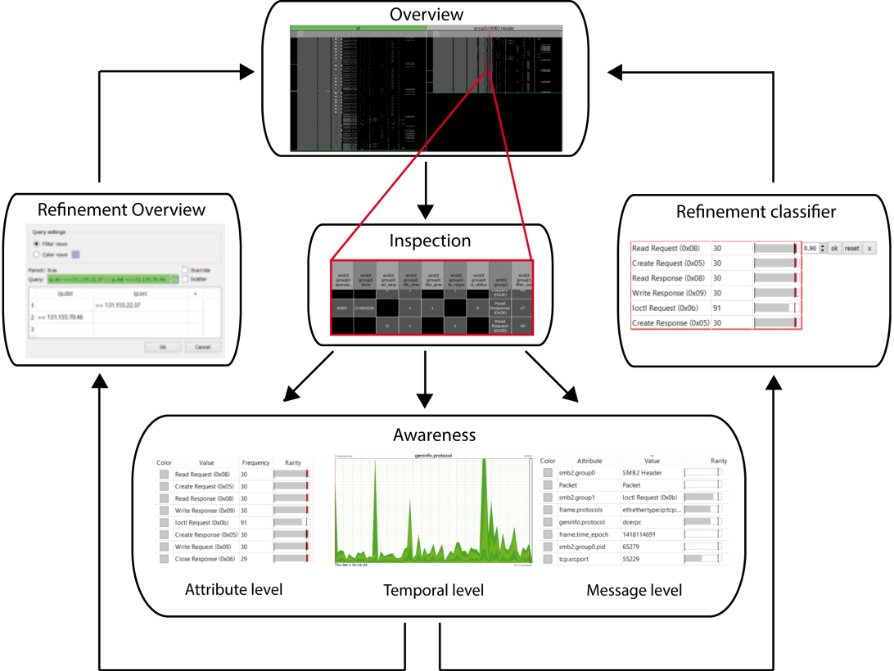
Visualization
Integration with a visual interface for displaying alerts and traffic in detail and updating the model.
Bram Cappers <b.c.m.cappers@tue.nl>
https://www.youtube.com/watch?v=aYywTOYjYDA

Slide 30
Future Work
Feature selection
Metrics of “feature quality“
Designer interface
Feature construction
Application to other domains
Back office traffic
Detection of sequential attacks
Looking at sessions or groups of messages

Slide 31
Thank you
o.yuksel@tue.nl
Project: http://security1.win.tue.nl/spyspot/
Notes:
Datasets?

Slide 32
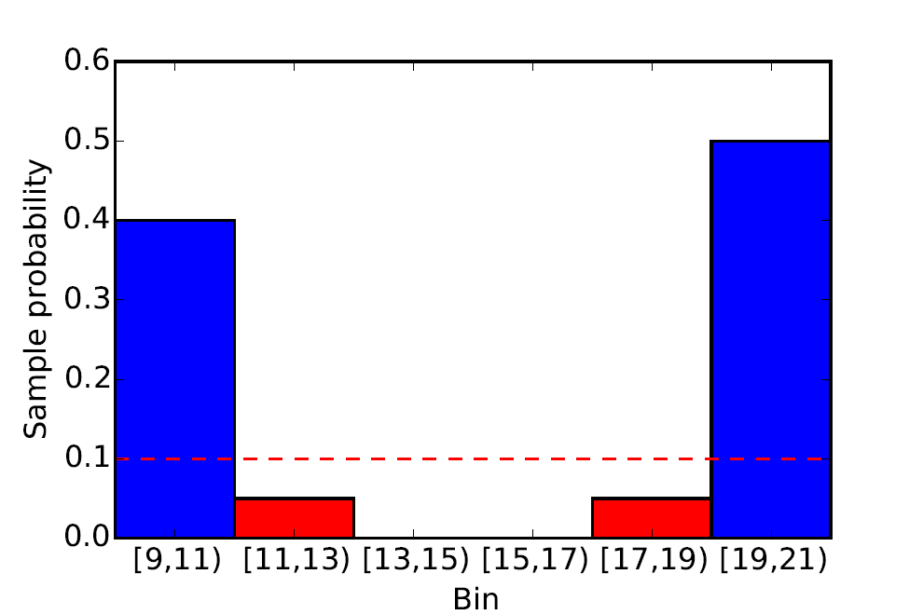
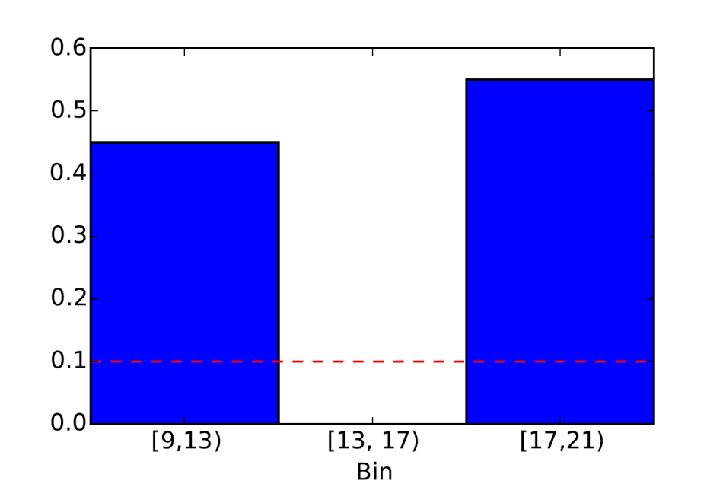
Tuning
Human operator can update the model by modifying bins or thresholds.

